Slide 1
Introduction to Between-Subjects Experiments
Separate groups of participants in each condition
Comparison of the scores between treatments
Control of all other variables
Example:
No Treatment Gp vs Treatment Gp
Treatment 1 Gp vs Treatment 2 Gp
Placebo Gp vs Treatment Gp

Slide 2
Review of the Two Basic Research Designs
Within-subjects design
Different sets of scores are obtained from the same group of participants.
Between-subjects design
Each set of scores is obtained from different groups of participants.

Slide 3
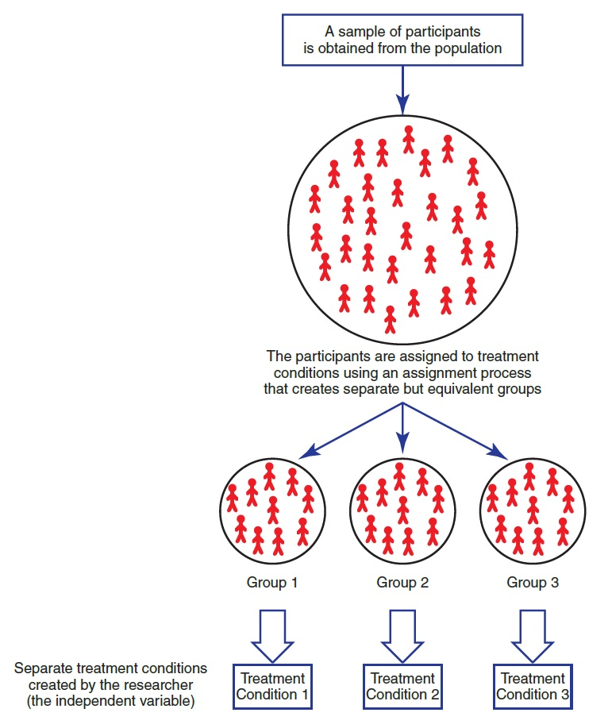
The Structure of a Between-Subjects Experiment
Notes:
Figure 8.1 The Structure of a Between-Subjects Experiment
The key element is that separate groups of participants are used for the different treatment conditions.

Slide 4
Advantages of Between-Subjects Designs
Each individual score is independent from all other scores.
No Carry-over or time-related confounds:
practice or experience gained in other treatments
fatigue or boredom from participating in a series of different treatments
contrast effects that result from comparing one treatment to another

Slide 5
Disadvantages of Between-Subjects Designs
Requires large number of subjects
Example: three different treatment conditions with 30 scores in each treatment ► 90 participants are required
Groups can be different based on Selection effects
Environmental differences between conditions still possible
Large within group Variance reduces sensitivity of difference testing

Slide 6
Differences between Treatments and Variance within Treatments
Goal: Large differences between treatments; provide evidence of differential treatment effects.
Large differences within treatments reduce sensitivity of statistical testing
Large variance can hide patterns in the data.

Slide 7
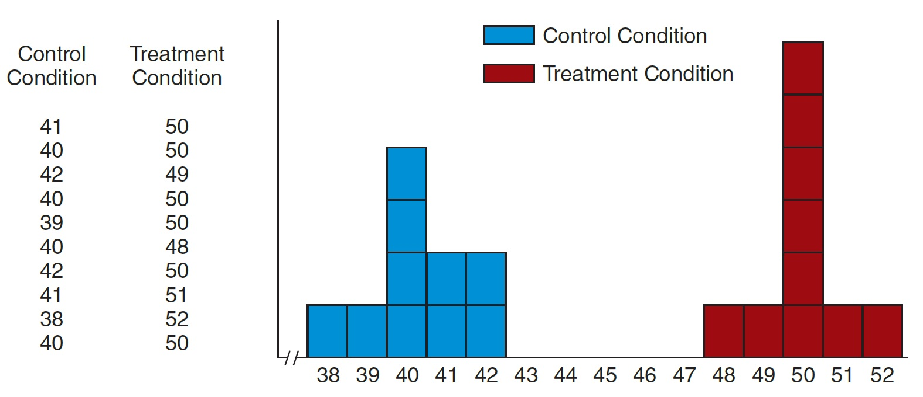
Experiment in Which Individual Differences Are Relatively Small
Notes:
Figure 8.3 Results from a Simulated Experiment Comparing Two Conditions Using Participants Selected from a Population in Which Individual Differences Are Relatively Small
When the individual differences are small, the variance is also small, and it is easy to see the 10-point treatment effect.

Slide 8
Experiment in Which Individual Differences Are Relatively Large
Notes:
Figure 8.4 Results from a Simulated Experiment Comparing Two Conditions Using Participants Selected from a Population in Which Individual Differences Are Relatively Large
When the individual differences are large, the variance is also large, and it is not at all easy to see the 10-point treatment effect.

Slide 9
Minimizing Variance within Treatments
Standardize procedures and treatment settings
Limit individual differences
Random assignment and matching
Sample size

Slide 10
Confounding Variables
Two major sources of confounding in between-subjects designs:
Confounding from individual differences
Example: participants in one group may be older, smarter, taller, or have higher socioeconomic status than the participants in another group.
Confounding from environmental variables
Example: testing one group in a large room and another group in a smaller group.

Slide 11
Selection Effects
The groups in a between-subjects experiment must be as similar
The only difference between groups should be the effect of the IV
If the groups are different, then individual differences can become confounding variables.
It then becomes impossible to draw conclusions about a treatment.

Slide 12
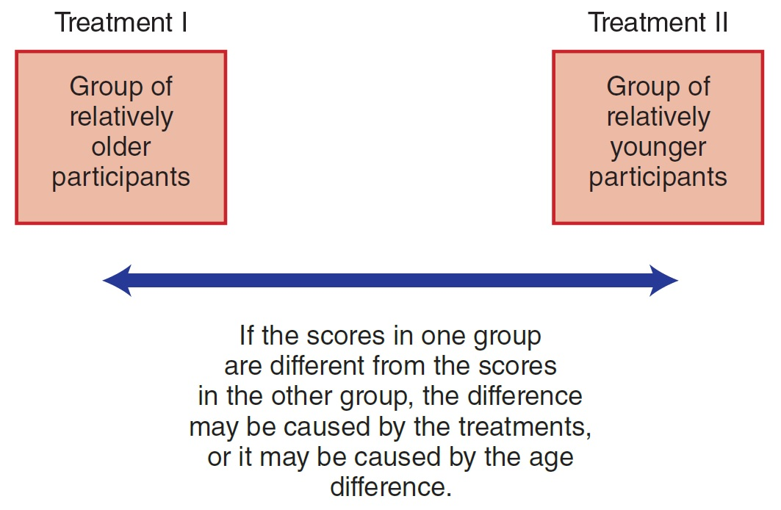
Age as a Confounding Variable
Notes:
Figure 8.2 An Experiment in Which Individual Difference (Participant Age) Is a Confounding Variable

Slide 13
Minimize Selection Confound: Equivalent Groups
The researcher has control over creating groups that are equivalent.
The separate groups must be:
created equally
treated equally
composed of equivalent individuals

Slide 14
Limiting Selection Confound
What are three primary techniques?
Random assignment (randomization)
Assign participants to groups by a random process
Matching groups (matched assignment)
Match individuals in the group on a specific variable
Holding variables constant
Example: a researcher suspecting gender to be a confounding variable would eliminate gender as a variable.

Slide 15
Other Threats to Internal Validity of Between-Subjects Designs
Differential attrition (participant dropout rate) from one group to another
Large differences between groups create selection effects

Slide 16
Additional Confounds
Communication between groups (no isolation)
Diffusion: treatment spreads to the control group
Compensatory equalization: subject demands treatment received by the other group
Compensatory rivalry: control group changes their normal behavior (works extra hard)
Resentful demoralization: participants in control group become less productive and less motivated

Slide 17
Applications and Statistical Analyses of Between-Subjects Designs
Two-group means test
Simplest version of between-subjects experimental design; interval scale scores
Between-subjects ANOVA
Independent-measures t test

Slide 18
Comparing Proportions for Two or More Groups
When the DV in a research study is measured on a nominal or ordinal scale
Researcher does not have a numerical score.
Each participant is classified into a category.
Data consist of a simple frequency count of the participants in each category on the scale of measurement.
Data can be analyzed with a chi-square test for independence ►compares proportions between groups.

Slide 19
Group Exercise
Instructions: Form a research study based on the following information; form each of the following design types: correlational, within-subjects, between-subjections designs
Scenario: Researcher wants to explore the connection between sugar consumption and aggressive behavior in 5-year-old children.

