Slide 1
An Introduction to Correlational Research
What is the goal of the correlational research strategy?
To establish that a relationship exists between variables and to describe the nature of the relationship
Associative Relationship
No independent variables
Dependent Variables only
Predictive Relationship; “Link”, “Associated with”, “Increases/Decreases Risk for..”

Slide 2
Comparing Research Strategies
Correlational, experimental, and descriptive research
Correlational research
Intended to demonstrate the existence of a relationship between two variables
Does not determine cause-and-effect relationship
Experimental research
Demonstrates a cause-and-effect relationship between two variables

Slide 3
Comparing Research Strategies
Descriptive Research
Exploratory
Describes characteristics and factors associated with a certain population
Does not determine any relationship
Can suggest hypothetical relationships for further study

Slide 4
Statistical Analysis for Correlational Studies
Evaluating relationships for numerical scores
Scores in each pair are identified as X and Y.
Data can be presented in a list showing the two scores for each individual.
Scores can be shown in a scatter plot graph.
Each individual’s score is shown as a single dot with a horizontal coordinate (X) and a vertical coordinate (Y).
(e.g., Each Subject has a score For GPA and Score for Sleep Quality)

Slide 5
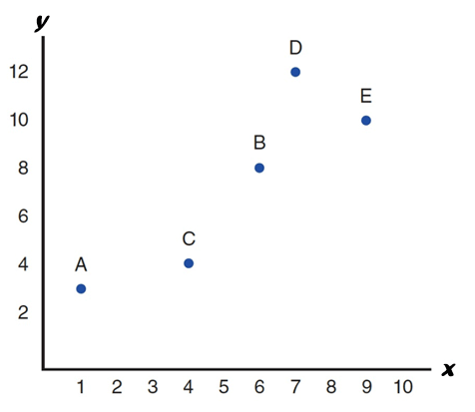
Scatter Plot Data from a Correlational Study
Person | X | Y
A | 1 | 3
B | 6 | 8
C | 4 | 4
D | 7 | 12
E | 9 | 10
Notes:
Figure 12.1 Data from a Correlational Study
Two Scores, X and Y, for each of five people are shown in a table and in a scatter plot.

Slide 6
Calculating a Correlation Coefficient
A correlation coefficient measures and describes the relationship between two variables.
It describes two characteristics of a relationship:
Direction
Consistency or strength

Slide 7
The Direction of the Relationship
Positive relationship: two variables change in the same direction.
As one variable increases ► the other variable increases.
Negative relationship: two variables change in opposite directions.
Increases in one variable ► matches with decreases in the other variable

Slide 8
Limited to Linear Relationships
Linear relationship: the data points in the scatter plot tend to cluster around a straight line.
Positive linear relationship: each time the X variable increases by one point, the Y variable increases in a consistently predictable amount.
A Pearson correlation describes and measures linear relationships when both variables are numerical scores from interval or ratio scales.

Slide 9
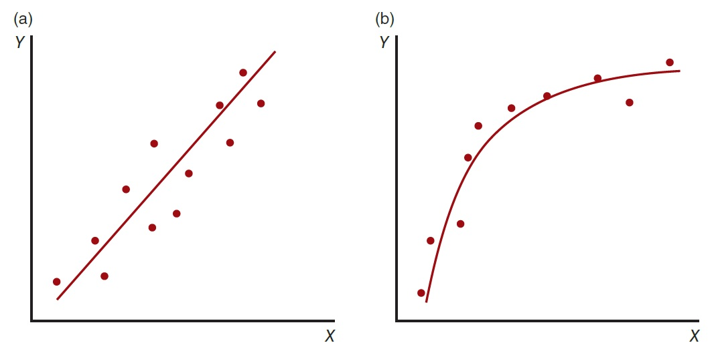
Linear and Monotonic Relationships
Notes:
Figure 12.2 Linear and Monotonic Relationships
(a) An example of a linear relationship. The data points cluster around a straight line.
(b) An example of a monotonic relationship. The data points show a one-directional trend; as the X values increase from left to right, the Y values also tend to increase from bottom to top.

Slide 10
The Consistency or Strength of the Relationship
Correlation (correlation coefficient): measures and describes the relationship between two variables.
The sign (1/–) indicates the direction of the relationship.
The numerical value (0.0–1.0) indicates the strength or consistency of the relationship.

Slide 11
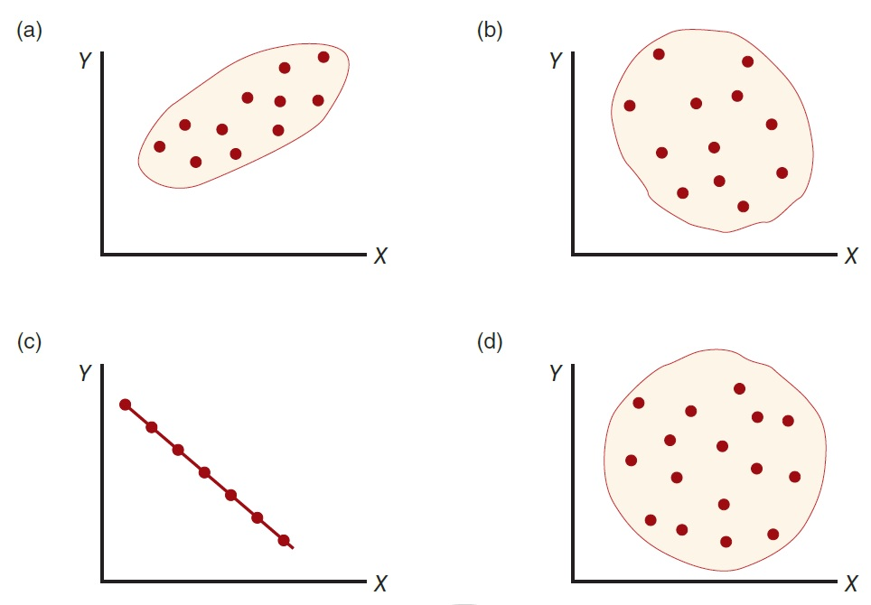
Examples of Different Degrees of Linear Relationship
Notes:
Figure 12.3 Examples of Different Degrees of Linear Relationship
shows a strong positive correlation, approximately 10.90;
shows a relatively weak negative correlation, approximately –0.40;
shows a perfect negative correlation, –1.00;
shows no linear trend, a correlation of 0.
In all graphs, the X values increase from left to right, and the Y values increase from bottom to top.

Slide 12
Evaluating Relationships for Nominal Data
One numerical score and the other score non-numerical
Use the non-numerical variable to organize the scores into separate groups
Non-numerical value with two categories—numerically code the categories as 0 and 1
Calculate the Pearson correlation ► point-biserial correlation

Slide 13
Evaluating Relationships for Nominal Data
If both variables are non-numerical
Evaluate by organizing the data in a matrix
Categories of one variable form the rows; categories of the second variable form the columns.
Apply the chi-square test
 | SAT Above Ave | SAT Below Ave
Math Tutoring | 17 | 3
Test taking Training | 12 | 8
Notes:
Figure 12.4 Hypothetical Data Showing Results from a Study Examining the Relationship Between Tutoring type and Success on a Math Section of SAT
The values are the number of individuals in each category; for example, 12 of the males successfully completed the task and 8 failed.

Slide 14
Interpreting the Strength of a Correlation
Degree of Relationship | Value of the Correlation Coefficient, or Coefficient of Determination
Small | r = 0.10 or r² = 0.01 (1%)
Medium | r = 0.50 or r² = 0.25 (25%)
Large | r = 0.80 or r² = 0.64 (64%)
Coefficient of determination: the squared value of a correlation
Measures the percentage of variability in one variable that is determined, or predicted, by its relationship with the other variable

Slide 15
The Significance of a Relationship
Statistical significance of a correlation
The correlation is unlikely to have been produced by random variation.
Sample Size matters:
With a small sample, it is possible to obtain what appears to be a very strong correlation when in fact there is no relationship between the two variables.
Increasing the sample size makes it more likely that a correlation represents a real relationship.

Slide 16
Applications of the Correlational Strategy
Prediction
A correlational study demonstrating a relationship between two variables
Allows researchers to use knowledge about one variable to help predict or explain the second variable
The two variables
Predictor variable: the first variable
Criterion variable: the second variable (being explained or predicted)

Slide 17
Prediction
Regression
The statistical process for using one variable to predict the other
Goal: to find the equation that produces the most accurate predictions of Y (the criterion variable) for each value of X (the predictor variable)
The predictor variable is relatively simple and well defined.
The criterion variable is relatively complex and unknown.
Example: Coping Style predicting Depression Risk

Slide 18
Strengths and Weaknesses of the Correlational Research Strategy
Strengths
Describes relationships between variables
Nonintrusive—natural behaviors
High external validity

Slide 19
Weaknesses of the Correlational Research Strategy
Weaknesses
Cannot assess causality
Third-variable problem
Directionality problem
Low internal validity

Slide 20
Weaknesses of the Correlational Research Strategy
The third-variable problem
Because two variables are related, does not mean that there must be a direct relationship between the two variables.
A third (unidentified) variable may be responsible for producing the observed relation.
The directionality problem
A correlational study does not establish a relationship of cause-and-effect.

Slide 21
The Third-Variable Problem
Ice Cream Sales positively predicts Increase in Crime
Closer Look: Mediating Factor linking A & B
Variable X
Temperature
Variable A
Ice cream consumption
Variable B
Crime rate
Notes:
Figure 12.5 The Third-Variable Problem
Although ice cream sales (Variable A) and crime rate (Variable B) appear to vary together, there is no direct connection between these two variables. Instead, both are influenced by a third variable. In this example, the temperature (Variable X) influences ice cream sales. In addition, temperature influences the crime rate.

Slide 22
The Directionality Problem: Which is the cause?
Notes:
Figure 12.6 The Directionality Problem
Although a correlational study can demonstrate a relationship between the sexual content of television programs that adolescents watch and their sexual behaviors, the study cannot determine if the television content is influencing behavior or whether the behavior is influencing the choice of television programs.

Slide 23
Relationships with More Than Two Variables
Multiple regression: a statistical procedure for studying multivariate relationships
Can be used to examine the relationship between two specific variables
Controlling the influence of other, potentially confounding variables
Predictor variables only predict
Relationships can be described—not explained
Example: Depression among 1st generation immigrants may be better explained by multiple variables together, but not one alone (exp; language barriers, discrimination, norm changes, isolation, employment status, lack of health services)

