Slide 1
Introduction to Research Methods
Saadia McLeod, Ph.D.
Psychology 2204

Slide 2
Defining Knowledge
How do we know what we know?
Defining Truths and Facts?
  Accuracy, Reliability
Nonscientific Approaches:
  Tenacity
  Intuition
  Authority
  Logic/Reason
  Empirical only

Slide 3
Method of Tenacity
What is tenacity?
  Information accepted as true because it has always been believed or because superstition supports it.
  Limitations: potential inaccuracies; no method for correcting erroneous ideas.
  Question: What are some things we do because it is common practice or follows superstition?

Slide 4
Method of Intuition
What is intuition?
  Information accepted on the basis of a hunch.
  Limitation: no way to know why right or wrong; risky
  Questions: When do we make “gut” decisions?

Slide 5
Method of Authority
Relies on information or answers from an expert in the field.
Good starting point—often quickest and easiest way to obtain answers.
Some limitations:
  Does not always provide accurate information.
  Often accepts expert’s statements as fact (method of faith).
  Not all “experts” are experts.
  Question: What are some potential problems with solely relying on expertise? What are the consequences?

Slide 6
Method of Logic
Logical Reasoning: based only on agreed upon premises or ideas. Not tested:
  All 3-year-old children are afraid of the dark.
  Amy is a 3-year-old girl.
  Therefore, Amy is afraid of the dark.
In the above argument:
  First two sentences are premise statements;
  Final sentence is a logical conclusion based on the premises.
  Question: Do you see any potential problems with this method?
Notes:
Relies on people’s ability to have accurate logic
Premise statement are not tested to be true

Slide 7
Observation Method
Also known as empiricism: answering questions by direct observation or personal experience.
  Based on the philosophy that all knowledge is acquired through the senses.
Limitations
  Observations can be misinterpreted (Figure 1.1).
  Sensory experience can be swayed by beliefs.
  Time-consuming and sometimes dangerous.
Early Psychology: Built on “Arm-Chair Science”; Phenomenology emphasized the subjective experience as the only relevant one.

Slide 8

Fallibility of the Senses: Illusions
Notes:
Question to Class: which line appears longer than the other?

Slide 9
Practicing Psychology
Group Exercise:
  A new mom enters therapy a few months after giving birth to her first child. She states that she is experiencing episodes of extreme fatigue, bouts of crying, and transient suicidal ideation. She discloses that she is a single mom and is unsure of the identity of the child’s biological father. She is having a difficult time managing the demands of a full time job and costs of child care. She states that she is seeking help primarily because of concerns over her baby who seems to be quite colicky and is not taking well to breast feeding. She would like advice on helping her baby and ways to help herself feel better.
  What feedback would you give her? What knowledge method are you using to base your feedback?

Slide 10
The Scientific Method
What makes the scientific method superior to all others in discerning truths and facts?
  Is it more reliable?
  Does it assure greater accuracy?
  How did the scientific method evolve as source of knowledge?
    Born out of a tradition of observation, measurement, and idea of universal truths (Astronomy discovery of the solar system, – our subjective perceptions are not reliable or accurate)

Slide 11
Scientific Method
Observe behavior or other phenomena.
Form a tentative answer or explanation (a hypothesis).
Use your hypothesis to generate a testable prediction.
Evaluate the prediction by making systematic, planned observations.
Use the observations to support, refute, or refine the original hypothesis.

Slide 12
Testable Hypothesis
What is a hypothesis?
  Predicted outcomes
  Expected Relationships between Variables
  Expected Relationships between Variables/Factors
    Example: Stressors cause depressive symptoms
    Example: Childhood trauma predicts adult psychopathology
    Example: Optimism improves resilience
    Testability: Variables of interest must be measurable and observable
    Problematic Untestable Theory: Subconscious Conflict reflects psychosexual developmental arrest. (Freudian Psychoanalytic Theory)

Slide 13
Testability
Psychology: Abstract Concepts dominate the discipline;
What are some Psychological Concepts that are difficulty to observe or measure/test?

Slide 14
Refutable Hypothesis
A Testable Hypothesis is a Refutable Hypothesis
  A hypothesis that can be proven wrong
  Example of Refutable Hypotheses:
    There is a relationship between intelligence and creativity for adolescents
    There is a significant difference in verbal ability for 5 year old boys and girls.
  Examples of Unrefutable Hypotheses:
    The human mind emits telepatic waves that influence people and situations
    For Adults, there is no relationship between age and memory ability (denying the existence of a relationship is untestable)

Slide 15
Testable Predictions Derived from a General Hypothesis
Original Hypothesis: Social nurturance reduces pain.
Predictions:
  1) Subjects will report lower levels of pain when people are in proximity
  2) Subjects will report lower levels of pain when in physical contact with a family member or partner.
  3) Reports of pain perception will be significantly higher when alone.

Slide 16
Main Principles of Science
Observable
Testable/Measurable
Replicable
    Goal: Remove Bias
How might this make the Scientific Method superior to the other methods of knowledge?
    Note: Reliability; Accuracy

Slide 17
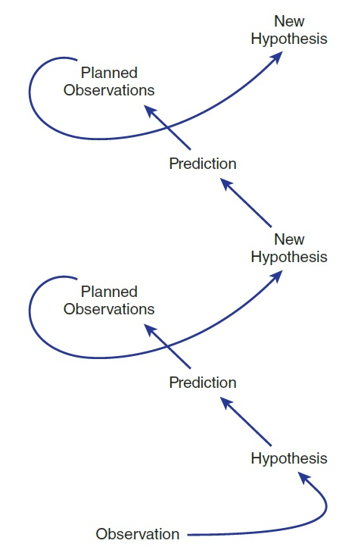
Process of Science

Slide 18
So What is Pseudoscience?
Claims submitted to the public without sufficient evidence or scientific support.
Examples?
  Aromatherapy
  Mozart Effect
  Astrology
  Question: What are some pseudoscientific claims do you adopt in your lifestyle?

Slide 19
The Research Process
Find a research idea: select a topic and search the literature to find an unanswered question.
Form a hypothesis.
Determine how you will define and measure your variables.
Identify the participants or subjects for the study, decide how they will be selected, and plan for their ethical treatment.
Decide your procedure to collect information from subjects.

Slide 20
Research Process
Select a research design.
Conduct the study.
Evaluate the data.
Report the results.
Refine or reformulate your research idea.

Slide 21
Lecture Review Questions
1. The scientific method would be an appropriate method to answer which of the following questions:
  a. How many angels can stand on the head of pin
  b. Is physician assisted suicide immoral
  c. How would civilization be if electricity was never discovered?
  d. What childhood factors increase the likelihood of adult substance abuse?
  2. Which of the following is not a good research hypothesis?
  a. Insomnia does not hurt health.
  b. Increase of carbohydrates leads to increase risk for obesity
  c. Low teacher-student ratio is related to student academic success.

