Slide 1
Multivariate Design:
Complex Correlational Relationships

Slide 2
Why Correlational Designs?
Ethical Limits to Independent Variables
Cost efficient
Time efficient
Predictive power

Slide 3
Correlation is not Causation
What are the necessary requirements for causal relationship?
1. Covariance
2. Temporal Precedence: resolves Directionality Problems
3. Internal Validity: Third Variable Problem with bivariate correlations

Slide 4
Longitudinal Design
Def: Take measurements across time with same sample.
Greater Power of Causal Claim
1. Covariance
2. Temporal Precedence: Directionality is assessed in design
3. Causal Power Limitation:No resolution to third variable problem

Slide 5
Sample Longitudinal Study
Hypothesis: Does watching videos or hearing about self-harming increase self-harming behavior? (Contagion hypothesis)
Expected Outcome:
Cross-lag Corr of Exposure-Self Harm – nsig Cross-lag Corr of Self Harm – Exposure: Sig

Slide 6
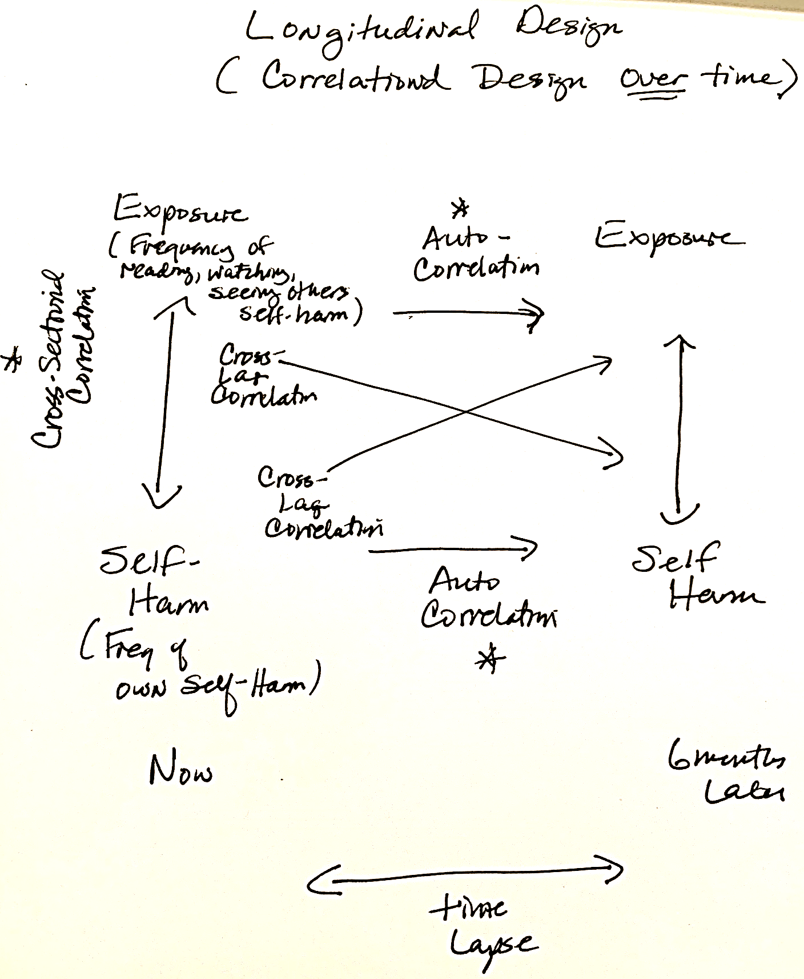

Slide 7
Longitudinal Design: Types of Correlations
Cross-Lag Correlations: (Directionality addressed)
Self Harm -> Exposure Not Sig
Exposure -> Self-Harm – Sig only if prior self-harming behavior
Auto-Correlations: (relationship to itself across time)
Exposure – Exposure : sig Exposure tends to predict later exposure
Self Harm – Self Harm: sig Self-Harming tends to perpetuate later self harm
Cross-Sectional Correlations (like a bivariate correlation):
Self Harming – Exposure are correlated positively

Slide 8
Group Exercise
Create a longitudinal study that explores the relationship of two variables across time
You are welcome to focus on variables you have already explored in your descriptive research project.
Please create a diagram of the following correlations with predicted correlations: Cross-Sectional, Auto-correlations, Cross-lag

Slide 9
Multivariate Correlational Design
Allows the evaluation of Third Variables
Allows the exploration of multiple predictors of a criterion
Example: Acculturative Stress positively predicts Chronic Illness
Question: Which acculturative factor is most problematic or creates greatest risk for illness?

Slide 10
Multivariate Correlation
Acculturative Stressors Beta Chronic Illness risk (r=.8)
Language Barrier .3
Employment Difficulties .5 (sig)
Social Isolation .4
Loss of Income .6 (sig)
Discrimination .4
Social Norm Changes .3
*Beta value indicates the association when all other factors are eliminated.

Slide 11
Multivariate Correlational Design
What is the most important factor contributing to chronic illness in immigrant population?
Assesses for the presence of Third Variables (terminology)
“Taking into account”
“Adjusting for”
“Controlling for”
“Factoring out”

Slide 12
Question of Causal Power
Multivariate Correlational Design:
Covariance : meets criteria
Temporal Precedence (directionality): does not meet criteria
Internal Validity: Third Variables are evaluated but there may be other third variables that are not accounted for in the study that also may contribute to the prediction of the criterion variable.

Slide 13
Group Work
See website for multivariate design exercise
Please turn in as a group via e-mail
Subject line: Group #

