Slide 1
15.1 The Role of Statistics in the Research Process
Descriptive statistics
Methods that help describe the characteristics about a population
Inferential statistics
Methods that help understand relationships between variables and make judgements about a population

Slide 2
Examples of Statistical Conclusions
Descriptive Research:
25% of college students practice safe sex
75% engage in casual sex, with half unprotected
Inferential Research:
Use of Alcohol reduces Condom use in college pop

Slide 3
Statistics Terminology
Statistic: a summary value that describes a sample
Example: the average score for a sample
Parameter: a summary value that describes a population
Example: the average score for a population

Slide 4
15.2 Descriptive Statistics
Frequency distributions
A method of simplifying and organizing a set of scores by grouping them into an organized display
A frequency distribution table consists of two columns of information:
X-axis► the scale of measurement
Y-axis ► the frequency of individuals located in each category

Slide 5
A Frequency Distribution Table
The table shows the distribution of scores from a 5-point quiz.
X | F
5 | 1
4 | 3
3 | 4
2 | 3
1 | 2
0 | 2
Notes:
Table 15.1 A Frequency Distribution Table

Slide 6
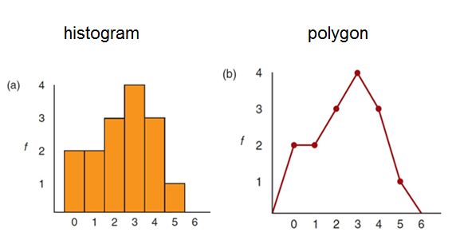
Frequency Distribution Graphs
Notes:
Figure 15.1 Frequency Distribution Graphs
The same set of scores is shown in a histogram (a) and in a polygon (b).

Slide 7
Measures of Central Tendency
Central tendency is a statistical measure.
Identifies a single score that defines the center of a distribution
Goal: to identify the value that is most typical or most representative of the entire group
Mean: mathematical average of a set of scores
Median: score that divides a distribution in half
Mode: most commonly occurring score

Slide 8
Standard Deviation
The square root of the variance
Provides a measure of variability by describing the average distance from the mean

Slide 9
Variance
Variance measures the variability of the scores by computing the average squared distance from the mean.
Measure the distance from the mean for each score ► square the distances and find the sum of the squared distances.
Compute the average squared distance by dividing the sum of the squared distances by n – 1.
Take the square root for standard deviation.

Slide 10
Describing Non-Numerical Data
Some data are non-numerical
Nominal and ordinal variables
Described by:
Percentages
Proportions
Mode
Notes:
Most common Nominal Data: Frequency of yes and no, favorite color, sex, occupation ( cannot calculate averages)
Ordinal Variables: Rank Order (example: class ranking)

Slide 11
Correlations
Measures and describe three aspects of the relationship between two variables:
The direction of the relationship is described by the sign of the correlation (+ or -).
The form of the relationship
Pearson correlation is most commonly used.
The degree of association of the relationship; Predictive Power
The data for a correlation
Always consist of two scores for each individual
The scores are identified as X and Y and can be presented in a table or in a scatter plot.
The numerical value of the correlation (0 to 1.00)

Slide 12
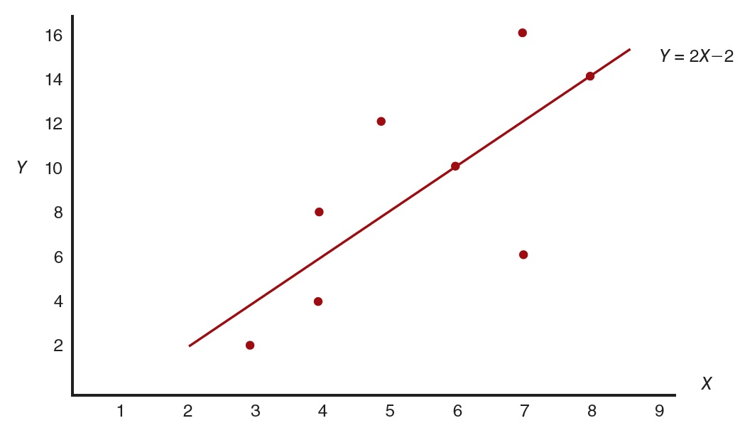
Regression
The statistical process of finding the linear equation
Produces the most accurate predicted values for Y using one predictor variable (X); uses the correlation coefficient (r)

Slide 13
Multiple Regression
Often, researchers want to use more than one predictor variable to make more accurate predictions.
Multiple regression
Multiple regression equation
Example: Predicting Weight based on Height and Gender

Slide 14
Inferential Statistics
Inferential statistics addresses the issue of how accurately a sample represents a population.
Sampling error: naturally occurring difference between a sample statistic and the population parameter
Population of 1,000 College Students
Population Parameters
Average age = 21.3 Years
Average IQ = 112.5
56% female, 44% male

Slide 15
Inferential Statistics
Study Sample 1
Eric
David
Laura
Karen
Brian
Sample Statistics
Average age = 19.8
Average IQ = 104.6
40% female, 60% male

Slide 16
Inferential Statistics
Study Sample 2
Stacey
Kristen
Sara
Andrew
Jessica
Sample Statistics
Average age = 20.4
Average IQ = 114.2
80% female, 20% male
Question: Which sample has the least sampling error?

Slide 17
Inferential Statistics
What is a hypothesis test?
A systematic procedure
Determines whether the sample data provide convincing evidence to support the original research hypothesis
Goal of a hypothesis test
Rule out chance as a plausible explanation for the results
Predictions exist beyond the possibility of chance

Slide 18
The Five Basic Elements of a Hypothesis Test
Null hypothesis
Sample statistic
Standard error
Test statistic
Alpha level (level of significance)

Slide 19
Errors in Hypothesis Testing
Type I error
Researcher finds evidence for a significant result when there is actually no effect.
Type II error
Sample data do not show evidence of a significant effect when a real effect exists in the population.
Occurs when the effect is so small that it does not show up in the sample.

Slide 20
Factors That Influence the Outcome of a Hypothesis Test
The number of scores in the sample
1
Large Sample: A mean difference or a correlation more likely to be found with a large sample
More likely to be significant than the same result found with a small sample
The size of the variance
2
A sample mean with high variance
Less likely to be significant than the same result found with low variance

Slide 21
Supplementing Hypothesis Tests with Measures of Size Effects
It is recommended to include an independent measure of effect size.
Cohen’s d
Percentage of variance
Confidence intervals

Slide 22
Finding the Right Statistics for Your Data
Three distinct data structures:
Category 1: descriptive research strategy
one group of participants; one variable measured per participant
Category 2: correlational research strategy
one group of participants; two (or more) variables measured for each participant
Category 3: experimental, nonexperimental, and quasi-experimental research strategies
two or more groups of scores with each score a measurement of the same variable

Slide 23
Statistics for Data from Category 1 (1 of 3)
Numerical scores from interval or ratio scales
Descriptive Statistics
Mean and Standard deviation
Inferential Statistics (If a reasonable hypothesis exists.)
Single-sample t test
Use the sample mean to test a hypothesis about the population mean
Proportions or percentages to describe the distribution across categories
Chi-square test for goodness of fit
Use the sample frequencies to test a hypothesis about the proportions in the population
Notes:
Figure 15.12 Statistics for Data from Category 1: A Single Group of Participants with One Score per Participant
The goal is usually to describe the variable as it exists naturally.

Slide 24
Statistics for Data from Category 1 (2 of 3)
Ordinal scores (ranks or ordered categories) Median
Proportions or percentages to describe the distribution across categories
Chi-square test for goodness of fit
Use the sample frequencies to test a hypothesis about the proportions in the population
Notes:
Figure 15.12 Statistics for Data from Category 1: A Single Group of Participants with One Score per Participant
The goal is usually to describe the variable as it exists naturally.

Slide 25
Statistics for Data from Category 1 (3 of 3)
Nominal scores (named categories) Mode
Proportions or percentages to describe the distribution across categories
Chi-square test for goodness of fit
Use the sample frequencies to test a hypothesis about the proportions in the population
Notes:
Figure 15.12 Statistics for Data from Category 1: A Single Group of Participants with One Score per Participant
The goal is usually to describe the variable as it exists naturally.

Slide 26
Statistics for Data from Category 2
The goal of analyzing data in this category
To describe and evaluate the relationships between variables, typically two variables at a time
The most commonly used statistics are correlation and regression.
An alternative statistic is the chi-square test for independence.
Notes:
Figure 15.12 Statistics for Data from Category 1: A Single Group of Participants with One Score per Participant
The goal is usually to describe the variable as it exists naturally.

Slide 27
Statistics for Data from Category 3
Analysis methods:
Numerical scores ► one-way ANOVA and t-tests (independent or repeated measures)
Nominal or ordinal scales ► chi-square test for independence
Two-factor designs with interval or ratio scales ► two-way ANOVA

Slide 28
Special Statistics for Research
The Spearman–Brown formula
Adjusts the simple correlation measured by split-half reliability
Two basic concerns of split-half reliability:
Scores are based on only half of the test scores.
Tends to underestimate the true reliability of the full test
Spearman–Brown formula increases the size of the correlation producing a better estimate of the true reliability for the full test set.

Slide 29
The Kuder–Richardson Formula 20 (K-R 20)
An optional method for correcting concerns related to split-half reliability
Measures the average correlation from every possible way to split a test in half
Limited to tests in which each item has only two possible answers
Produces values ranging from 0 to 1.00
Higher values indicate a higher degree of internal consistency or reliability

Slide 30
Cronbach’s Alpha
A modification of the K-R 20
Used when test items have more than two alternatives
Measures split-half reliability by estimating the average correlation
Obtained by considering every possible way to split the test in half
Produces values between 0 and 1.00

Slide 31
Cohen’s Kappa
A measure of agreement that attempts to correct for chance
Corrects for interrater agreements

