Slide 1
Theory Data Cycle
Starting a Research Study

Slide 2
Purpose of Research
What is research?
Investigation into a problem
Exploration of relationships
Collection of information with unbiased analysis and conclusions
Why?
Fills gaps in knowledge within a scientific discipline
Resolves problems that aid in the treatment of illness or promote welfare of civil society
Creates new ways of exploring a psychological concept

Slide 3
What to Research?
Identifying Topic or Area of Interest
First Step: Find a Research Area
General Topic of Interest
Meaningful pursuit
Explore Previous research in that topic to identify unanswered questions to explore.

Slide 4
Sources of Research Topics
Personal Interests/Curiosities
Life Experiences
Challenges, Adversities
Personal Insight
Casual Observations
Resolutions of Problems in the Field
Basic Research: BuildingTheory
Applied Research: Improve Clinical Practice

Slide 5
Research Process
Literature Review: Once topic is selected, the next step is to explore the extant research in the area and the outstanding questions left to explore.
The literature: the mass of published information worldwide
Your job is to identify a handful of studies directly related to your research idea.
This sounds daunting, but cross-referencing and summaries can help.

Slide 6
Starting a Review of the Literature
Do your homework: collect background information.
Read books and journal articles.
Do not try to read everything.
Read enough to gain a good grasp of your topic.

Slide 7
Starting a Review of the Literature
Keep an open mind.
Begin with a general topic and let background reading lead you to a more specific topic.
Be critical; ask questions as you read.
Maintain a degree of flexibility.
Focus, focus, focus.
Develop one research question and find relevant background information.
Take one step at a time.

Slide 8
Primary and Secondary Sources
Primary sources: firsthand reports in which the authors describe their own observations
Examples: empirical journal articles/theses
Secondary sources: secondhand reports in which the authors discuss someone else’s observations
Examples: textbooks/introductory sections of research reports; meta-analysis
GOOD PLACE TO START A LITERATURE REVIEW*********

Slide 9
The Purpose of a Literature Search
Two basic goals:
To gain a general familiarity with the current research in your specific area of interest
To find a small set of research studies to serve as the basis for your research idea
Find a set of published research reports defining the current state of knowledge
KEY: Identify a gap in that knowledge base that your study will attempt to fill

Slide 10
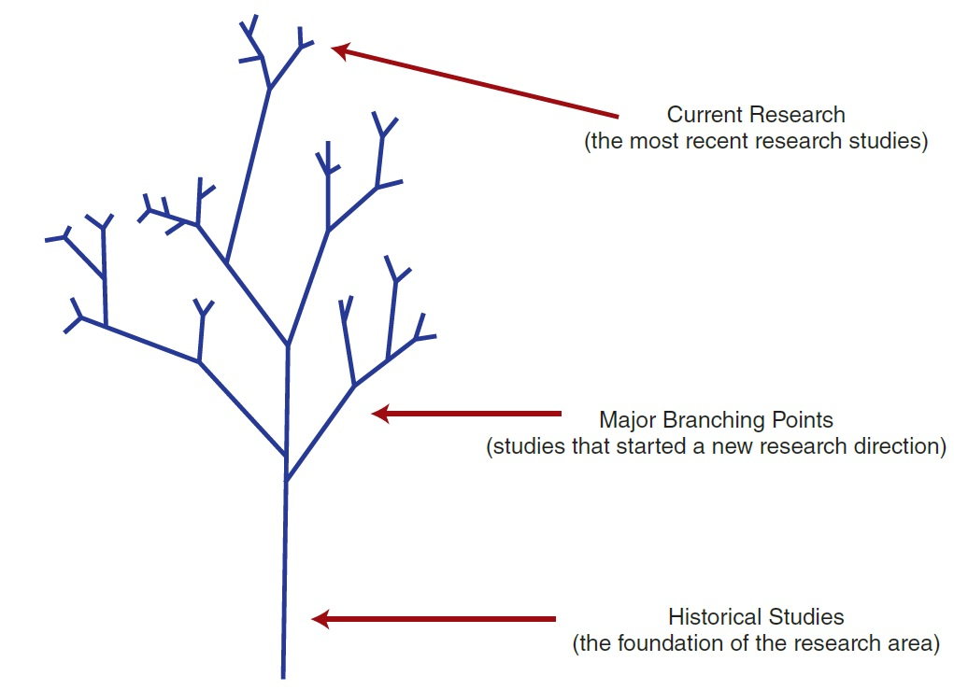
How New Research Grows Out of Old
Notes:
Figure 2.1 How Research Grows Out of Old
The tree-like structure emphasizes the notion that current research (the tips of the branches) is always based in previous research.

Slide 11
Note taking: Literature Search
Make note of subject words.
List correct terms or subject words.
These words identify and describe the variables in the study and the characteristics of the participants.
Make note of author names.
The same authors’ names encountered repeatedly are likely the current leading researchers in the field.

Slide 12
Using Online Databases
A typical database contains about one million publications.
Search the database by subject word or author name
Articles listed by the search may be:
Brief summaries
Abstracts
Full-text

Slide 13
Information About PsycINFO Database
PsycINFO is the American Psychological Association’s (APA) definitive resource for abstracts of scholarly journal articles, book chapters, books, and dissertations.
Largest resource devoted to peer-reviewed literature in behavioral science and mental health
American Psychological Association (APA) offers video guide for using PsychINFO:
www.youtube.com/psycinfo
Notes:
Table 2.1
Information About PsycINFO® and PsycARTICLES® Databases

Slide 14
Information About PsycARTICLES Database
PsycARTICLES is the American Psychological Association’s (APA) definitive source of full-text, peer-reviewed scholarly and scientific articles in psychology.
Contains more than 163,000 articles from more than 80 journals published by the APA, the Educational Publishing Foundation (EPF), and from allied organizations
Notes:
Table 2.1
Information About PsycINFO® and PsycARTICLES® Databases

Slide 15
Screening Articles During a Literature Search
Ways to weed out irrelevant material:
Use the title as your first basis for screening.
Use the abstract as your second screening device.
Look for a link to a full-text version.
If the article still looks relevant, then read it carefully.
Use references from articles you have already found to expand your literature search.

Slide 16
When is the Literature Review Complete?
The search is completed when you:
feel comfortable with your knowledge about the topic area, and
have found a few recent research studies that are particularly relevant to your own interests.
How many articles is enough?
The key criterion is that the study (or studies) you find provides some justification for new research.

Slide 17
Components of a Research Article
Section | Content | Critical Evaluation Questions
Introduction | Literature review | Is the review complete and up to date? Are relevant or related topics not covered? Is the hypothesis clearly stated?
 | Hypothesis or purpose for study | Is the hypothesis directly related to the reviewed literature? Does the predicted outcome logically follow from the hypothesis?
 | Specific prediction from hypothesis | Can other specific predictions be made?
Method | Participants | Are the participants representative of the population being considered? If participants were restricted (e.g., males only), is it justified? Would different participants produce different results? Are there alternative ways to define and measure the variables?
 | Procedure | Could alternative procedures be used?
Notes:
Table 2.2
Critically Reading a Research Article

Slide 18
Components of a Research Article
Section | Content | Critical Evaluation Questions
Results | Statistics (descriptive and inferential) | Were the appropriate statistics used? Exactly what is significant and what is not? Are the effects large enough to be meaningful?
Discussion | Results related to hypothesis | Do the results really support (or refute) the hypothesis? Are the conclusions justified by the results?
 | Justified conclusions | Are alternative conclusions/explanations possible?
 | Alternative explanations | Would other variables affect the results? Do the results have real-world applications?
 | Applications Limits to generalization | Is there reason to suspect that the same results would not occur outside the lab? Would the same results be expected with different participants or under different circumstances?
References | List of items cited | Is the list of references current and complete?
Notes:
Table 2.2
Critically Reading a Research Article

Slide 19
Review: What is a good Hypothesis?
What are the characteristics of a good hypothesis?
Logical: the logical conclusion of a logical argument
Testable: all of the variables, events, and individuals can be defined and observed
Refutable: can be demonstrated to be false
Positive: must make a positive statement about the existence of some effect or significant relatioship

Slide 20
What Happens after the Literature Review and Identification of the Hypotheses?
The next steps
Specify how the variables will be defined and measured.
Identify the individuals who will participate in the study,
Describe how they will be selected and provide for their ethical treatment.
These will be discussed in subsequent lectures

