Slide 1
Within-Subjects Experiments
What are the general characteristics of within-subjects designs?
Uses a single group of participants
Same group of individuals participates in every level of the IV.
Often called a repeated-measures design

Slide 2
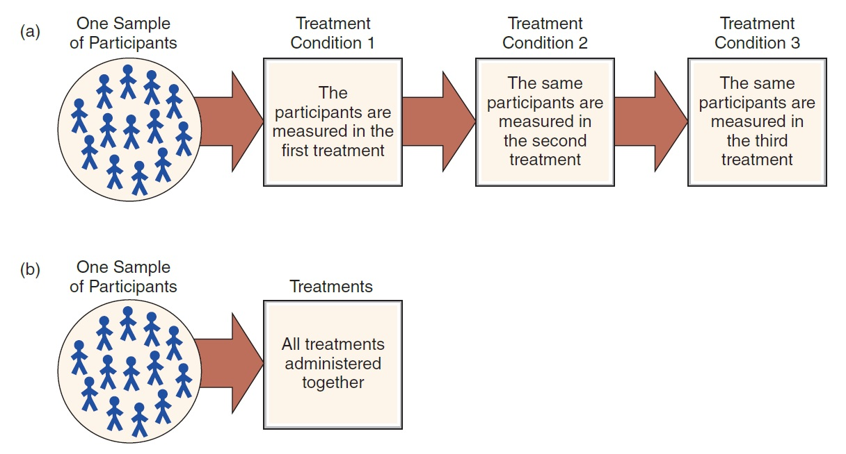
The Structure of a Within-Subjects Design
Notes:
Figure 9.1 The Structure of a Within-Subjects Design
The same group of individuals participates in all of the treatment conditions. Because each participant is measured in each treatment, this design is sometimes called a repeated-measures design. Note: All participants go through the entire series of treatments but not necessarily in the same order.

Slide 3
Threats to Internal Validity to Within-Subjects Experiments
Two major sources of potential confounding
Confounding from environmental variables
environment may change from one treatment condition to another.
Confounding from time-related variables
Factors change in time across conditions investigated.

Slide 4
Specific Threats to Internal Validity
What are five time-related threats?
History
Maturation
Instrumentation
Regression toward the mean
Order effects (practice, fatigue, and carry-over effects)

Slide 5
Confounds
History: Events in the environment outside of the treatment or control conditions that affect the dependent variable.
Example: Events at home or school that affect students performance
A event such as a violent crime in the community affects participants response to treatment for anxiety
Solution?

Slide 6
Confounds
Maturation: Systematic changes in participant’s mental or physical self
Example: Exploring treatment effect on PTSD in children
No control for the natural psychological adaptation that evolves in children over times
Most problematic when evaluating longterm effects of a intervention
Solution?

Slide 7
Confounds
Instrumentation: Changes in the accuracy of measurements over time.
Example: Researcher observing occurrences of aggressive behavior in a group of children
Difficult to assure sustained accuracy
Problematic when exploring longterm effects or taking a series of measurements across time
Solution?

Slide 8
Confounds
Statistical Regression: Mathematical phenomenon that extreme scores are followed by less extreme scores. Changes in scores to general regression to the mean phenomenon.
Problem with comparing multiple scores across time
Example: Selecting students with very poor responses on memory test to assess improvements from a new memory technique. Likely to do well in subsequent testing based on “regression to the mean” phenomenon.
Solution?

Slide 9
Confounds
Order Effects: Problem with Within-Subjects Design
Practice
Carry-over Effects
Fatigue
The intervention in the first condition effects responses to subsequent conditions.
Example: Within-Subjects Design – effectiveness of memory techniques on learning.
Mem tech1 -> Mem tech2 -> Mem tech3

Slide 10
Dealing with Time-Related Threats and Order Effects
Controlling time
Shortening the time between treatments increases the likelihood that order effects will influence results.
But reduces maturation and regression
Increasing the time between treatments increases the risk of time-related threats to internal validity.
But reduces order effects like fatigue

Slide 11
Switch to a Between-Subjects Design
Between-subjects design is a better choice for research conditions that are prone to order effects.
Examples: conditions leading to fatigue or boredom

Slide 12
Counterbalancing: Matching Treatments with Respect to Time
Counterbalancing: changing the order in which treatment conditions are applied from one participant to another
Matches treatment conditions with respect to time
Goal: to use every possible order of treatments with an equal number of subjects participating in each sequence
Purpose: to eliminate time-related confounding

Slide 13
Counterbalancing and Order Effects
Counterbalancing a within-subjects design prevents any order effects from accumulating in one particular treatment condition.
Spreads order effects evenly across all the different conditions ► allows a fair, unbiased comparison between treatments
Does not eliminate the order effects

Slide 14
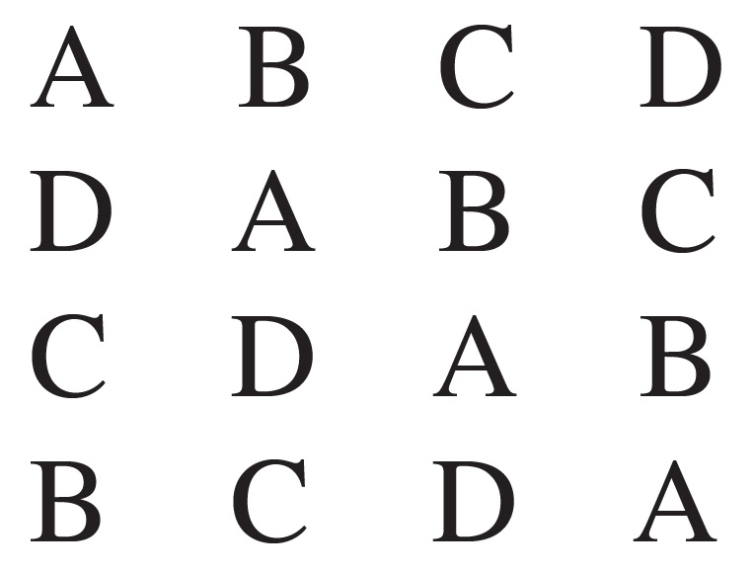
Counterbalancing and the Number of Treatments (2 of 2)
In partial counterbalancing, a Latin square can be constructed to decide which sequences to select.

Slide 15
Advantage of Within-subjects Design
Advantages of within-subjects design
Requires relatively few participants
Controls for individual differences between groups
Reduces variance
Increases the chances of detecting a treatment effect

Slide 16
Disadvantages of Within-Subjects Designs
Time-related factors which influence the subjects’ scores
Participant attrition: some of the subjects who start the study will drop out before the study is completed

Slide 17
Approx. Within Design:Matched-Subjects Designs
Type of Between-Subjects Design
Each individual in one group is matched one-to-one with an individual in every other group.
Matching is based on a variable that is particularly relevant to the specific study.
Goal: to duplicate all the advantages of within- and between-subjects designs without the disadvantages of either one

Slide 18
Applications and Statistical Analysis of Within-Subjects Designs
Two-treatment designs
The simplest application of a within-subjects design is to evaluate the difference between two treatment conditions.
With data measured on an interval or ratio scale, data analysis requires using a repeated-measures t or a single-factor ANOVA (repeated measures).
With ordinal scale data (or rank ordered), data are analyzed with a Wilcoxon test or a Sign test.

