Slide 1
Survey Research Presentation
Each Group Presentation must consist of the following: (please use power-point)
Background description of the problem or issue.
Discussion of Hypothesis and Predictions.
Description of the Subjects
Description of Survey, Operational Definition of Constructs
Description of Procedure
Presentation or Results with Graphic Representations
Discussion of implications and impact of findings.

Slide 2
The Research Report: APA Style

Slide 3
16.1 The Goal of a Research Report
Provide three kinds of information about the research study
What was done
How it was done
What was found
How the study is related to other knowledge in the area

Slide 4
Definition of a Research Report
A written description of a research study that includes these components:
Clear statement of the purpose of the research
Review of the relevant background literature that led to the research study
Description of research methods used
Summary of the research results
Discussion and interpretation of the results

Slide 5
16.2 General APA Guidelines for Writing Style and Format
Some elements of writing style
Impersonal style
Although you may use personal pronouns to describe what you did as a researcher
Verb tense – past tense for completed research
Reduce biased language (not persuasive, or advocating a position) –impartial discussion

Slide 6
Citation
Identifies the author(s) and the year of publication of the source of a specific fact or idea mentioned in a research report
Provides enough information for a reader to locate the full reference in the list of references at the end of the report

Slide 7
Two Formats Commonly Used for Citations
States a fact or makes a claim in the text
Cites the source in parentheses within the same sentence
Uses the source as the subject of a sentence
Author(s) name(s) appear within the body of the sentence and only the year of publication is noted in parentheses

Slide 8
Rules for Use of References
Be conservative: select only those references that are useful and contribute to your arguments.
A general rule: paraphrase a point using your own words rather than a direct quote.
Use direct quotations only when it is necessary to preserve the whole essence of the original statement.
Quotations should be used sparingly.

Slide 9
Examples of Original and Subsequent Citations
Number of Authors | First Time in Text | Subsequent Times in Text | First Time in Parentheses | Subsequent Times in Parentheses
1 | Jones (2017) | Jones (2017) | (Jones, 2017) | (Jones, 2017)
2 | Smith and Jones (2016) | Smith and Jones (2016) | (Smith & Jones, 2016) | (Smith & Jones, 2016)
3-5 | Jones, Smith, and Brown (2014) | Jones et al. (2014) | (Jones, Smith, & Brown, 2014) | (Jones et al., 2014)
6 or more | Jones et al. (2015) | Jones et al. (2015) | (Jones et al., 2015) | (Jones et al., 2015)
Notes:
Table 16.1 Examples of Original and Subsequent Citations

Slide 10
Guidelines for Typing or Word Processing
Manuscript settings
Double-spaced (except tables)
One-inch margins
Left-aligned without hyphenation
Indent the first line of each paragraph
Typeface: 12-point Times New Roman

Slide 11
Manuscript Pages
Manuscript organization with each part starting on its own separate page
Title page
Abstract
Text (body)
References
Tables
Figures
Appendices (if any)

Slide 12
16.3 The Elements of an APA-Style Research Report
Title page: manuscript’s first page
Running head (abbreviated title) and page number (1)
Title of the paper
Author name(s) (byline) and affiliations
Author note

Slide 13
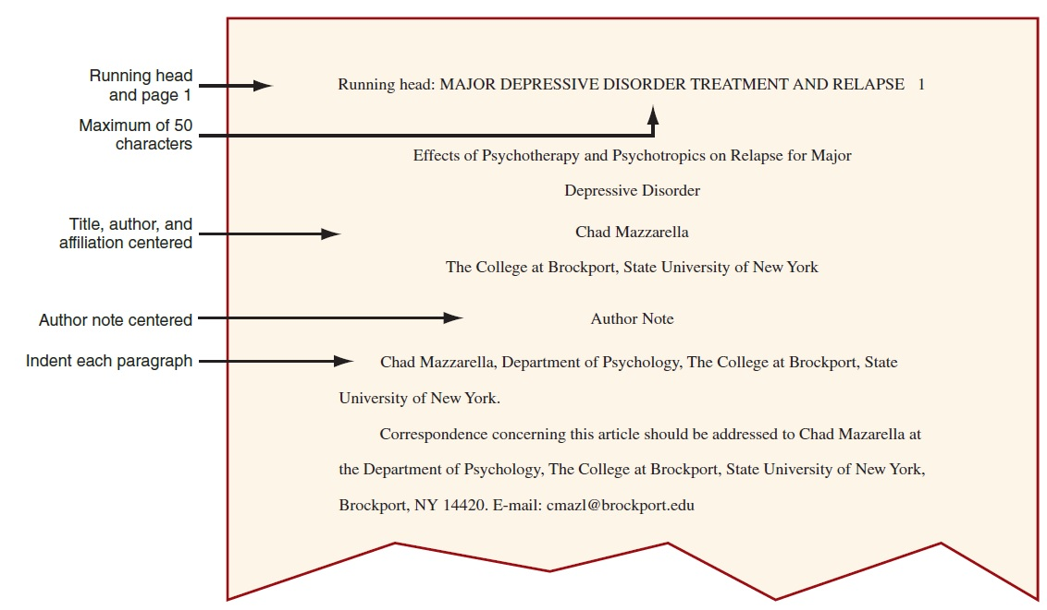
An APA-Style Title Page
Notes:
Figure 16.1 An APA-Style Title Page

Slide 14
The Elements of an APA-Style Research Report: Abstract
An empirical study’s abstract includes:
A one-sentence statement of the problem or research question
A brief description of the participants
A brief description of the research method and procedures
A report of the results
A statement about the conclusions or implications

Slide 15
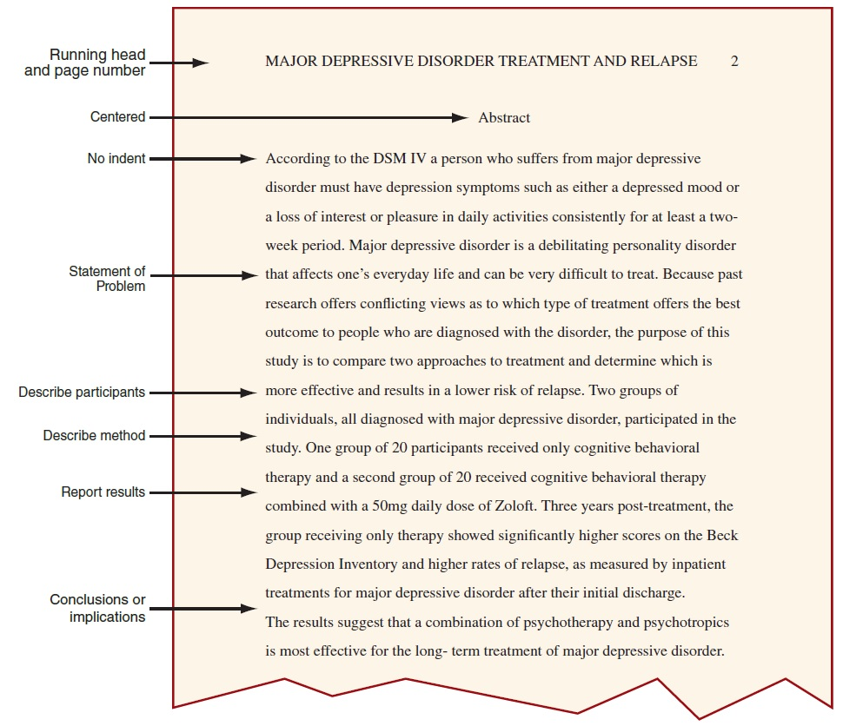
An APA-Style Abstract
Notes:
Figure 16.2 An APA-Style Abstract

Slide 16
The Elements of an APA-Style Research Report: Introduction
Components of the introduction
A general introduction to the topic of the paper
A review of the relevant literature
A statement of the problem or purpose of the study with relevant variables clearly defined
A description of the research strategy that used to evaluate the hypothesis or to obtain an answer to the research question

Slide 17
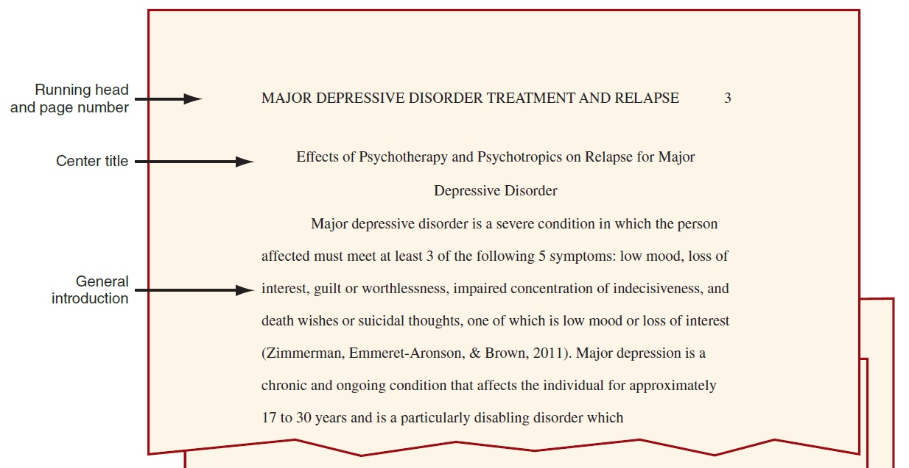
Excerpts from an APA-Style Introduction
Notes:
Figure 16.3 Excerpts from an APA-Style Introduction

Slide 18
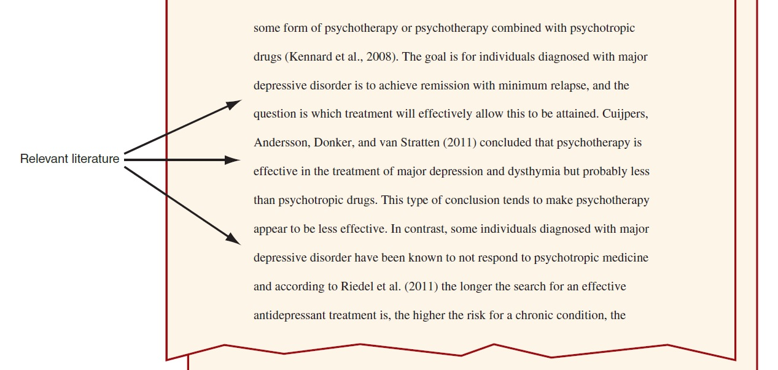
Excerpts from an APA-Style Introduction: Relevant Literature
Notes:
Figure 16.3 Excerpts from an APA-Style Introduction: Relevant Literature

Slide 19
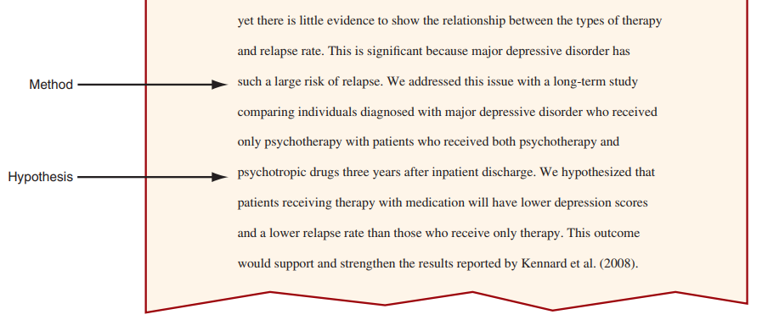
Excerpts from an APA-Style Introduction: Method and Hypothesis
Notes:
Figure 16.3 Excerpts from an APA-Style Introduction: Method and Hypothesis

Slide 20
The Elements of an APA-Style Research Report: Methods
A relatively detailed description of exactly how the variables were defined and measured and how the research study was conducted
Subsections of the method section
Subjects subsection
Procedure subsection
Apparatus subsection
Materials subsection

Slide 21
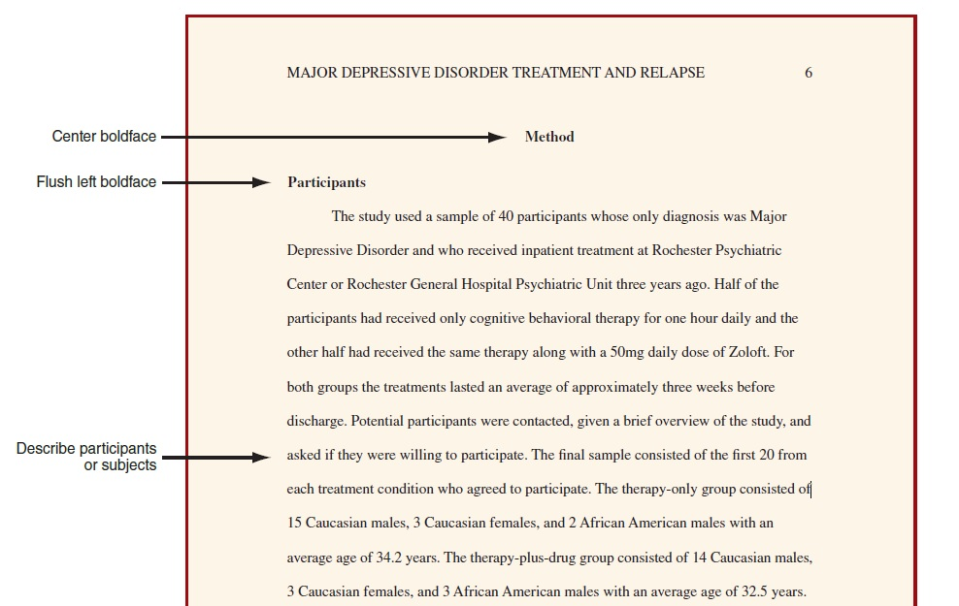
An APA-Style Method Section: Participants Subsection
Notes:
Figure 16.4 An APA-Style Method Section: Participants Subsection

Slide 22
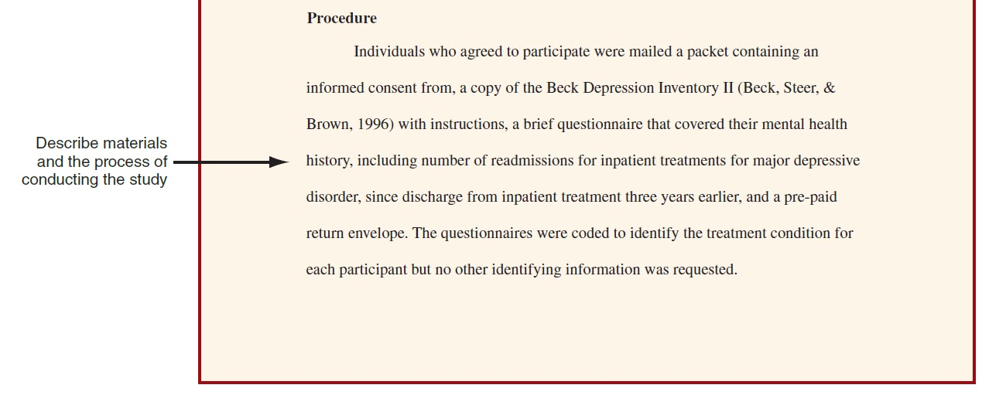
An APA-Style Method Section: Procedure Subsection
Notes:
Figure 16.4 An APA-Style Method Section: Procedure Subsection

Slide 23
The Elements of an APA-Style Research Report: Results
A summary of the data and the statistical analyses
Begins immediately following the method section—not starting on a new page
Provides a complete and unbiased reporting of the findings, just the facts, with no discussion of the findings

Slide 24
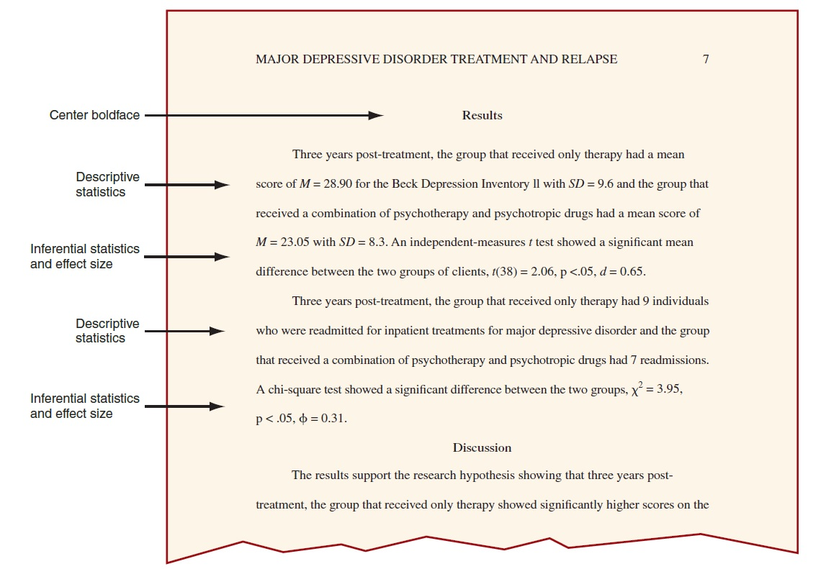
An APA-Style Results Section
Notes:
Figure 16.5 An APA-Style Results Section

Slide 25
The Elements of an APA-Style Research Report: Discussion
Restates the hypothesis, summarizes the results, and then presents a discussion of the interpretation, implications, and possible applications of the results
Begins immediately after the results section—not starting on a new page

Slide 26
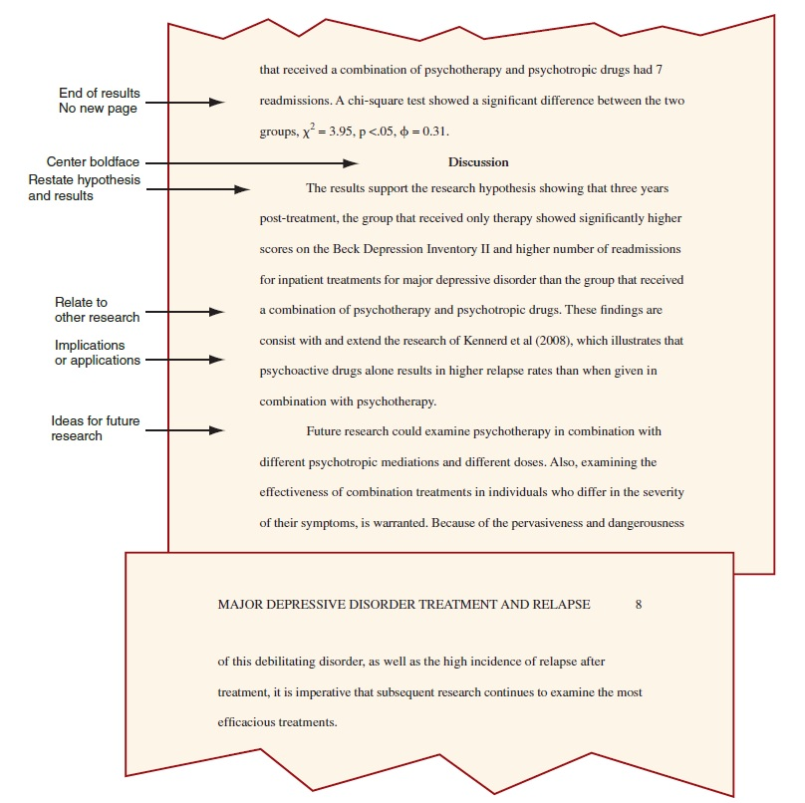
An APA-Style Discussion Section
Notes:
Figure 16.6 An APA-Style Discussion Section

Slide 27
The Elements of an APA-Style Research Report: References
Listing of complete references for all sources of information cited in the report
Organized alphabetically by the last name of the first author
Begins on a new page
Recommendation: include the digital object identifier (DOI) if it is available for a source

Slide 28
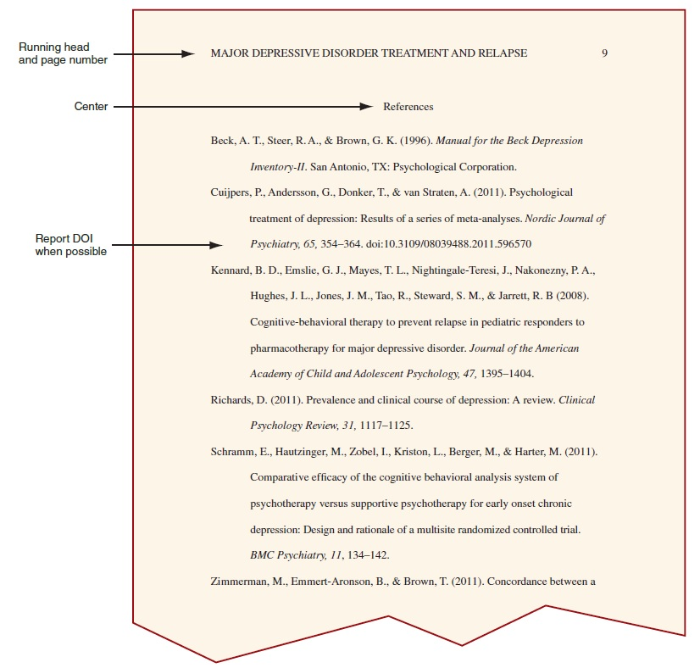
An APA-Style References Section
Notes:
Figure 16.7 An APA-Style References Section

Slide 29
The Elements of an APA-Style Research Report: Figures
As a general rule, tables and figures supplement the text—they should not duplicate information that has already been presented in text form.
Any table or figure should be mentioned in the text by number.
The text should point out some of the more important aspects of the figure or table.
Each table or figure is on a new page.

Slide 30
The Elements of an APA-Style Research Report: Appendix
Presents detailed information
Useful, but would interrupt the flow of information if presented in the body of the paper
Group Discussion: Review Introduction and Discussion sections of an article posted on website

Slide 31
Submitting a Manuscript for Publication
Find the right journal.
Consult the journal’s submission requirements.
Attach a cover letter to the journal editor along with the manuscript.
Most submitted manuscripts are rejected; only the best of the best are published.

Slide 32
Conference Presentations: Papers and Posters
Presenting a paper
An oral presentation: typically involves a PowerPoint presentation (10 to 20 minutes)
Presenting a poster:
Poster sessions occur in a large room where researchers are given space to display their research for an hour or two
Guidelines are provided by the organization for style and requirements

Slide 33
16.4 Writing a Research Proposal
A research proposal is a plan for a new study
To obtain funding, help a researcher define his or her thinking, or obtain approval from a dissertation committee
What to include?
What will be done
What may be found
How the planned study is related to other research

Slide 34
How to Write a Research Proposal
Very similar to writing research report
Follow APA guidelines
However, always use the future tense to describe the study.
Other differences
An abstract is optional.
The literature review in the introduction is typically more extensive.
Include a combined Results/Discussion or Expected Results section.

