Slide 1
Abnormal Psychology
Chapter 1
Introduction

Slide 2
Historical Perspectives on the Mentally Ill
Prehistoric and ancient beliefs
Evil spirits residing in a person’s body
Trephining
Naturalistic explanations: Greco-Roman thought
Early thinkers: Galen ‘s Theory of Humors
Pathology is physical: Paradigm shift

Slide 3
The Middle Ages Through the 17th Century
Middle Ages
Regression in thought
Exorcism
Group hysteria: mental illness-witchcraft
15th through 17th centuries
Spanish Inquisition: Mental illness is evil
Witch hunts
https://goo.gl/images/3WXVeh
100,000 people (mostly women) executed

Slide 4
Marginalization of Mentally ill
18th through 19th centuries: “Deporables”
Horrendous conditions in asylums
Mentally ill and Disabled institutionalized away from society
https://www.youtube.com/watch?v=SfTkBK6aXZg
https://www.youtube.com/watch?v=nNuoff-tNoc
The rise of humanism
Philosophical movement emphasizing uniqueness and worth of the individual
Notes:
Mentally ill were put away from society; out of sight out of mind approach culturally – does it still exist??

Slide 5
The Moral Treatment Movement (18th and 19th Centuries)
Shift to more humane treatment of mentally disturbed people
Philippe Pinel (1745-1826)
Took charge of mental hospital in Paris
Removed chains, replaced dungeons with sunny rooms, and encouraged exercise
Changes shown to foster recovery

Slide 6
Causes: Early Viewpoints
Invention of the Microscope
Germ theory of disease
Disease is cellular/reductionistic
Biological view gained greater strength
Discovery of Antibiotics: Penicilin
Curing Small Pox, Measles, other infectious diseases
- Proved that mental symptoms of general paresis are linked to syphilis bacteria

Slide 7
Causes of Mental Illness: Early Viewpoints
The biological viewpoint: Early 20th century
Mental disorders have a physical or physiological basis
Practice of Medicine – proving effective
Kraepelin (1856-1926)
Defined syndromes based on clusters of symptoms
Foundation for DSM used today

Slide 8
The Psychological Viewpoint: France & Germany
Belief that mental disorders are caused by psychological and emotional factors
Friedrich Anton Mesmer (1734-1815)
Practiced therapies that evolved into modern hypnotism
Mesmer: Idea that suggestion could treat hysteria
“Power of the Mind”

Slide 9
Catharsis: The First tx
Breuer
Discovered symptoms disappeared after female patient spoke about past trauma while in a trance (hypnosis)
Freud (1856-1939)
Technique of psychoanalysis
Built on practices of Breuer
Cathartic method
Therapeutic use of verbal expression

Slide 10
Behaviorism: United States
Viewpoint rooted in laboratory science
Focus on directly observable behaviors
Behavior shaped by environment (rewards/punishments; modeling; associative learning)
Alternative explanation to Mental Illness
Offered successful procedures for treating some psychological conditions

Slide 11
Contemporary Trends in Abnormal Psychology
Bio-Psycho-Social Model
Culture, race, ethnicity, gender, age, and socio-economic class relevant to understanding and treating abnormal behavior
Mental health professionals need to:
Increase cultural sensitivity
Acquire knowledge biological factors
Develop integrative therapy approaches
Notes:
Not enough to have a genetic risk, or a bad upbringing, or poor social relationships to create pathology.

Slide 12
Positive Psychology
Objectives
Shift away from illness narrative
Patients are clients
Collaborative approach
Focuses on human strength and capacity for resilience
Psychological resilience
Prevention
Notes:
Shift away from learning how we get sick to understanding how people evade illness in the face of stressors

Slide 13
Changes in the Therapeutic Landscape
The drug revolution in psychiatry
Introduction of psychotropic medications in the 1950s
Considered one of the great medical advances in the 20th century
Naturally occurring lithium found to radically calm some mental patients
Many drugs made available for different disorders – Antipsychotics
Resulted in depopulation of mental hospitals

Slide 14
The Development of Outpatient Treatment Model
Some changes brought about by managed care
Deinstitutionalization of mental health tx
Cost-cutting focus
Business interests of insurers influence treatment duration
Cost-cutting focus limits over-treatment
Increased appreciation for evidence based treatment

Slide 15
The Current Field of Clinical Psychology
Psychopathology
Scientific study of symptoms and causes of mental disorders
Objectives: describing, explaining, predicting, and modifying behaviors associated with mental disorders
strive to alleviate distress and life disruption of those with mental disorders

Slide 16
Predicting Behavior
Various risk factors for violent behavior to self and others
Duty to protect
Involuntary Hospitalization: “5150”
Limits civil liberties
The premise of the legal system
An individual is innocent until proven guilty
Notes:
Legal premise is contrary to psychology purpose to predict and prevent destructive behavior. These are cross-purposes.

Slide 17
Creating Change
Psychotherapy
Theoretical foundation in understanding cause (psychoanalytic, behavioral, etc.)
Goal: improve a person’s behavioral, emotional, or cognitive state
Many types of therapies and professional helpers
Individual, Couples, Family, Group Modalities

Slide 18
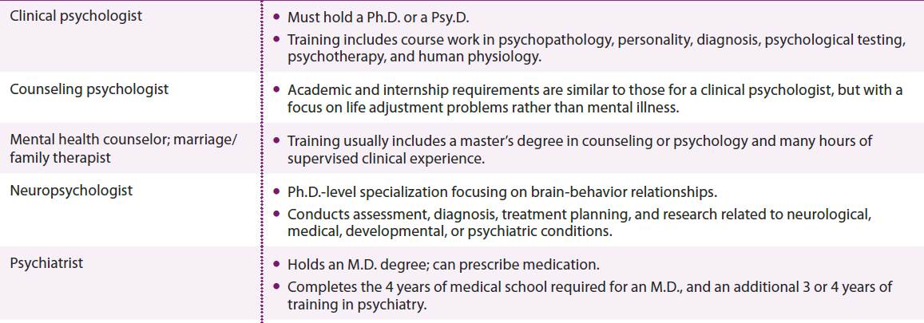
The Mental Health Professions
Notes:
Table 1.1 The mental health professions

Slide 19
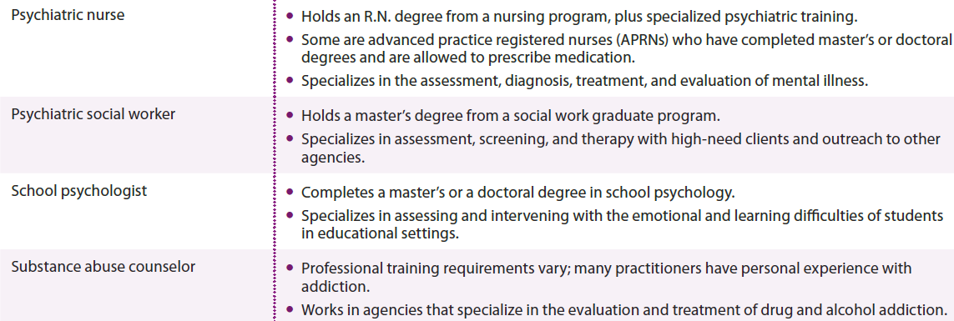
The Mental Health Professions (cont’d.)
Notes:
Table 1.1 The mental health professions

Slide 20
Views of Abnormality
The most widely used classification system
Diagnostic and Statistical Manual of Mental Disorders, 5th Edition (DSM-5)
Defining Criteria for Mental Illness:
Distress
Dysfunction
Deviance
Dangerousness

Slide 21
DSM Definitions
Questions:
When are symptoms or behavior significant enough to have meaning?
What if it is unnoticed by person?
Is it possible to have a mental disorder without distress or discomfort?
What criteria are to be used in assessing symptoms?

Slide 22
Cultural Considerations in Abnormal Behavior
What is culture?
Learned behavior that members of a group transmit to the next generation
Viewpoints: Both are Important
Cultural relativism
Expression/determination of behaviors depends on lifestyles, cultural values, and worldviews
Cultural universality
Symptoms of mental disorders are independent of culture

Slide 23
Sociopolitical Considerations in Abnormality
Criticisms of Science of Psychopathology:
A society labels behavior that is different as abnormal
Are we pathologizing unusuality? e.g. Schizoid; histrionic
Unusual belief systems are not necessarily wrong
Abnormal behavior a reflection of something wrong with society: sx of corrupted society

Slide 24
How Common Are Mental Disorders?
Prevalence
Percentage of people in a population who have the disorder during a given interval of time
Dept. of Health and Human Services study
24.8 percent of U.S. adults have experienced a mental disorder in the past 12 months, excluding drug and alcohol disorders
Lifetime prevalence
Existence of a disorder during a person’s life

Slide 25
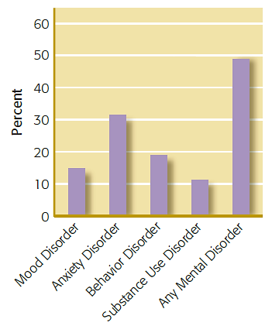
A Sampling of Lifetime Prevalence
Notes:
Figure 1.1 Lifetime prevalence of mental disorders in a sample of 10,000 U.S. adolescents

Slide 26
Implications to Society
$135 billion a year spent on mental health and substance abuse services in U.S.
25 percent of adults have a diagnosable mental health condition
Many more experience mental health problems not meeting criteria for disorder
57 percent of adults with severe mental health conditions not receiving treatment

Slide 27
Overcoming Social Stigma and Stereotypes
Mentally ill are frequently stereotyped and stigmatized
Prejudice
Vilifying illness
Discrimination
Occupation, social, academic
Self-stigma
Undermines self-worth and self-efficacy
Hinders recovery

Slide 28
Social Stigma
Common belief that the mentally ill are somehow responsible for their condition
How does biological vulnerability influence mental illness?
80 percent surveyed cited biological reasons as a cause of major depression
This has not translated into lessening of desire for avoiding these individuals

Slide 29
Efforts to Increase Public Awareness
National Alliance on Mental Illness (NAMI)
“You Are Not Alone” campaign
Goals: educating the public and reducing stigma
Commending more accurate portrayals of mental disorders in movies and TV

Slide 30
Decreasing Social Stigma
Countries with less discrimination and prejudice
Have higher rates of help-seeking, positive quality of life, and lower self-stigma
Public disclosures from well-known people such as actors and sports figures
Reduces public social stigma
https://www.youtube.com/watch?v=XE93xahPxaE
https://www.youtube.com/watch?v=gAoY3F0eknQ

Slide 31
Review
What is abnormal psychology?
How do we differentiate between normal and abnormal behaviors?
What societal factors affect definitions of abnormality?
How common are mental disorders?

Slide 32
Review (cont’d.)
Why is it important to confront the stigma and stereotyping associated with mental illness?
How have explanations of abnormal behavior changed over time?
What were early explanations regarding the causes of mental disorders?
What are some contemporary trends in abnormal psychology?

Slide 33
Group Work
Identify existing stereotypes associated with specific mental illness
What is the impact of these on the lives of those affected?
How do we minimize stigma on this campus?
Develop an anti-stigma campaign that can be implemented at our university keeping in mind the needs of college students here.

