Slide 1
Assessment & Diagnosis

Slide 2
Assessment Process
Purpose: Clarification of the Presenting Problem
Gathering information and drawing conclusions
Traits, abilities, emotional function, and more
Main assessment methods
Interviews; Observations
Psychological tests and inventories
Neurological tests

Slide 3
The Clinical Interview
Initial Evaluation: Observe client and collect data about the person’s life history, current situation, and personality
Analyze
Verbal behavior
Nonverbal behavior
Content
Goal: Formulate Dx and Tx Plan

Slide 4
The Clinical Interview
Reason for Referral
Hx of Treatment and Response
Occupational Functioning/Hx
Interpersonal Fx/Hx
Family Hx
Trauma Hx
Substance Use
Coping Methods/Efficacy
Medical Hx
Mental Status Exam

Slide 5
Mental Status Examination
Objective: evaluate client’s current orientation/awareness, cognitive, and emotional functioning
Forms tentative opinion of diagnosis and treatment needs
Concise and Very useful

Slide 6
Types of Interviews
General Clinical Interview – Unstructured
Structured interviews (e.g, Structured Interview for eval Depression)
Common rules and procedures
Specific questions
Disadvantage: limits scope of assessment
Advantage: Helps with accurate Dx

Slide 7
Observations: Additional Data
Controlled observations
Made in outpatient, hospital, or other contrived setting
Naturalistic observations
Informal observations made in a natural setting (schoolroom, office, hospital ward, home)
Usually in conjunction with an interview

Slide 8
Psychological Tests and Inventories
Helps to Clarify Clinical Concerns
Measure characteristics such as personality, social skills, Sx, Suicidality
Projective personality tests
Test taker presented with ambiguous stimuli and projects unconscious processes
Rorschach Technique
Thematic Apperception Test (TAT)
Sentence-completion test
Draw-a-person test

Slide 9
Validity: Does it measure what is Intends
Predictive validity
How well a test predicts a person’s behavior or response
Can it accurately predict the likelihood my client will be violent?
Construct validity
How well a test or measure relates to the characteristics or disorder in question
Does it actually measure my client’s depression or anxiety?

Slide 10
Reliability of Tests:
Test-retest reliability: important only for some tests (IQ, Personality)
Same results when given at two different points in time
Internal consistency
Various parts of measure yield similar or consistent results

Slide 11
Reliability (cont’d.)
Interrater reliability
Consistency of responses when scored by different test administrators
Very important with diagnostic tests (e.g., clinicians agreement on diagnosis)
Clinicians are trained to score tests following the same criteria

Slide 12
Standardization: Do the test norms apply to a particular client?
Are standard procedures followed?
Professionals administering a test must follow common rules or procedures
-norms only useful if standard procedure used
Do the test norms apply to my Client?
Standardization sample: Normed on What population?
Group of people who initially took the measure
Test-takers should be similar to the standardization sample for test to be valid

Slide 13
Problems with Projective Personality Tests
Do not meet reliability and validity standards
Analysis and interpretation of responses subject to wide variation
Subjectivity affects scoring
May have limited cultural relevance

Slide 14
Self-Report Inventories
Used to assess depression, anxiety, or emotional reactivity
May involve completion of open-ended sentences
Minnesota Multiphasic Personality Inventory (MMPI and MMPI-2)
Interpretation is complicated
Beck Depression Inventory (BDI)

Slide 15
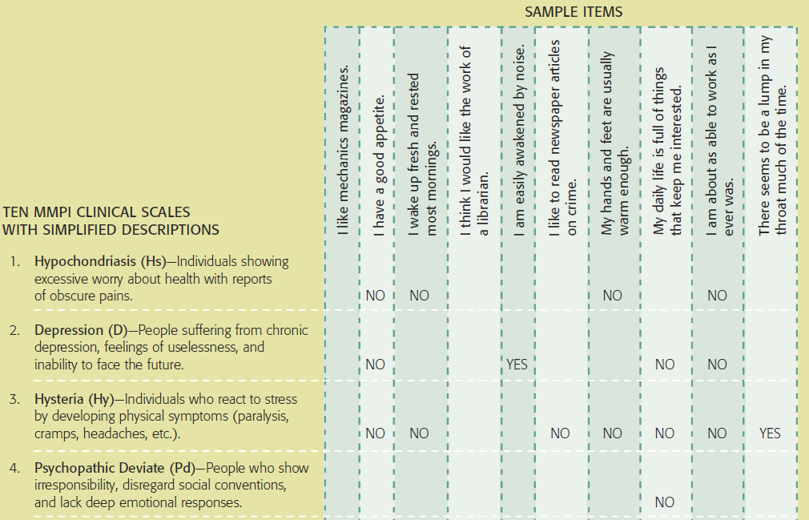
The Ten MMPI-2 Clinical Scales and Sample MMPI-2 Tests (Partial)
Notes:
Figure 3.1 The 10 MMPI- 2 Clinical Scales and Sample MMPI- 2 Tests
Shown here are the MMPI- 2 clinical scales and a few of the items that appear on them. As an example, answering “no” or “false” (rather than “yes” or “true”) to the item “I have a good appetite” would result in a higher scale score for hypochondriasis, depression, and hysteria. These sample questions do not pertain to some of the MMPI categories such as paranoia, hypomania, and social introversion.

Slide 16
Intelligence Tests
Primary functions
Obtain intelligence quotient (IQ), or level of cognitive functioning
Provide clinical data: Strength and Weaknesses
Wechsler scales
For Children and Adults
Stanford-Binet scales
Used for to assess IQ deficits & giftedness
Original intelligence test

Slide 17
Criticisms of Intelligence Tests
Fail to consider the effects of culture, poverty, discrimination, and oppression
Do not consider multidimensional intelligences; yields uniform IQ
Poor predictive value
Do not accurately predict future success or achievement
Motivation and work ethic may matter more

Slide 18
Tests for Cognitive Impairment
Bender-Gestalt Visual-Motor Test
Involves copying geometric designs
Halstead-Reitan Neuropsychological Test Battery
Differentiates patients with brain damage
Can provide valuable information about the type and location of the damage

Slide 19
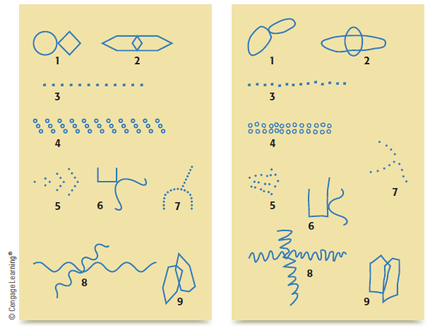
The Nine Bender Designs
Notes:
Figure 3.3 The nine Bender designs The figures presented to participants are shown on the left. The distorted figures drawn by participants that are possibly indicative of brain damage are shown on the right.

Slide 20
Diagnosing Mental Disorders
Psychiatric classification system
Similar to a catalogue of Mental Health Disorders
Criteria of Symptoms associated with each
Comprehensive range of disorders
Instructions on diagnostic decision making; improve inter-rater reliability

Slide 21
Diagnostic and Statistical Manual of Mental Disorders (DSM)
Inspired by World Health Organization International Classification of Diseases (ICD-10)
Widely used classification system
DSM-I (1952): Identified 106 mental disorders
DSM-II (1968): Identified 182 disorders
Revisions (DSM-II, DSM-III, DSM-III-R, DSM-IV, DSM-5) increase reliability and validity

Slide 22
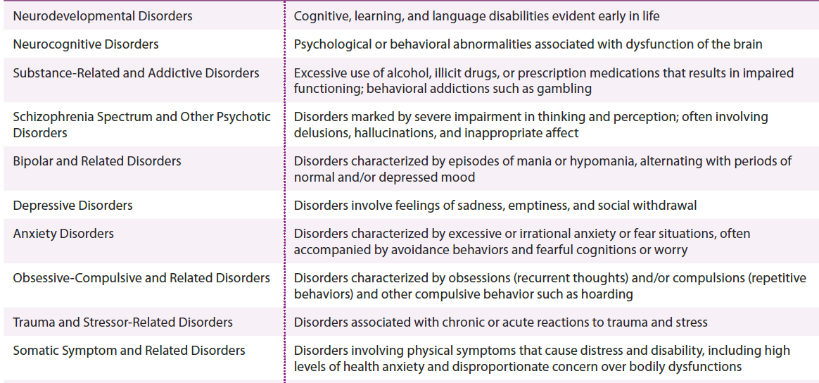
DSM-5 Disorders – Categories and Features
Notes:
Table 3.3 DSM-5 disorders (continues)

Slide 23
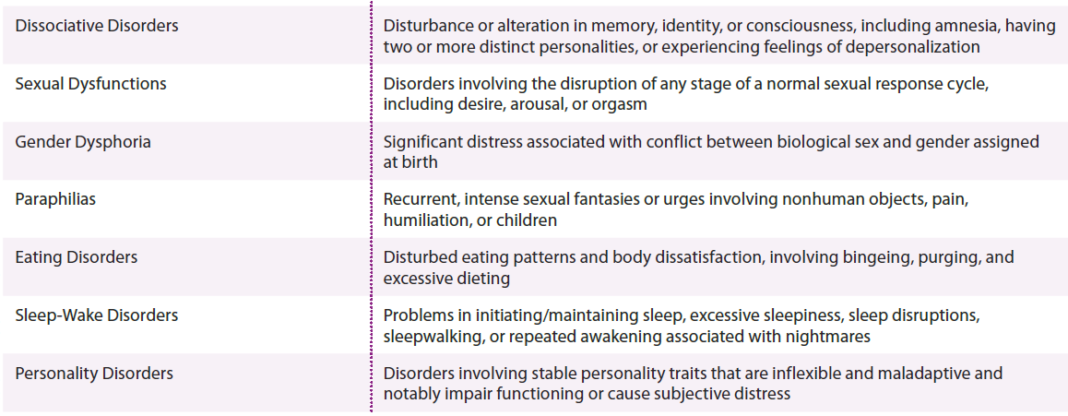
DSM-5 Disorders – Categories and Features (cont’d.)
Notes:
Table 3.3 DSM-5 disorders (cont’d.)

Slide 24
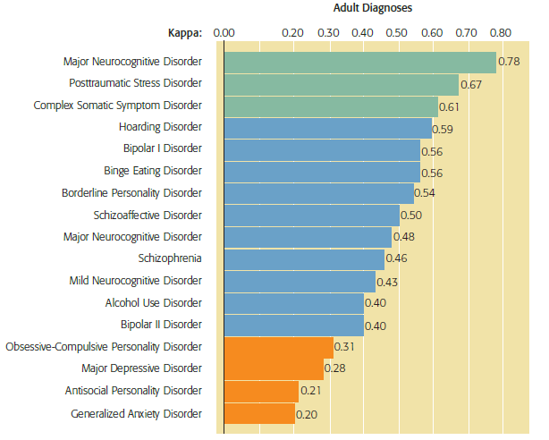
Interrater Reliability of DSM-5 Diagnostic Categories
Notes:
Figure 3.4 Interrater Reliability of DSM-5 Diagnostic Categories During the DSM-5 field trials, individuals undergoing diagnostic evaluation were assessed by two clinicians; each clinician interviewed the person and made a diagnosis. Kappa scores from the field trials (which take into account diagnostic agreement between clinicians and data regarding the frequency of a diagnosis) varied significantly for both adult and child/adolescent diagnostic categories.

Slide 25
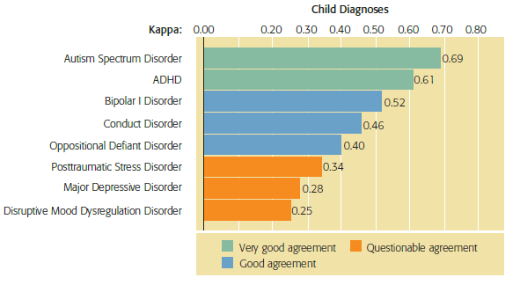
Interrater Reliability of DSM-5 Diagnostic Categories (cont’d.)
Notes:
Figure 3.4 Interrater Reliability of DSM-5 Diagnostic Categories During the DSM-5 field trials, individuals undergoing diagnostic evaluation were assessed by two clinicians; each clinician interviewed the person and made a diagnosis. Kappa scores from the field trials (which take into account diagnostic agreement between clinicians and data regarding the frequency of a diagnosis) varied significantly for both adult and child/adolescent diagnostic categories.

Slide 26
Final Version of the DSM-5
Remains a categorical system with exceptions
Exceptions to DSM-5 categorical system
Autism and Asperger’s merged: “spectrum”
Bereavement can be part of clinical depr
Substance use and dependency not differentiated
Subtle differentiation for mood disorders

Slide 27
Other Attributes of the DSM-5
Subtypes: e.g., anorexia binge-purge type
Specifiers: severity level, suicidality, psychosis
Remission: partial or full
Comorbidity
Presence of two or more disorders in the same person

Slide 28
Cultural Factors in Assessment
Determining whether a behavior is consistent with cultural norms
Responsibility of the clinician
Bias
DSM-5 includes guidelines for conducting a cultural assessment
16 questions (identity, coping, resources, and client-clinician cultural differences, explore cultural norms, perception of sx)

Slide 29
Review
How do we know if psychological tests and evaluation procedures are accurate?
How do mental health professionals evaluate a client’s mental health?
How do professionals make a psychiatric diagnosis?
What changes are occurring that will affect assessment?

Slide 30
Conducting the Mental Status Exam
Group Exercise:
Choose roles: client, clinician, & observer
Client: patient profile (handout)
Observer: evaluate the effectiveness of questions, critique outcome; consider possible dx
Therapist: Ask open and closed ended questions to assess for the major dimensions of a MSE (on website)

