Slide 1
Understanding Anxiety Disorders
Symptoms:
Affective: Anxiety
Behavioral: Avoidance; Body Tension; Stress Response
Cognitive: Irrational fears; worries
Dysfunction Criteria: Symptoms interfere with an individual’s day-to-day functioning

Slide 2
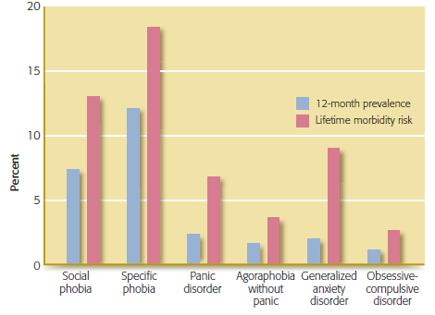
Prevalence and Lifetime Morbidity Risk of Anxiety Disorders in the U.S.
Notes:
Figure 5.1 12-month Prevalence and Lifetime Morbidity Risk of Anxiety Disorders in Individuals 13 and Older in the United States
*Lifetime morbidity risk is the estimate of the likelihood of developing an anxiety disorder based on the age of the individual during the survey with the risk period for the specific disorder.

Slide 3
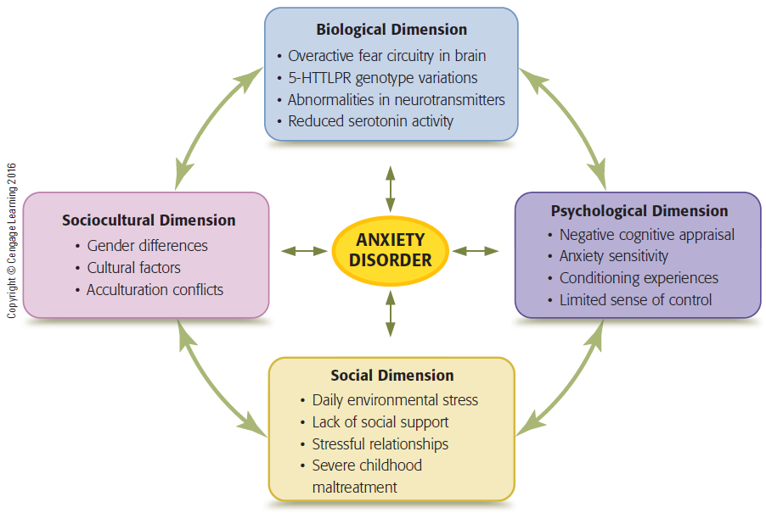
Biopsychosocial Model of Anxiety Disorders
Notes:
Figure 5.2 Multipath Model of Anxiety Disorders
The dimensions interact with one another and combine in different ways to result in a specific anxiety disorder. The importance and influence of each dimension vary from individual to individual.

Slide 4
Medical Causes
Ruling out medical or physical causes of anxiety symptoms is important
Hyperthyroidism
Cardiac arrhythmias
Asthma medications
Stimulants
Withdrawal from alcohol
Request a full physical before dx; can co-occur

Slide 5
Fear in the Brain
Amygdala
Plays a central role in triggering state of fear or anxiety
Enlarged in chronically anxious
Hijacks higher brain processes-irrationality
Hypothalamus: fight or flight response
All or nothing Stress Response
Not a rational process
Instinctive, Reactive

Slide 6
Biological Influences
Serotonin (a neurotransmitter) linked to depression and anxiety
Multiple genes affect vulnerability
Inherit Risk only; environment a factor
Higher incidence of Anxiety disorders in 1st degree relative
Nature vs Nurture Debate: Which is it?

Slide 7
Interactions Between Biological and Environmental Influences
Children with Anxiety
Behavioral inhibition linked to family stressors (e.g., domestic violence) and a genetic predisposition combined
Parents modeling avoidance as means of coping with anxiety
Living in a chaotic household, unpredictability, uncertainty

Slide 8
Psychological Risks
Risk Factors for Anxiety
Negative appraisal: expecting the worst
Interpreting events as threatening
Skill of reappraisal: decrease likelihood of anx
Looking at a situation from various perspectives
Minimize negative responses
Question: How do individuals learn the ability to appraise situations flexibly or negatively?

Slide 9
Social and Sociocultural Risk Factors
Daily stress can produce anxiety
Noise, traffic, work stress, lack of green space, safety, loneliness, access to resources
Chronic Stress
Poverty, traumatic events, adverse working conditions, limited social support, and acculturation
Culture can influence how anxiety is expressed (how much affect, which sx prominent, etc.)

Slide 10
Cultural Idioms of Distress
Culture can influence how anxiety is expressed
“Ataque de Nervious”(Latin Amer) – anxiety, paralysis, pain; represents a range of disorders from no dx to severe psychosis
“Shenjing Shuairuo” (Mand Chin): weakness of the nervous system; numbing, mental fatigue, irritability, ruminating thoughts, excitement/conflicted; related to no dx to somatic sx disorder, depression

Slide 11
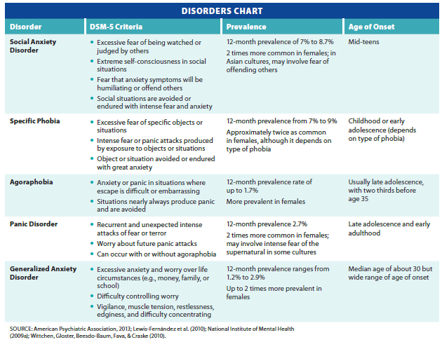
Anxiety Disorders
Notes:
Table 5.1 Anxiety disorders

Slide 12
Phobias
Strong, persistent, unwarranted fear of a specific object or situation
Extreme anxiety or panic is expressed when phobic stimulus is encountered
Most adults recognize fear is irrational, but children may not
Most common mental disorder in United States

Slide 13
Specific Phobia
https://www.youtube.com/watch?v=1h3Dh5QAD7w
(Patient suffering from Clown Phobia)
Primary types
Living creatures (example: spiders)
Environmental conditions (example: heights)
Blood/injection or injury (example: needles)
Situational factors (example: flying)

Slide 14
Agoraphobia
Intense fear of at least two of the following
Being outside of the home alone
Traveling via public transportation
Being in open spaces
Being in stores or theatres
Standing in line or being in a crowd
Situations are feared because escape or help may not be readily available

Slide 15
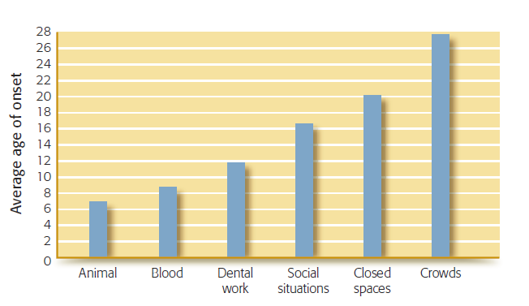
Phobia Onset
Notes:
Figure 5.4 Phobia onset This graph illustrates the average ages at which 370 people said their phobias began. Animal phobias began during childhood, whereas the onset of agoraphobia did not occur until the individuals were in their late twenties. What accounts for the differences reported in the age of onset for the types of phobias?
Source : Based on Öst (1987, 1992)

Slide 16
Etiology of Phobias
All phobia subtypes have moderate genetic contribution
31 percent heritability
Psychological dimension
Classical conditioning
Little Albert (Watson) 1920s: pairing rabbit(cs) with loud noise(ucs)
Chemotherapy: pairing strong flavored drink with tx
(helps avoid aversion to normal dietary foods)
Observational learning or modeling

Slide 17
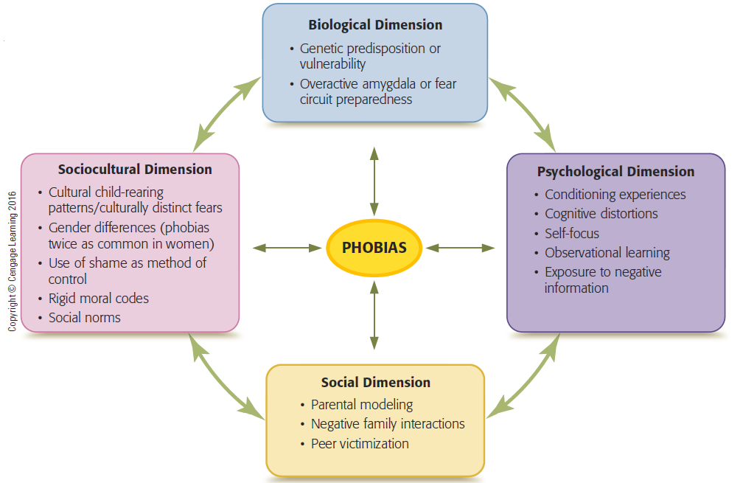
Biopsychosocial Model of Phobias
Notes:
Figure 5.5 Multipath model of phobias
The dimensions interact with one another and combine in different ways to result in a phobia.

Slide 18
Social Anxiety Disorder
Intense fear of negative evaluation
Often comorbid with major depressive disorder and substance-use disorders
Women 2x as likely as men to have social anxiety disorder
Can be chronic and disabling

Slide 19
Causes of Social Anxiety
Parental behaviors influence development of social anxiety in children
Overprotection
Lack of support for independence
Punitive maternal parenting style
Negative family interactions and family stress
Associated with social anxiety in middle childhood

Slide 20
Sociocultural Dimension
Females more likely to have phobias
Some objects of phobia trigger both fear and disgust responses
Disgust response stronger in females
Social anxiety disorder (SAD) more common in collectivistic cultures
Individual behaviors seen to reflect on entire family or group
Q: Why?

Slide 21
Psychiatric Treatment of Phobias
Medications with efficacy for SAD
Benzodiazepines - sedating
Examples: Ativan, Xanax, Valium
Can produce dependence
SSRIs
Often prescribed for chronic forms of anxiety
Beta-blockers – shuts off symp nerv sys
D-cycloserine (Seromycin) antibiotic used to tx Tuberculosis – affects area of brain that unlearns fear response

Slide 22
Cognitive-Behavioral Treatments
Exposure therapy
Flooding
Systematic desensitization
Gradual exposure with relaxation
In vivo or imagined
Cognitive restructuring
Identifying and changing irrational thoughts
Modeling therapy
Viewing another person’s successful interactions with the subject of the phobia

Slide 23
Panic Disorder
Recurrent, unexpected panic attacks
Combined with apprehension about having another attack or behavior changes designed to avoid having another attack
Reactions present for one month or more
Twelve month prevalence rate in the U.S. is 2.7 percent
- Women 2x Men
https://www.youtube.com/watch?v=dzA4wFHBiEI

Slide 24
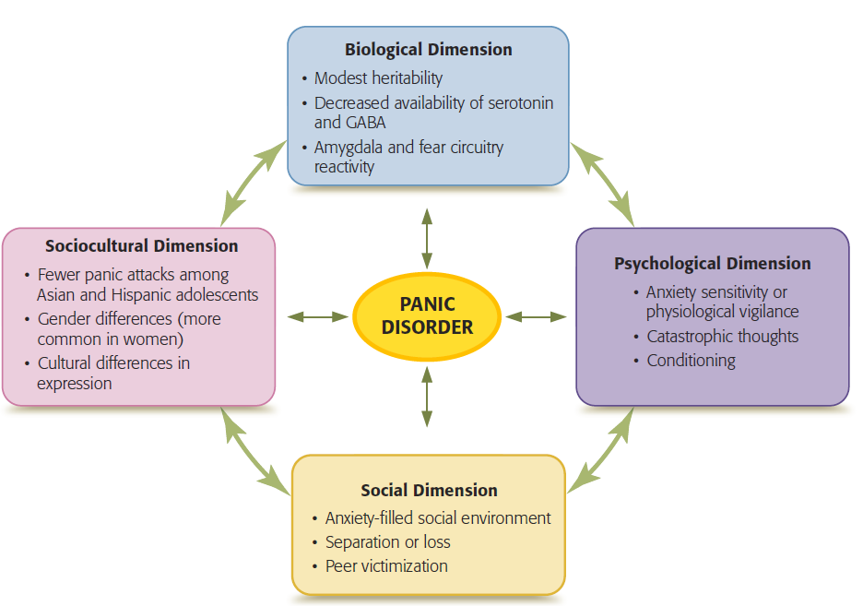
Biopsychosocial Model of Panic Disorder
Notes:
Figure 5.6 Multipath Model of Panic Disorder
The dimensions interact with one another and combine in different ways to result in panic disorder.

Slide 25
Etiology of a Panic Disorder
Biological dimension
Heritability is 32 percent
SSRIs have been shown to be effective
Designed to increase serotonin levels
Psychological dimension
Heightened fear responses to bodily sensations
Trauma hx can heighten the sensitivity

Slide 26
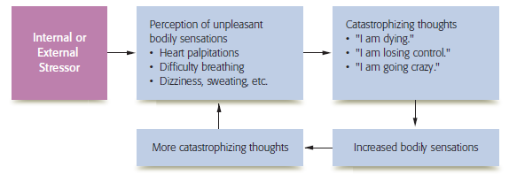
Role of Cognitions in Panic Attacks
Notes:
Figure 5.7 Role of Cognitions in Panic Attacks
A positive feedback loop between cognitions and somatic symptoms leads to panic attacks.

Slide 27
Sociocultural Risk Factors of Panic Disorder
Contributing factors
Stressful childhood
Separation anxiety, family conflicts, school problems, or loss of a loved one
Asian American and Latino/Hispanic adolescents less likely to panic
Higher anxiety sensitivity for European American adolescents
European Amer more likely to have panic attacks
Accuracy of incidence statistic unclear

Slide 28
Psychiatric Treatment of Panic Disorder
Benzodiazepines
Antidepressants
Beta-blockers
High relapse rates after cessation of drug therapy

Slide 29
Cognitive-Behavioral Treatment of Panic Disorder
Promotes self-efficacy
General steps
Educating the client about panic disorder
Identifying and correcting catastrophic thinking
Teaching client to self-induce physiological symptoms in order to extinguish the conditioning
Encouraging client to face the symptoms

Slide 30
Generalized Anxiety Disorder (GAD)
Persistent anxiety and excessive worry over life circumstances
DSM-5 diagnostic criteria
Symptoms must be present on the majority of days for six months
Causes significant impairment in life activities
Develops gradually
Often begins in childhood or adolescence

Slide 31
Etiology of Generalized Anxiety Disorder
Biological dimension
Small but significant heritability factor
May disrupt prefrontal cortex modulation of response to threatening situations
Psychological dimension
Cognitive theories: Distortive Thinking underlies persistent worries, not able to reality test thinking

Slide 32
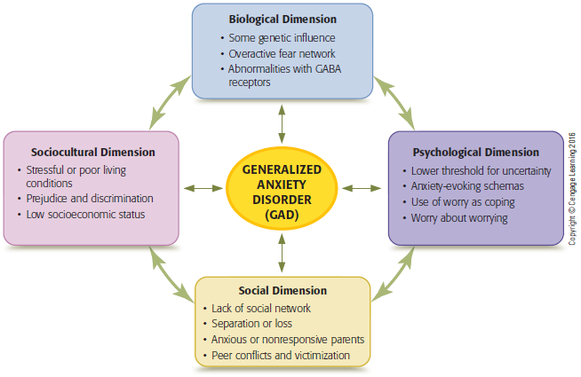
Biopsychosoical Model of Generalized Anxiety Disorder (GAD)
Notes:
Figure 5.8 Multipath Model of Generalized Anxiety Disorder (GAD)
The dimensions interact with one another and combine in different ways to result in generalized anxiety disorder (GAD).

Slide 33
Psychological Dimension of GAD
Negative schemas play a key role
Ambiguous or positive situations seen negatively
Aspects of worrying
Poor Coping
Constantly generate solutions to “what if” scenarios
Worry about worry

Slide 34
Social and Sociocultural Dimensions of GAD
Mothers with anxiety
may be less engaged with their infants
Associated with increased likelihood of child developing GAD
Stressors that influence GAD
Poverty, poor housing, prejudice, and discrimination
Peer relationship conflicts

Slide 35
Treatment of Generalized Anxiety Disorder
Drug therapy
Benzodiazepines
Issues with dependence
Antidepressants
Lower less risk of dependence
Cognitive-behavioral therapy
Effective psychological treatment
60 percent showed significant symptom reduction that persisted 12 months after treatment

Slide 36
Obsessive-Compulsive and Related Disorders
Obsessive-compulsive disorder
Obessions: Consistent, anxiety producing thoughts or images: Immoral thoughts/images or Catastrophic thoughts/images
Compulsions: Overwhelming need to engage in activities or mental acts to prevent feared event
Washing - ritualistic behaviors
Checking - ritualistic thoughts
Order of activity
https://www.youtube.com/watch?v=KOami82xKec&t=22s

Slide 37
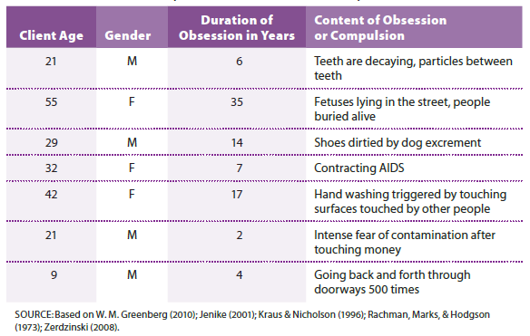
Clinical Examples of Obsessions and Compulsions
Notes:
Table 5.5 Clinical examples of obsessions and compulsions

Slide 38
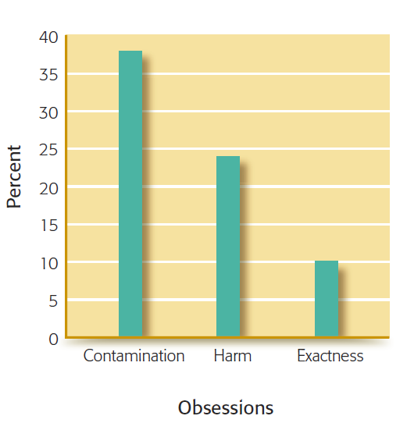
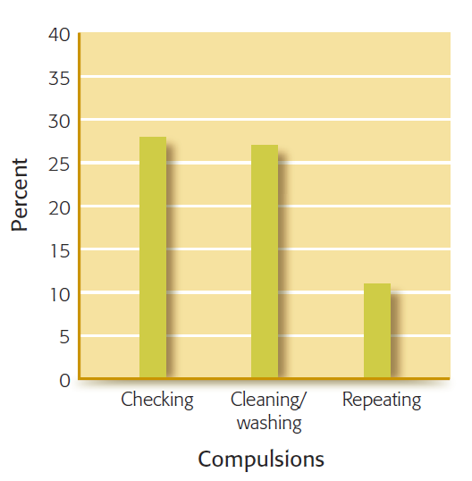
Common Obsessions and Compulsions
Notes:
Figure 5.9 Common Obsessions and Compulsions
About half of the clients reported both obsessions and compulsions. Twenty-five percent believed that their symptoms were reasonable.

Slide 39
Other Types of OCD-Related Disorders
Body dysmorphic disorder
Preoccupation with a perceived physical defect
Symptoms cause significant distress or impairment in life activities
Hair-pulling disorder
Recurrent and frequent hair-pulling despite repeated attempts to stop
Skin-picking disorder
Results in skin lesions

Slide 40
Etiology of Obsessive-Compulsive and Related Disorders
Heredity is involved
Impairment in:
Decision-making
Planning
Mental flexibility : thought-action fusion
Increased metabolic activity in frontal lobe of left hemisphere of the brain

Slide 41
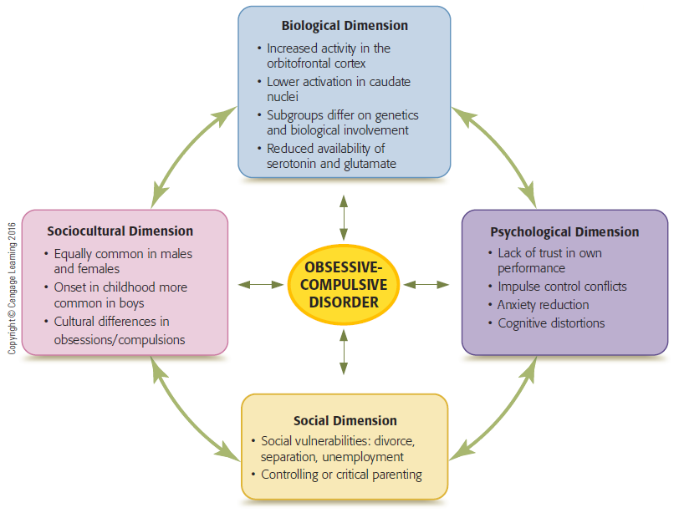
Biopsychosocial Model of Obsessive-Compulsive Disorder
Notes:
Figure 5.11 Multipath model of obsessive-compulsive disorder
The dimensions interact with one another and combine in different ways to result in obsessive-compulsive disorder.

Slide 42
Psychological Dimension of OCD
Behavioral perspective
Obsessive-compulsive behaviors develop because they reduce anxiety
Self-Reinforcing
Cognitive characteristics
Overestimate risk
Perceived Control
Intolerance of uncertainty

Slide 43
Social and Sociocultural Dimensions
Family variables
Controlling, overly critical parenting styles
Low parental warmth
Discouragement of autonomy
Reactions of family members to OCD can increase symptom severity
Culture may affect how symptoms are expressed

Slide 44
Treatment of Obsessive-Compulsive and Related Disorders
Biological treatments
SSRI antidepressants
Only about 60 percent respond to this therapy
Outcome improved when combined with behavioral interventions
Cognitive- Behavioral treatments
Flooding
Response prevention
Cognitive Restructuring of Distortive Beliefs (guilt for thought, thought-action fusion)

Slide 45
Review
According to the multipath model, how are biological, psychological, social, and sociocultural factors involved in the development of anxiety disorders?
What are phobias, what contributes to their development, and how are they treated?
What is panic disorder, what produces it, and how is it treated?

Slide 46
Review (cont’d.)
What is generalized anxiety disorder, what are its causes, and how is it treated?
What are characteristics of obsessive-compulsive and related disorders, what causes these disorders, and how are they treated?

Slide 47
Anxiety Management
Diaphragmatic Breathing
https://www.youtube.com/watch?v=gAkjx25o4eI
Mindfulness Exercise
Body Scan
Progressive Relaxation
Safe Place Visualization

