Slide 1
Trauma Disorders and Treatment
What is Trauma?
1. The Stress Response:
Hypothalamus- “Fight or Flight” overreactive
Constant Hypervigilance
Avoidance of Stimuli reminders
Ruminative Thoughts/Images of Trauma
Hippocampus: Memory
Trauma: creates Flashbulb memories
“Stuck in Time
` Flashbacks
Re-living Traumatic events
Hallucinations/Delusions
Adrenals: Cortisol and Epinephrine overload

Slide 2
PTSD Case Examples
Soldiers in War
Adult PTSD
https://www.youtube.com/watch?v=-Fc6_aTnRXQ
Childhood Abuse Case: Patricia

Slide 3
Trauma- and Stressor-Related Disorders
Types of disorders:
Adjustment Disorder
Acute stress Disorder
Post-traumatic stress Disorder
Complex PTSD: newly researched dx; childhood or chronic trauma

Slide 4
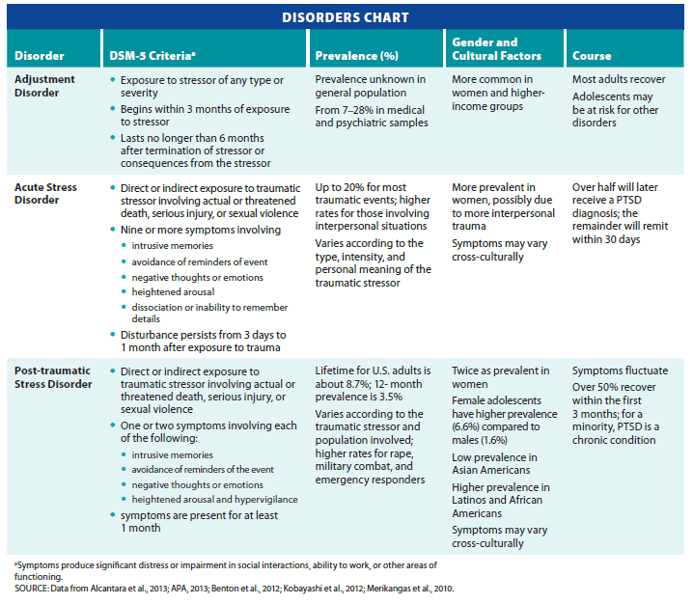
Trauma- and Stressor-Related Disorders
Notes:
Table 6.1 Trauma- and Stressor-Related Disorders

Slide 5
Trauma-Related Disorders
Typical outcomes after exposure to traumatic incidents:
Resilience
Recovery
Initial distress with symptom reduction over time
Delayed symptoms: Case of Incest
Few initial symptoms
Increasing symptoms over time
Chronic symptoms

Slide 6
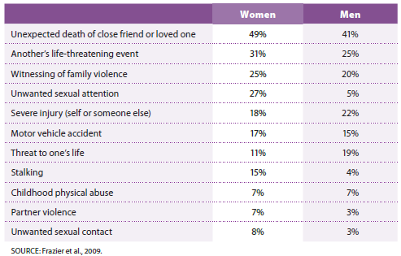
College Student’s Lifetime Exposure to Traumatic Events
Notes:
Table 6.2 Undergraduates’ lifetime exposure to traumatic events

Slide 7
General Population: Traumatic Events Associated with ASD and PTSD
Combat
Sexual assaults
Violent crime or domestic violence
Sexual harassment
Natural disasters
Car accidents or work-related accidents

Slide 8
Factors Increase Risk of trauma
Factors associated with increased risk
More severe physical injuries
Stroke or injury to the head or extremities
Major burn injuries
Rape or sexual assault
Intentional trauma/ Hx of Trauma
Close relationship with the perpetrator of sexual assault

Slide 9
Additional Risk Factors
Existing Mood Disorder Dx
Anxiety and Depression, Hostility, and Anger
Hx of Trauma/ current PTSD dx
Negative/Anxious expectations/events

Slide 10
Sociocultural Dimension of trauma
Ethnic differences
Different exposure to previous trauma
NonAnglo-Amer – more somatic/disassoc>avoidance/numbing
Gender Differences: Women are twice as likely as men to suffer a trauma-related disorder
Female police officers less likely than civilian women to have PTSD symptoms
Why?

Slide 11
Resiliency in midst of major Stressors
Factors that create “hardiness” or “resiliency”
Social Support
Strong Family Network
Religiosity/ Spirituality
Social Skills/bonding
Sense of Purpose
Sense of Humor
Hx of Secure Attachment with Parent

Slide 12
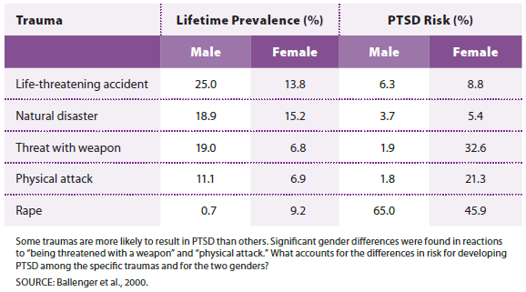
Lifetime Prevalence of Exposure to Stressors by Gender and PTSD Risk
Notes:
Table 6.3 Lifetime prevalence of exposure to stressors by gender and PTSD risk

Slide 13
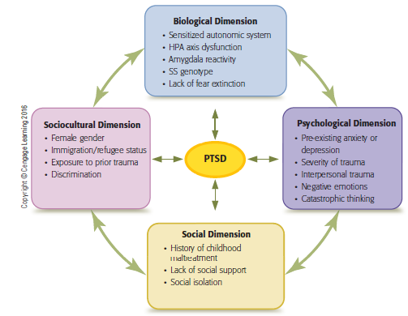
Biopsychosocial Model for PTSD
Notes:
Figure 6.1 Multipath model for post-traumatic stress disorder
The dimensions interact with one another and combine in different ways to result in posttraumatic stress disorder (PTSD).

Slide 14
Medication Treatment for Trauma
Antidepressants
Effective in fewer than 60 percent of individuals
Only 20-30 percent show full recovery
D-cycloserine (Seromycin – antibiotic tx Tuberculosis)
Mixed results
Prazosin (hypertension medication)-blocks sympathetic ns
Propranolol (beta-blocker) – blocks sympathetic ns
may offer little benefit

Slide 15
Anxiety Management Techniques
Diaphragmatic Breathing
https://www.youtube.com/watch?v=gAkjx25o4eI
Mindfulness Exercise
Body Scan
Progressive Relaxation
Safe Place Visualization

Slide 16
Psychotherapy for Trauma
Prolonged exposure therapy (PE)
Involves exposure to trauma-related cues
Case Example: Incest Case (handout)
Goal: Reduce Anx/Avoidance assoc with Trauma cues
Cognitive-behavioral therapy (CBT)
Involves identifying and challenging dysfunctional cognitions

Slide 17
Psychotherapy treatments
Eye movement desensitization and reprocessing (EMDR)
Nontraditional therapy
Involves visualizing traumatic experience while following a therapist’s fingers moving side to side
Class Demonstration: “Tapping” – Lateral stimulation

Slide 18
Group Work: Case Analysis
Case of Annie
Identify Stressor(s)
Identify Symptoms and Diagnosis
How can exposure therapy be implemented in this case?

Slide 19
Psychological Factors Affecting Medical Conditions
Chronic Stress
Chronic Illnesses:
Cardiovascular Disease;
Heart Attack
Strokes
Atherosclerosis

Slide 20
Coronary Heart Disease
Stress Response:
Epinephrine
Lack of Recovery of Blood Vessels- creating pits/plaque build up
Cardiac arteries narrow
Results in complete or partial blockage of flow of blood and oxygen to heart
Some risk factors for Heart Disease
Poor eating habits
Obesity and lack of physical activity
Hypertension
Stress
Depression

Slide 21
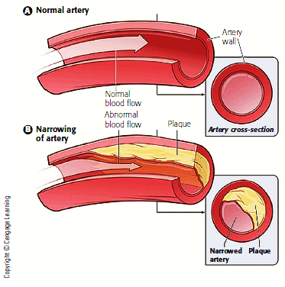
Atherosclerosis
Notes:
Figure 6.3 Atherosclerosis
Atherosclerosis occurs when fat, cholesterol, and other substances build up in arteries and form a hard structure called plaque. The buildup of plaque and resultant narrowing of the arteries can result in arteriosclerosis, or hardening of the arteries, a condition that can reduce or even stop blood flow to tissues and major organs.

Slide 22
Hypertension
Strokes : a leading cause of death
Symptoms are difficult to recognize : “silent killer”
Related to Chronic Stress
Poor Coping
Hostility/Unexpressed Anger highly increases risk
Stress-Management key part of tx

Slide 23
Types of Headaches
Migraine headaches
Result from constriction of the cranial arteries
Pressure on nearby nerves produces moderate to severe pain
Often accompanied by nausea and vomiting
Tension headaches
Stress creates a prolonged contraction of scalp and neck muscles
Results in vascular constriction and steady pain

Slide 24
Cluster Headaches
Excruciating stabbing or burning sensations located in the eye or cheek
Pain so severe that 55 percent report suicidal thoughts
Attacks have a rapid onset
15 minutes to three hours in duration
End abruptly
Headaches preceded by aura in about 20 percent of cases

Slide 25
Asthma
Chronic inflammatory disease of the lungs
Stress or other triggers cause excessive mucus secretion
Spasms and swelling of the airways, which reduces the amount of air that can be inhaled
Symptoms range from mild to severe

Slide 26
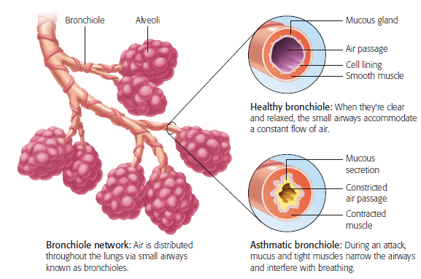
An Asthma Attack
Notes:
Figure 6.7 An asthma attack
Asthma attacks and deaths have increased dramatically since the 1980s.

Slide 27
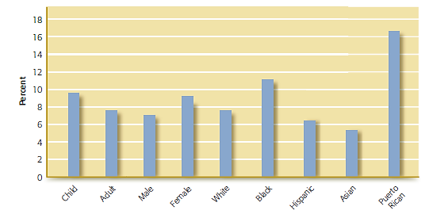
Asthma Prevalence
Notes:
Figure 6.8 Asthma prevalence
This figure shows the prevalence of asthma among adults and children, men and women, and members of different ethnic groups. Of these groups, Puerto Ricans, African Americans, females, and children appear to be especially vulnerable.

Slide 28
Stress and the Immune System
Stress – shuts off the long-term survival fx and focus on immediate survival
Purpose – survive acute physical stressors
Appears to decrease immune system’s efficiency
Results in more susceptibility to chronic disease
Stress response involves release of hormones (such as cortisol) that impair immune functioning
Chronic stress accelerates disease progression

Slide 29
Etiological Influences on Physical Disorders
Biological dimension
Stressors can dysregulate physiological processes in the brain and body
Release of norepinephrine, epinephrine, and cortisol – shuts down immune fx, rest fx, digestive fx, long-term health
Early environmental influences may produce changes in stress-response systems
Negative Parental Factors – unpredictability, safety

Slide 30
Psychological Dimension
Psychological and personality characteristics can influence health status
Positive emotions help regulate stress reactions: Optimism, social support, active coping
Negative emotions accentuate the stress response; anxiety/depression increase risk of death
Commitment, control, and openness to challenge associated with thriving through stressful situations: “hardiness”

Slide 31
Sociocultural Dimension to Health
Women are more likely to be impacted by stress
Due to care-giving role for children, parents, and partners
More likely to live in poverty
Exposure to racism and discrimination
Can Create PTSD sx
Coping skills, resources,social support mitigate vascular reactivity to racism

Slide 32
Treatment of Stress-Related Disorders
Relaxation training
Learn to relax muscles of the body under almost any circumstances
Biofeedback training
Learn to voluntarily control physiological processes in order to improve physical or mental health
Examples: heart rate, blood pressure

Slide 33
Review
What do we know about disorders caused by exposure to specific stressors or traumatic events?
In what ways can stress affect our physical health?

