Slide 1
Somatic and Dissociative Disorders
Psychosomatic Disorders

Slide 2
Somatic Symptom and Related Disorders
Prominent physical or bodily symptoms associated with significant impairment or distress
Actual physical illnesses may or may not be present

Slide 3
Somatic Symptom and Related Disorders
Somatic symptom disorder (SSD)
Illness anxiety disorder(“hypochondriasis”)
Conversion disorder (functional neurological symptom disorder)
Factitious disorder
Psychophysiological disorders (Chapter 6)

Slide 4
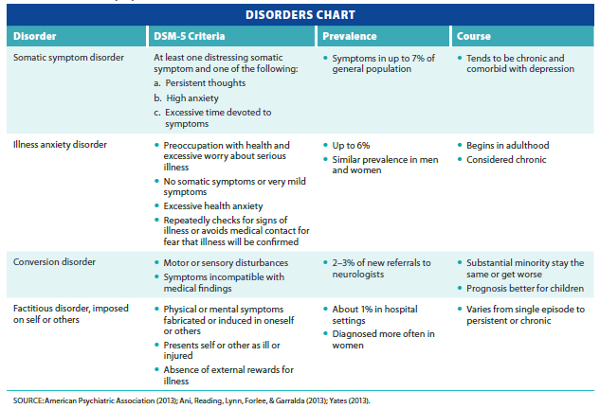
Diagnosis, Prevalence, and Course of Somatic Symptom and Related Disorders
Notes:
Table 7.1 Somatic symptom and related disorders

Slide 5
Somatic Symptom Disorder (SSD)
Pattern of reporting and reacting to pain or other distressing symptoms
Pattern occurs for at least six months
Involves persistent thoughts or high anxiety about the symptoms
Over focus on body aches, pains, discomforts
May have a medical dx (arthritis, asthma, back injury)

Slide 6
Illness Anxiety Disorder
Chronic pattern of preoccupation with having or contracting a serious illness
Pattern must be present for at least six months
Involves minimal or no somatic symptoms
High anxiety level
Strongly associated with a person’s cognitions

Slide 7
Conversion Disorder
Motor, sensory, or seizure-like symptoms
Inconsistent with any recognized medical disorder
Motor weakness and abnormal movements most common symptoms among children
Individuals not consciously faking symptoms
Believe problem is genuine

Slide 8
Factitious Disorder and Factitious Disorder Imposed on Another
Symptoms of physical or mental illness are deliberately induced or simulated with no apparent incentive
Individuals usually unaware of motive
Differs from malingering
Faking a disorder to achieve some goal, such as an insurance settlement

Slide 9
Factitious Disorder Imposed on Self
Presentation of oneself to others as ill or impaired
Through recurrent falsification or induction of physical symptoms
May include sabotaging or intentionally interfering with medical care
No obvious rewards except attention, support, and social relationships

Slide 10
Factitious Disorder Imposed on Another
Pattern of falsification of physical or psychological symptoms in another individual
In many cases, the individual is a mother who appears loving and attentive
Simultaneously sabotaging child’s health
Exp: Munchausen by Proxy
Diagnosis of this condition is difficult
Aaron: 3 years old

Slide 11
Biological Dimension of Somatic Disorders
Genetic factors – unclear heritability
Biological vulnerabilities
Heightened sensitivity to pain
Hypervigilance focus on bodily sensations
Dysregulated connectivity has been found in brain regions associated with symptoms
Neural connections normalize after successful treatment

Slide 12
Psychological Dimension of Somatic Disorders
Psychodynamic perspective
Symptoms seen as defense against awareness of unconscious emotional issues
Secondary gain - attention
Cognitive-behavioral perspective
Cause: reinforcement, modeling, cognitions
Illness identity reinforced
Family models reward for illness
Cognitions – illness makes them special

Slide 13
Social Dimension of Somatic Disorders
History of sexual abuse
Previous physical illness
Parents or family members with chronic physical illness
Parental attentiveness to somatic complaints

Slide 14
Treatment of Somatic Symptom Disorders
Biological
Antidepressant medications such as SSRIs reduce anxiety and depression
Medication rarely successful by itself
Psychological treatments
Understanding the client’s view of the problem
Demonstrating empathy
Explaining how physical sx can be stress related
Emotional pain manifesting as physical sx

Slide 15
Dissociative Disorders
Involve some sort of dissociation (separation) of a part of a person’s consciousness, memory, or identity
Types of dissociative disorders
Dissociative amnesia
Depersonalization/derealization disorder
Dissociative identity disorder (multiple personality)
Rare

Slide 16
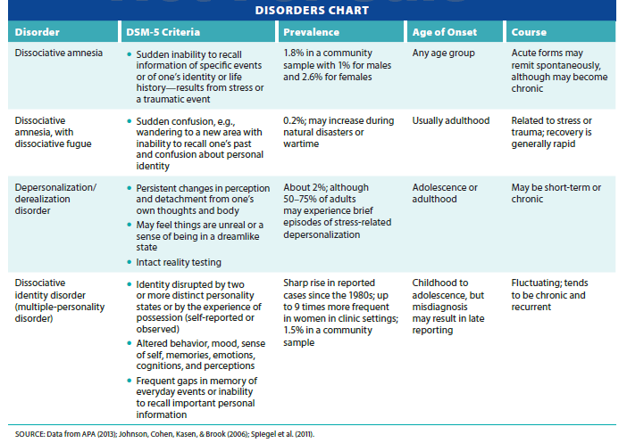
Summary of Dissociative Disorders
Notes:
Table 7.6 Dissociative disorders

Slide 17
Dissociative Amnesia
Partial or total loss of important personal information
May occur suddenly after traumatic event or stressful circumstances
Sexual Abuse/Physical Abuse
Life Threatening Trauma

Slide 18
Types of Dissociative Amnesia
Localized
Inability to recall a specific event or events
Systematized
Loss of memory for certain categories of information
Selective amnesia
Inability to remember certain details of an incident

Slide 19
Types of Dissociative Amnesia
Repressed memory
Amnesia may come to light only after recalling details of a traumatic event
Related to Overwhelming childhood trauma
Not all researchers believe in the validity of repressed memories
Possibility of feigning amnesia
Especially by criminals

Slide 20
Dissociative Fugue
Confusion over personal identity
Complete loss of memory of one’s entire life
Unexpected travel to a new location
Partial/complete assumption of new identity
Recovery is often abrupt and complete
Some individuals who have experienced several fugue episodes decide to wear personal identification
In case of future occurrence

Slide 21
Depersonalization/Derealization Disorder
Most common dissociative disorder
Characterized by feelings of unreality or being detached from oneself and the environment

Slide 22
Dissociative Identity Disorder (DID)
Formerly called multiple personality disorder
Disruption of identity
Caused by two or more personality states
Alterations in behaviors, attitudes, and emotions
Alternate personality state may appear to help deal with difficult situations
Legal debate over responsibility for actions

Slide 23
Etiology of Dissociative Disorders
Dissociation and memory
Disruptions in memory encoding due to acute stress
Atypical brain functioning has been documented
Permanent structural changes in brain due to trauma may play a role
Reduction in amygdalar volume

Slide 24
Documentary
Dissociative Identity Disorder
Please address the following: (take notes)
Is there a Common History?
What Types of Dissociative Amnesia?
Role of Therapy ?

Slide 25
Psychological Dimension of Dissociative Disorders
Psychodynamic theory
Repression protects the individual from painful memories or conflicts
Contemporary theory
Personality split develops because of the traumatic experience and the inability to deal with it
Difficult to formulate and test hypotheses

Slide 26
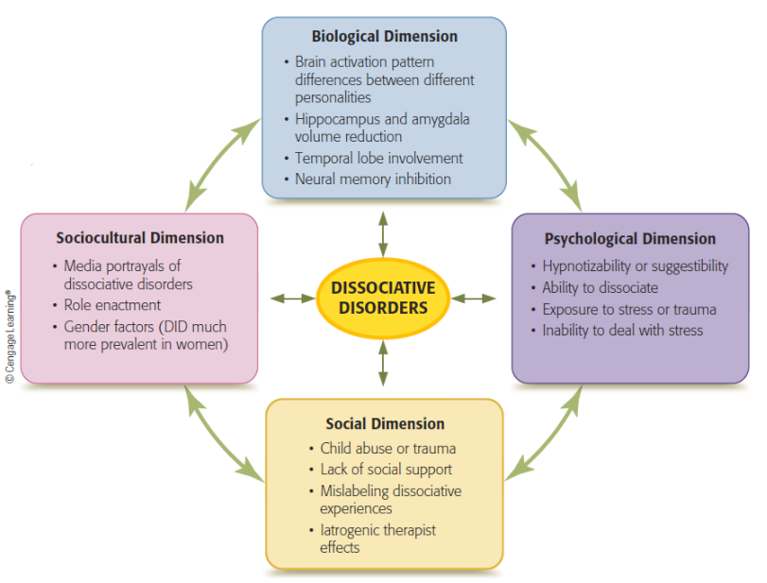
Multipath Model of Dissociative Disorders
Notes:
Figure 7.4 Multipath Model of Dissociative Disorders
The dimensions interact with one another and combine in different ways to result in a dissociative disorder.

Slide 27
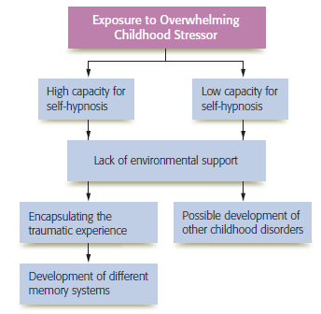
Post-Traumatic Model of DID
Notes:
Figure 7.5 The post-traumatic model of dissociative identity disorder
Note the importance of each of the factors in the development of dissociative identity disorder.

Slide 28
Sociocultural Dimensions of Dissociative Disorders
Sociocognitive model of DID
Individuals learn about DID through mass media and begin to act out its roles
Iatrogenic disorder
Condition unintentionally produced by a therapist through mechanisms placed on the client
Individuals who report dissociations score high on fantasy proneness and fantasy susceptibility

Slide 29
Treatment of Dissociative Disorders
Treating dissociative amnesia and dissociative fugue
Symptoms tend to abate spontaneously
Depression often associated with the fugue state
Reasonable approach: alleviate depression and stress
Antidepressants, cognitive-behavioral therapy, and stress management techniques

Slide 30
Treating Depersonalization/Derealization Disorder
Subject to spontaneous remission
Slower rate than dissociative amnesia and fugue
Treatment focuses on alleviating feelings of depression, anxiety, or fear of detachment symptoms
Antidepressants and antianxiety medications
Behavioral therapy
Reinforcement of appropriate responses

Slide 31
Treatment of DID
Trauma-focused therapy
Help individual develop healthier ways of dealing with stressors
Major goal is integration of personalities
Examples of steps
Working on safety issues, stabilization, and symptom reduction
Reducing cognitive distortions
Developing healthy relationships and practicing self-care

Slide 32
Review
What are the somatic symptom and related disorders and what do they have in common? What are the causes and treatments of these conditions?
What are dissociations? Why do they occur, and how are they treated?

