Slide 1
Mood Disorders
Major Depression and
Bipolar Disorders
Diagnosis and Treatment

Slide 2
Symptoms Associated with Depressive and Bipolar Disorders
NOT Temporary
Characteristics of mood symptoms
Affects a person’s well being, school, work, or social functioning
Continues for days, weeks, or months
Often occurs for no apparent reason
Involves extreme reactions not easily explained by individual’s circumstances

Slide 3
Symptoms of Depression
Cluster of Symptoms:
Affect
Behavioral
Cognitive
Physiological

Slide 4
Affective Symptoms of Depression
Depressed mood
Sadness, emptiness, hopelessness, worthlessness, or low self-esteem
Limited enthusiasm for things that previously brought joy and pleasure
Irritable, anxious, or worried

Slide 5
Cognitive Symptoms of Depression
Rumination
Continually thinking about certain topics or reviewing distressing events
Inability to concentrate, remember things, or make decisions
Frustration over inability to handle tasks normally managed without difficulty
Thoughts of suicide

Slide 6
Behavioral Symptoms of Depression
Fatigue, social withdrawal, and reduced motivation
May appear to not care about grooming or personal cleanliness
Possible agitation and restlessness
Daily activities take immense effort and feel overwhelming
May cry for no particular reason or in reaction to sadness, frustration, or anger

Slide 7
Physiological Symptoms of Depression
Appetite and weight changes
Sleep disturbance
Unexplained aches and pain
Aversion to sexual activity
Dramatically reduced sexual interest and arousal

Slide 8
Types of Depressive Disorders
Major depressive disorder
Persistent depressive disorder
Premenstrual dysphoric disorder

Slide 9
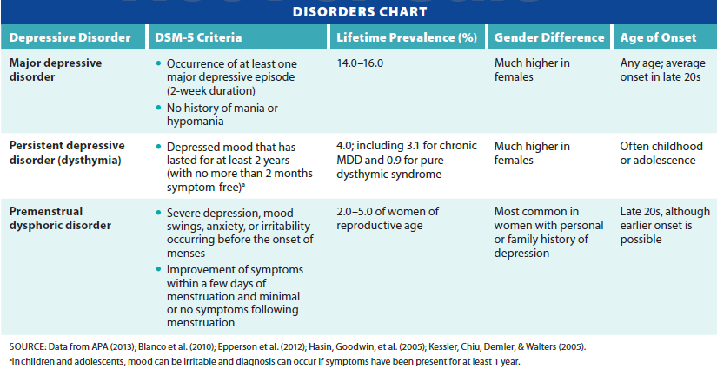
Summary of Depressive Disorders
Notes:
Table 8.2 Depressive disorders

Slide 10
DSM-5 Diagnostic Guidelines
Impairment in functioning for most of the day, and nearly every day, for two weeks or more
Depressed mood, sadness, or emptiness
Loss of pleasure in previously enjoyed activities
At least four additional changes in functioning:
Alteration in weight, atypical sleep patterns, restlessness, low energy, feelings of worthlessness, difficulty concentrating, or preoccupation with death or suicide

Slide 11
Seasonal Depression
Some individuals with MDD and bipolar report seasonal pattern to depressive episodes
Associated with changes in daylight as the seasons change
Occurs more often in Northern latitudes
Previously termed seasonal affective disorder
DSM-5 refers to MDD with a seasonal pattern

Slide 12
Symptoms of MDD with a Seasonal Pattern
Low energy
Increased sleep
Social withdrawal
Carbohydrate craving

Slide 13
Persistent Depressive Disorder
Symptoms are present most of the day for more days than not for a two-year period
Two or more of the following symptoms
Feelings of hopelessness
Low self-esteem
Poor appetite or overeating
Low energy or fatigue
Difficulty concentrating or making decisions
Sleeping too little or too much

Slide 14
Premenstrual Dysphoric Disorder
Serious symptoms of depression, irritability, and tension appearing the week before menstruation and remit soon after the onset of menses
At least five symptoms must be present
Significant depressed mood or mood swings, anger, irritability, anxiety, tension, difficulty concentrating, social withdrawal, food cravings, insomnia or excessive sleeping, feeling overwhelmed, and lack of energy

Slide 15
Depressive Reactions to Grief
Normal grief-related reactions
May last for several years
Frequency and intensity diminishes over time
Important to distinguish from MDD
Persistent complex bereavement disorder
Condition undergoing study as a diagnostic category in the DSM-5

Slide 16
Prevalence of Depressive Disorders
One of the most common psychiatric disorders
Second leading cause of disability worldwide
Women at significantly greater risk
Chronic disorder for many people
About 15 percent do not improve
Possibly due to undiagnosed bipolar disorder

Slide 17
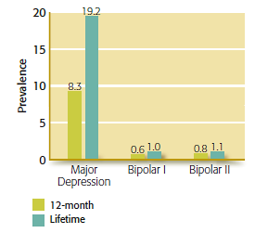
U.S. Prevalence of Major Depressive and Bipolar Disorders
Notes:
Figure 8.1 12-Month and Lifetime U.S. Prevalence of Major Depressive and Bipolar Disorders

Slide 18
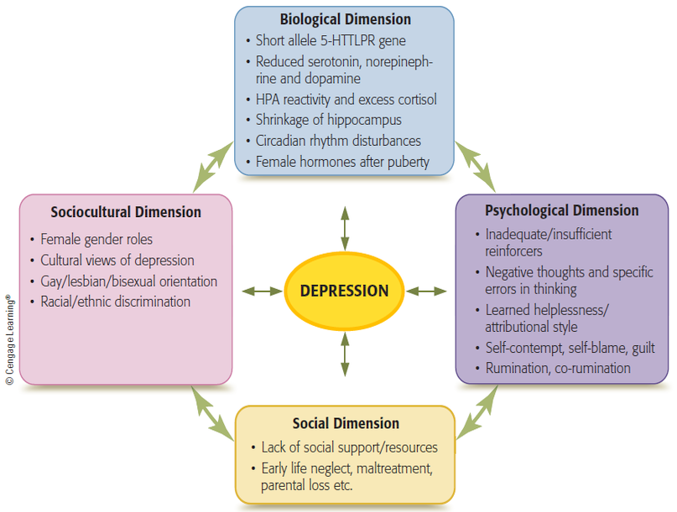
Biopsychosocial Model of Depression
Notes:
Figure 8.2 Multipath model of depression
The dimensions interact with one another and combine in different ways to result in depression.

Slide 19
Etiology of Depressive Disorders: Biological Dimension
Brain: Neurotransmitters linked to Depr
Low levels of neurotransmitters
Norepinephrine, serotonin, and dopamine
Selective Serotonin Reuptake Inhibitors (SSRIs – Prozac, Zoloft, Paxil, etc.)
Genes interact with environmental factors to produce depression
Depression tends to be familial
Stress-Diathesis Model

Slide 20
Stress and Depression
Overproduction of stress-related hormones: environment
People with depression have higher blood levels of cortisol
Exposure to stress during early development affects cortisol levels
High levels of cortisol can damage the hippocampus
Neurons die and fail to regenerate

Slide 21
Brain Changes with Depression
Depressed individuals have different patterns of neural activity
Reduced activation in the prefrontal cortex
Judgement and concentration affected
Increased activity in the amygdala
Reactive/anxious/rumination

Slide 22
Circadian Rhythm cause of Depression
Circadian rhythms: internal biological rhythms maintained by hormone melatonin
Play a role in depression, particularly seasonal depression: light therapy
Sleep disturbances, including irregularities in REM sleep, strongly linked to depression
Insomnia doubles the risk of developing depression
Sleeping for more than 10 hours per night also increases risk

Slide 23
Psychological Causes of Depression
Behavioral triggers
Social isolation
Lack of pleasureful activities
Few reinforcements available in the environment
The individual’s social skills and behavior

Slide 24
Cognitive Explanations in Depression
Irrational/Distortive thinking create Depr
Pessimism
Damaging self-views
“Learned Helplessness”
Negative Rumination
Constantly talking of problems or negative experiences
Increases depression risk, especially in girls

Slide 25
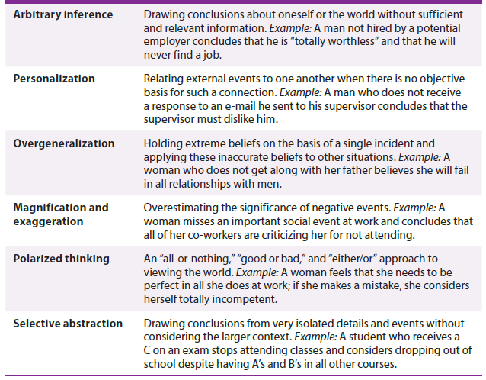
Beck’s Six Types of Faulty Thinking
Notes:
Table 8.4 Beck’s six types of faulty thinking

Slide 26
Social Dimension
Stressful interpersonal events increase risk of depression
Severe acute stress cause first episode
Failure to develop secure attachments and trusting relationships early in life
Prejudice/exclusion
Active, intentional social exclusion or rejection
Strongly linked with depressive symptoms

Slide 27
Gender and Depressive Disorders
Depression is far more common among women than among men
Evidence suggests difference is real, rather than an artifact of bias or tendency to self-report
Gender differences begin appearing during adolescence
Differences during phases of the menstrual cycle and in menopause

Slide 28
Treatment for Depression
Medication
Classes of antidepressants
Tricyclics, monoamine oxidase inhibitors, and serotonin-norepinephrine reuptake inhibitors
Atypical antidepressants
Circadian-related treatments
Sleep deprivation followed by sleep recovery
Light therapy

Slide 29
Brain Stimulation Therapies
Types
Electroconvulsive therapy (ECT)
Memory loss
Temporary
Treats recent mania only
Vagus nerve stimulation
Transcranial magnetic stimulation
Used for nonresponsive depression

Slide 30
Behavioral Treatments
Behavioral activation therapy
Increase pleasurable events
Improve Self-Mastery
Steps
Identifying and rating activities in terms of pleasure and self-confidence
Performing some of the selected activities
Setting up a structured schedule
Taking small steps to follow through

Slide 31
Interpersonal Psychotherapy
Evidence-based treatment focused on current interpersonal problems
Goals
Explore current relationships
Improving communication
Identifying role conflicts
Increasing social skills

Slide 32
Cognitive Therapy
Altering negative thought patterns
Identify thoughts associated with upsetting emotions
Distance self from these thoughts
Examine accuracy of beliefs
CBT - less likely to relapse than those treated with only antidepressants

Slide 33
Mindfulness-Based Cognitive Therapy
Self-soothe emotional pain: awareness of one’s present experience, thoughts, and feelings
Attitude of acceptance
Disrupt the cycle of negative thinking by focusing on present

Slide 34
Group Work: CBT Treatment Example
John is a 19-year-old college sophomore who comes into to see you at a college counseling center. He tells you that he has had trouble getting out of bed for the past three weeks. He doesn’t remember when he ate last and breaks down crying in session stating that he feels like a failure and is completely hopeless. When you question further, he states that he is failing all his classes and is avoiding seeing anyone. Much of this began after his ex-girlfriend broke up with him. He says that he is afraid no one will want to date him. He felt his girlfriend was only drawn to him because they were both “different”. He feels his friends are tired of him and his problems. He is also beginning to question whether he is cut out for the stresses of college.
Therapist: Help John identify the negative and irrational thinking that is perpetuating his depression. Use a thought record to evaluate the accuracy of the thought.

Slide 35
Bipolar Disorders
Involve episodes of hypomania and mania
Alternate with episodes of depression
Very strong genetic component
People with bipolar disorders respond to medications that have little effect with depressive disorders
Peak age of onset is teens and early twenties

Slide 36
Diagnosis and Classification of Bipolar Disorders (cont’d.)
Bipolar I
At least one manic episode (with or without a history of major depression)
Bipolar II
At least one major depressive episode and at least one hypomanic episode
Cyclothymic disorder
Milder hypomanic symptoms consistently interspersed with milder depressed moods for at least two years

Slide 37
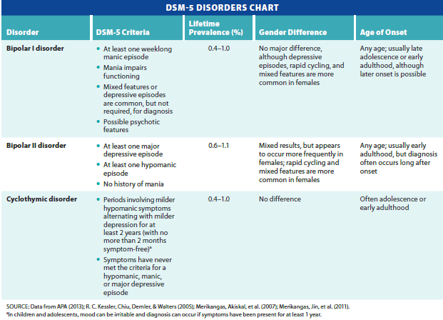
DSM-5 Disorders Chart
Notes:
Table 8-7 Bipolar disorders

Slide 38
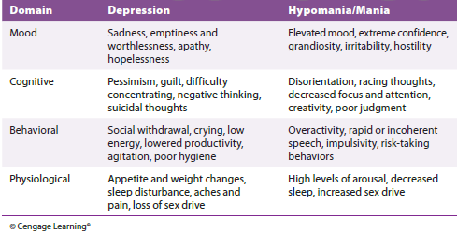
Symptoms of Depression and Hypomania/Mania
Notes:
Table 8.1 Symptoms of depression and hypomania/mania

Slide 39
Symptoms of Mania
Two intensity levels
Hypomania (milder form)
Mania
Hypomania : milder and more fx
Increased levels of energy/physical agitation
Combined with self-important, expansive mood or irritable, agitated mood
Impulsivity and risk taking may appear
Person may talk excessively
Uncharacteristic of how person normally functions

Slide 40
Symptoms of Mania
Mania
Even more pronounced mood change than hypomania
Variety of behaviors from euphoria to extreme irritability
Cause marked impairment in social or occupational functioning
May involve loss of contact with reality

Slide 41
Affective Symptoms of Mania
Mania
Unusually in high spirits, full of energy and enthusiasm, or uncharacteristically irritable
May overreact with hostility
Unstable and rapidly changing emotions
Grandiosity

Slide 42
Behavioral Symptoms of Mania
Uninhibited
Impulsivity and uncharacteristically risky behaviors
Fail to evaluate consequences of decisions
Energetic and productive, or agitated and angry
Rapid movement and incoherent speech
May include psychotic symptoms

Slide 43
Cognitive Symptoms of Mania
Energized, goal-oriented behavior
May talk excitedly without concern about giving others an opportunity to speak
Unaware of inappropriateness of actions
Pressured speech
Mania: difficulty maintaining focus
Change topics frequently

Slide 44
Physiological Symptoms of Mania
Decreased need for sleep
Often first sign of hypomanic or manic episode
High levels of physiological arousal
Increased libido
May lead to reckless sexual activity
Weight loss due to high energy expenditure

Slide 45
Prevalence of Bipolar Disorders
Lifetime prevalence 1.0 percent for bipolar I and 1.1 percent for bipolar II
Cyclothymic disorder lifetime prevalence between 0.4 and 1 percent
Bipolar may be underdiagnosed
Research on gender differences is mixed
Associated with high unemployment and decreased work productivity

Slide 46
Etiology of Bipolar Disorders
Biological dimension
Strong genetic basis
Including several genes influenced by lithium
Genes influencing circadian cycle
Concordance between Identical twins – 75%
Highest of all psychiatric conditions
Some SSRIs and stimulants can trigger mania

Slide 47
Treatment for Bipolar Disorders
Goal: Improve Functioning and Quality of Life
Compliance with Medication is a concern
Suicidality 5x higher; monitor risk
Medication treatment often will be a cocktail of various medications that will be readjusted throughout one’s life-time

Slide 48
Treatment for Bipolar Disorders (cont’d.)
Lithium
Considered most effective medication for those who respond to its effects
Anticonvulsant drugs are also being used
Antidepressants are added to deal with depressive symptoms, but they may exacerbate manic symptoms
Sedatives/Sleep Aids

Slide 49
Psychosocial Treatments for Bipolar Disorders
Family-focused therapy
Educating families reduces risk of relapse and hospitalization
Interpersonal therapy
Cognitive-behavioral therapy
Interventions focused on regulating sleep patterns
Mindfulness interventions

Slide 50
Review
What are symptoms of depression and mania?
What are depressive disorders, what causes them, and how are they treated?
What are bipolar disorders, what causes them, and how are they treated?

