Slide 1
Suicide
Assessment and Treatment

Slide 2
Suicide
The intentional and conscious taking of one’s own life
Of people who contemplate suicide, up to 90 percent have a mental illness
Often undiagnosed

Slide 3
Prevalence of Suicidal Behavior
About one million adults attempt suicide each year
One death for every 25 suicide attempts
Attempts higher for the young
Suicidal behavior begin with suicidal thoughts
Some people develop a plan
Smaller number attempt suicide

Slide 4
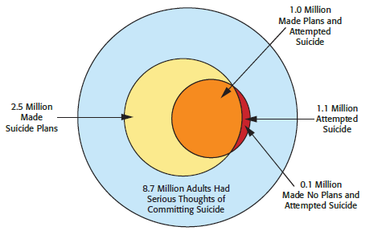
Pictorial Representation of Suicide Prevalence
Notes:
Figure 9.1 According to data from the 2010 National Survey on Drug Use and Health (NSDUH), an estimated 8.7 million adults (3.8 percent of those age 18 and over) had serious thoughts of suicide during the year. However, the vast majority (88 percent) of those with serious suicidal thoughts did not attempt suicide.

Slide 5
Prevalence of Suicide: Public Health Epidemic
Suicide is third leading cause of death among college students
Increasing Trend
Actual suicide rate may be 25-30 percent higher than recorded
Some deaths deemed accidental may have actually been suicides
More than war and homicides combined
40,000 in US/year

Slide 6
Facts About Suicide
10th leading cause of death in the U.S.
Psychological autopsy
Systematically examining information after a person’s death in effort to understand and explain behavior

Slide 7
Why?
Undertreated and Underresearched?
Stigma is Strong around Suicide
Illegal
Immoral
Spiritual Sinner
Crazy
Avoided Topic/Intimidating

Slide 8
Suicide: Overlooked Issue
2014 World Health Organization focused on Suicide Prevention
2004 Suicide Prevention Act: catalyst for research and change in field
Henry Ford Health Services – saw 75% drop
Goal of 0 suicides
Training for all staff
2012 National Strategy for Suicide Prevention – US Surgeon General

Slide 9
Common Characteristics of Suicide
Notes:
Table 9.1 Common characteristics of suicide

Slide 10
Occupational Prevalence
Higher than average suicide rates
Physicians
Highest among psychiatrists; lowest among pediatricians
Researchers speculate risk factors include burnout, stress, drug availability, and guilt over medical errors
Lawyers
Law enforcement personnel
Dentists

Slide 11
Suicide and At Risk Populations
Suicide among children and adolescents
15.8 percent of high school students seriously consider attempting suicide; Rural areas
Higher rates for female students than male
Hispanic/Latino and American Indian/Alaska Native females have highest rate of attempted suicides
Gay/Lesbian and Transgender

Slide 12
Possible Reasons for Increase of Suicide in Children and Adolescents
Bullying
Victims of bullying are two to nine times more likely to consider suicide
Social Media increase bullying
Copycat suicides
Media reports
Websites rate suicide methods and pain levels

Slide 13
Trends in Antidepressant Use in Children
2004 U.S. Food and Drug Administration warning of increased suicide risk for children taking SSRIs
Black Box warning with all antidepr
Akathisia – side effect; jittery/agitation; impulsive suicide increases
Starting dose must be very small
Medical professionals should monitor suicidal ideation

Slide 14
Suicide Among College Students
Comprehensive study of suicidal ideation in students at over 70 colleges
More than 50 percent reported suicidal thoughts
18 percent seriously considered attempting suicide
Among these, 90-92 percent had a specific plan
Between 8 and 14 percent made attempt

Slide 15
Suicide Among Military Veterans
Increasing rate of suicides in the military
More die from suicide than active combat
Factors contributing to increased risk
Barriers to mental health care in the military
PTSD, TBI, Injury
Access to guns
Frequent separation from family
Loss of comrades; failure to live up to values
Loss of role; loss of prestige; Loss of importance

Slide 16
Elderly
Suicide risk is high
Divorce Trend increasing
Loss of Role/Significance
Loss of Family/Friends
Loss of Financial Means
Life dreams/achievements not met

Slide 17
Ethnic and Cultural Variables
Highest rate of completed suicides
American Indian/Alaska Native
White males
Lower rates
African American
Hispanic/Latino males (females at risk)
Asian American/Pacific Islander

Slide 18
Choice of Method
Firearms
More than 50 percent of completed suicides
Drug overdose
70 percent of suicide attempts
Hanging/suffocation
Increased in recent years for all age groups
Especially among ages 45-59
Older adolescents most frequently try hanging, jumping, and using firearms

Slide 19
Effects of Suicide on Friends and Family
Consistent themes among surviving friends
Guilt, and an attempt to understand the tragedy
Development of risky behaviors
Altered relationships with friends
Surviving family members, especially parents, often feel guilt and responsibility
Increased rates of depression, anxiety, alcohol abuse, and marital difficulty

Slide 20
Suicide Effects on Children
Suicide of a parent can have lifelong effects
Child has increased risk of developing mental health problems
Increased risk of suicide, especially if deceased parent was the mother

Slide 21
Depression and Hopelessness
Psychological states most strongly associated with suicide
Even mild depression increases risk
Limited energy associated with severe depression makes suicide less likely
Psychache
Intolerable pain created from an absence of joy
Strongly associated with suicidal ideation

Slide 22
Alcohol Consumption
One of most consistent correlates
As many as 70% of suicide attempts involve alcohol
Strong correlation to successful attempt
May lower inhibitions related to fear of death
Alcohol-induced myopia
Focusing thoughts on the negative aspects of personal situations

Slide 23
Relational Perspective of Suicide:
Suicides are interpersonal in nature
Occur following relationship conflicts
Disconnection from friends, family, religious institution, or community
Increases susceptibility to suicide
Factors in children who consider suicide
Loss of parent figure before age 12
Abuse/ traumatic events

Slide 24
Sociocultural Perspective of Suicide
Marginalization
Acculturative Process
Inability to integrate oneself into society
Lack of close ties deprives one of support systems necessary for adaptive functioning
Isolation/Relational Detachment
Modern technological society
Alienation of lesbian, gay, bisexual and transgender youth; Discrimination

Slide 25
Marital Status
Stable marriage or relationship makes suicide less likely
For women, having children decreases suicide risk
Divorced, separated, or widowed have higher suicide rates
Death of a spouse associated with 50 percent higher suicide rate for men

Slide 26
Gender
Females have higher rates of suicidal thoughts and attempts
Death from suicide occurs much more frequently among males
79 percent of all U.S. suicides male
Males choose lethal methods
Drug overdose/poisoning most common means for women

Slide 27
Protective Factors
Meaning to life
Sense responsibility –family, pets, friends
Sobriety – see self as survivor
Persevering through adversity
Connection to others; learning their value to others/ worth to others
Fear of religious condemnation
Future goals

Slide 28
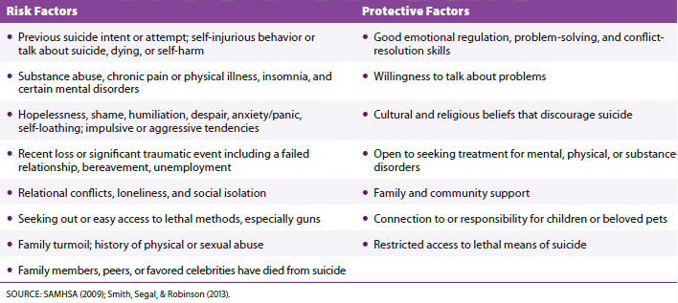
Risk and Protective Factors in Suicide Assessment and Intervention
Notes:
Table 9.2 Risk and protective factors in suicide assessment and intervention

Slide 29
Working with a Potentially Suicidal Individual
Have empathy for the need for break from emotional pain
Ask – get people talking
BE Direct – not “harm self” but “kill self”
Does not increase suicide risk
Does not plant ideas/suggestions
Talking about it does not prevent attempt
Evaluation:
Assess the degree of risk (low or high)
Ideation (low) ->Planning-> Intent (high)

Slide 30
Warning Signs
Specificity of Plan
Greater Detail = Greater Intent
Tend to not switch to another plan
Exp: NOT SWITCH FROM PILLS TO GUNS
Availability of means
Lethality: hanging and guns most lethal
Past Suicide attempt; how recent
Impulsivity: drugs; mania; ADHD; borderline; lack of sleep

Slide 31
Warning Signs
Prolonged Insomnia - Significant
Anxiety/Panic/Agitation – Significant
Psych-Ache - Significant
Recent Hospital discharge;1st week high risk
Physical Pain: Unresolved
Terminal Illness
Unresolved Trauma; Lack of support for disclosure of abuse
Demographic risks do not help with assessment – be individual focused

Slide 32
The Suicide State is Temporary
How intense is the suicide thoughts this week? Waxes and wains
Helping them through the difficult periods
Possibility for impact and change
Goal– to develop a plan to stop the pain, less about dying; identify the pain
Suicide is a Isolatory Act

Slide 33
Suicidal Crises
Danger + Opportunity
State of Mind: Physiological Changes
Crises creates need for change
IQ drops 30 points: poor judgement; cant see all options
Amygdala is primed –reactive/impulsive
Lessening perceived connection/trust

Slide 34
Suicide Crisis Intervention
Help them articulate what keeps them alive; reasons to live
“No-suicide” Safety Plan
List of people to contact
Actions to take when suicidal
Only helpful if include tools to stay alive
Use of Over-practice and Distraction
Temporary hospitalization; containing not resolving

Slide 35
Suicide Hotlines and Telephone Crisis Intervention
Crisis requiring immediate help any time, day or night
Hotlines typically operate 24/7
Numbers publicized throughout the community
Staffers are trained in crisis intervention techniques
1-800-273-TALK (8255) Suicide Prevention Lifeline

Slide 36
Psychotherapy for Suicidal Individuals
Treatment includes medication and psychotherapy
CBT and DBT proven to reduce suicide risk by 50 percent compared to other forms of therapy
CBT focuses on providing options to ease pain
DBT focuses acceptance of current life and emotional pain

Slide 37
Assessing Suicide Risk
Therapy Role Play
Patient Vignette
Jen is a 38-year old woman who sees you for depression and trauma. She lives alone and recently lost her job because of absences from work. She has been drinking more alcohol. She is taking Prozac, but “its not working”. She appears tearful today and is not sleeping. She reports her 19-year-old son just messaged he is not coming home for the holidays.
Therapist Goal: Identify ideation; plan; risk
Ultimately develop a safety plan (website)

Slide 38
Contemporary Trends and Future Directions
Considering suicide as a psychiatric disorder in its own right
“Suicide behavior disorder” being studied
DSM-5 encourages therapists to ask about suicidal thoughts
Durkheim Project
Linguistic-based prediction models to analyzing postings on social media to estimate individual’s suicide risk

Slide 39
Review
What do we know about suicide?
How is suicide unique in different age groups?
How does suicide affect friends and family?
What might cause someone to commit suicide?
How can we prevent suicide?
What are future directions in the field of suicidology?

