Slide 1
Eating Disorders
Diagnosis and Treatment

Slide 2
Eating Disorders
Types of eating disorders
Anorexia nervosa
Restricting
Binge-eating/purging
Bulimia nervosa
Binge-eating disorder
Muscle dysphoria
Extreme dissatisfaction with one’s muscularity

Slide 3
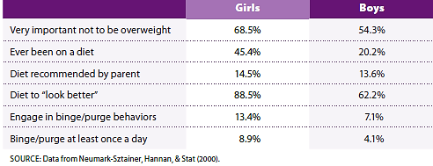
Prevalence of Weight Concerns of Youth
Notes:
Table 10.1 Prevalence of weight concerns of youth in grades 5-12

Slide 4
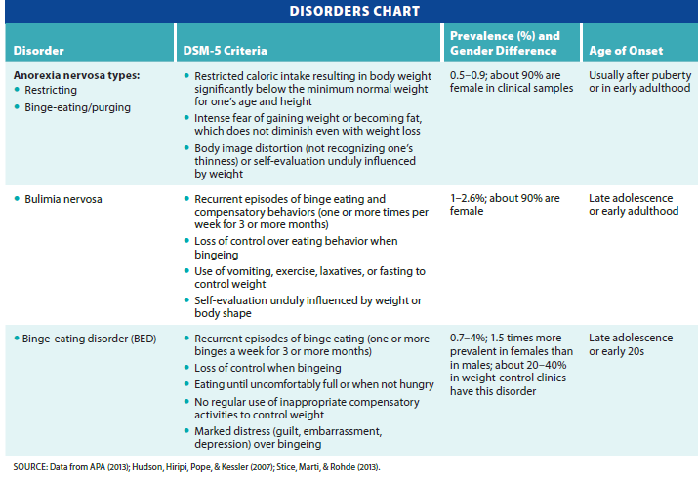
Summary of Eating Disorders
Notes:
Table 10.2 Eating disorders

Slide 5
Eating Disorders
Comorbid: depression, substance abuse, and suicidal ideation
Influencing factors
Societal emphasis on thinness
Unrealistic images in magazines
Obesity in the U.S.
68 percent of adults were overweight as of 2012

Slide 6
Anorexia Nervosa
Characterized by 15% below normal weight
Onset 12 years-old
Individuals starve themselves, detesting any weight gain
Most people insist they are overweight
Even when clearly emaciated
“Body Dysmorphia”

Slide 7
Anorexia Nervosa Subtypes
Restricting
Weight loss through severe dieting or exercising
Individuals with this type tend to be more introverted
Binge-eating/purging
Self-induced vomiting, laxatives or diuretics
Individuals are more extroverted and impulsive
Report more anxiety, depression, or guilt

Slide 8
Physical Complications of Anorexia Nervosa
Irregular heart rate
Low blood pressure
Heart damage when use muscle as an energy source – Heart attack prone
Kidney disease
Bone loss
Teeth – gum disease, enamel loss
Hair growth on limbs, scarring

Slide 9
Course and Outcome
Course is highly variable
Some recover after one episode
Others fluctuate between weight gain and relapse
Others have chronic and deteriorating course
Factors linked to unfavorable outcomes
Purging, vomiting, and obsessive-compulsive eating behavior
High mortality rate

Slide 10
Characteristics Associated with Anorexia Nervosa
Depression
Anxiety
Impulse control problems
Loss of sexual interest
Substance abuse (laxatives, stimulants)
Need for Control: addictive quality
Males with Anorexia:
https://www.youtube.com/watch?v=dTqv4tZRaFw

Slide 11
Bulimia Nervosa
Characteristics
Binge eating (rapid consumption of large quantities of food) at least once a week for three months
Loss of control over eating during the binge episode
Negative Self-esteem strongly influenced by weight or body shape

Slide 12
Bulimia Nervosa (cont’d.)
Those with bulimia are aware that their eating habits are not normal
Distressed and ashamed, individuals hide behavior from others
More prevalent than anorexia
Up to 2.6% of women have bulimia at some point in their lifetime
Another 10% report some symptoms but do not meet diagnostic criteria
Up to 10% of bulimics are male

Slide 13
Physical Complications of Bulimia Nervosa
Erosion of tooth enamel
Dehydration
Swollen salivary glands
Lowered potassium (can weaken heart and cause arrhythmia and cardiac arrest)
Inflammation of esophagus, stomach, and rectal area

Slide 14
Associated Characteristics
Eating can serve as coping response to stress
Close relationship between emotional states and disturbed eating
Maladaptive attempts at emotional regulation

Slide 15
Course and Outcome of Bulimia Nervosa
Onset - late adolescence or early adulthood
Mortality rates elevated, especially among those who exercise excessively
Prognosis more positive than anorexia
Follow up study analysis showed:
One third in complete remission
One third in partial remission
One third continued to meet criteria

Slide 16
Binge-Eating Disorder (BED)
Involves binging, feeling of loss of control, and marked distress over binge eating episodes
BED does not involve use of compensatory behaviors, such as vomiting, fasting, or excessive exercise
Diagnosis: history of binge-eating episodes at least once a week for three months
https://www.youtube.com/watch?v=NPgHu2Lup94

Slide 17
Binge-Eating Disorder (cont’d.)
Lifetime prevalence
3.5 percent of women; 2.0 percent of men
White women make up vast majority of those seeking treatment

Slide 18
Associated Characteristics Binge-Eating Disorder
Linked to Obesity and Overweight
20-40 percent of those in weight-control programs have BED
Gastric Bypass Surgery
Binges often preceded by poor mood, decreased alertness, feelings of poor eating control, and cravings for sweets
Complications
Type 2 diabetes, high blood pressure, and high cholesterol levels

Slide 19
Course and Outcome of Binge-Eating Disorder
Begins in late adolescence or early adulthood
Remission rates higher than anorexia or bulimia
Weight may remain high

Slide 20
Other Specified Feeding or Eating disorders
Disturbed eating patterns not meeting criteria for anorexia or bulimia nervosa
Night-eating syndrome
Individuals of normal weight who meet other criteria for anorexia
Individuals who meet criteria for bulimia but binge less than once a week
Individuals who do not binge but frequently purge to control weight

Slide 21
Etiology of Eating Disorders
Psychological risk factors
Body dissatisfaction
Perfectionism
Depression
Low levels of interpersonal competence
Use of control over eating to deal with stress

Slide 22
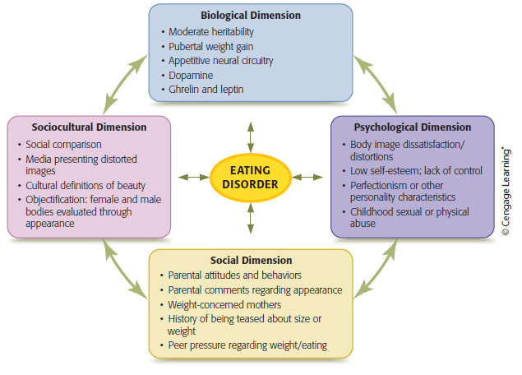
Biopsychosocial Model of Eating Disorders
Notes:
Figure 10.1 Multipath model of eating disorders
The dimensions interact with one another and combine in different ways to result in eating disorders.

Slide 23
Etiology of Eating Disorders: Social
Parental messages/ vigilance on child’s weight
emotional or sexual abuse during childhood
Social pressures to be thin (models, athletes, celebrities)
Peer pressures can increase risk of developing eating disorders
Friends extremely focused on dieting

Slide 24
Etiology of Eating Disorders: Sociocultural
Unrealistic standards of beauty in mass media
Women are socialized to be conscious of body shape and weight
Believe that primary value is to be attractive
Define themselves according to bodily standards in media
See themselves as objects rather than having capacity for independent action and decision making

Slide 25
Ethnic Minorities and Eating Disorders
Body dissatisfaction exists among women in ethnic minorities
Latina/Hispanic women have body dissatisfaction equal to white women
African-American women tend to be more satisfied with their body size
High ethnic identity and self-esteem serve as protective factors

Slide 26
Cross-Cultural Studies on Eating Disorders
Cultural values and norms affect views of body shape and size
Weight normalcy is influenced by cultural beliefs and practices
Example: Micronesians view thinness as a sign of illness
Eating disorders in Chinese populations have been rare
Exposure to Western beauty standards changed that in Hong Kong

Slide 27
Etiology of Eating Disorders: Biological
Disordered eating tends to run in families
Dopamine levels control appetite
People with lower levels desire food more
Other neurotransmitters and hormones involved
Serotonin
Ghrelin – signals hunger

Slide 28
Treatment of Anorexia Nervosa
Outpatient therapy: Cognitive-Behavioral Tx
#1 : Restore weight
Address Medical complications
Phobic reactions can occur from eating new foods previously thought “forbidden”
Psychological interventions
Help client understand dysfunctional beliefs
Improve interpersonal and social reinforcing
Family Therapy

Slide 29
Treatment of Bulimia Nervosa
Treatment goals
Dental Treatment, Cardiologist, Full Physical
Nutrition Consult and planning
Three or more balanced meals per day
Achieve healthy positive body and body image
Help clients develop sense of healthy self-control
Antidepressant medications such as SSRIs sometimes helpful

Slide 30
Treatment of Binge-Eating Disorder
Similar to treatments for bulimia
Obesity is sig medical complication
Include healthy approaches to self-care
Two phases
Identify Triggers to overeating
Learn self-soothing techniques/not food
Mindfulness eating
CBT can produce significant reductions in binge eating

Slide 31
Obesity
Defined as body mass index (BMI) greater than 30
Second only to tobacco use as preventable cause of disease and death
Childhood obesity has a significant health impact – Diabetes, Heart Disease, Strokes
DSM-5 does not recognize obesity as a psychological disorder

Slide 32
Review
What kinds of eating disorders exist?
What are some causes of eating disorders?
What are some treatment options for eating disorders?

