Slide 1
Addictions
Substance Use and Compulsive Disorders

Slide 2
Substance Abuse in the United States
Substance abuse
Excessive or harmful use of drugs and alcohol
Substance-use disorder
8.5 percent of pop
Alcohol - most common
Followed by marijuana, pain relievers, and cocaine

Slide 3
Substance-Related Disorders
What is addiction? (dysfx, excessive, harmful)
Serve psychological needs
Avoidance of pain
Numbing
Distraction
Addiction
Compulsive drug-seeking behavior
Loss of control
Withdrawal symptoms occur when discontinued

Slide 4
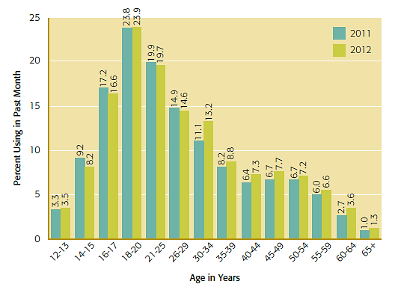
Two-Year Comparison of Past-Month Illicit Drug Use across Age Groups
Notes:
Figure 11.1 Two-Year Comparison of Past-Month Illicit Drug Use across Age Groups
In comparing 2011 and 2012, the rates of illicit drug use (cannabis, cocaine, heroin, hallucinogens, inhalants, and nonmedical use of prescription drugs) remained stable or decreased for those under age 30; however, rates of use increased slightly among older age groups, with the greatest increase occurring among 30- to 34-year-olds.
Source : Substance Abuse and Mental Health Services Administration (2013).

Slide 5
DSM-5 Substance-Use Disorders
Classified for each specific substance
Substance-use disorder severity
Mild if two or three of designated symptoms present
Moderate if four of five are present
Six or more symptoms indicates severe disorder

Slide 6
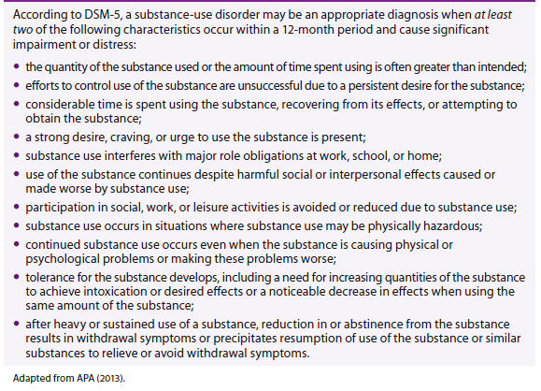
DSM-5 Criteria for a Substance-Use Disorder
Notes:
Table 11.1 DSM-5 Criteria for a Substance-Use Disorder

Slide 7
Substances Associated with Abuse
Prescription medications
Used to treat anxiety, insomnia or pain
Legal substances
Examples: alcohol, caffeine, tobacco, and household chemicals
Illegal substances
Examples: methamphetamine, cocaine, and heroin

Slide 8
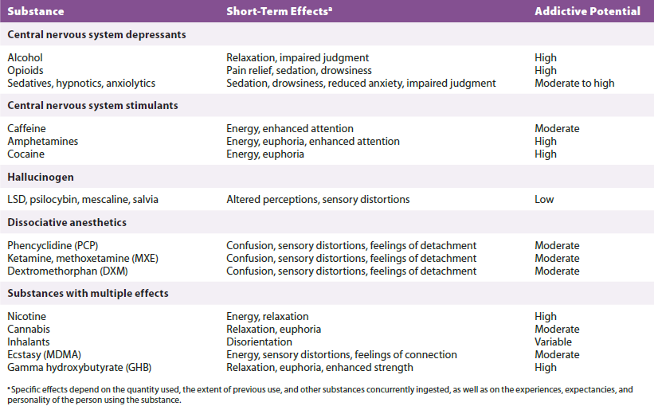
Commonly Abused Substances
Notes:
Table 11.2 Commonly Abused Substances

Slide 9
Depressants
Cause nervous system to slow down (motor responses, breathing)
Alcohol
Moderate drinking
Lower risk for addiction
No more than one drink for women or two drinks for men per day
Heavy drinking
Levels exceeding moderate
Binge drinking
Four to five drinks or more on a single occasion

Slide 10
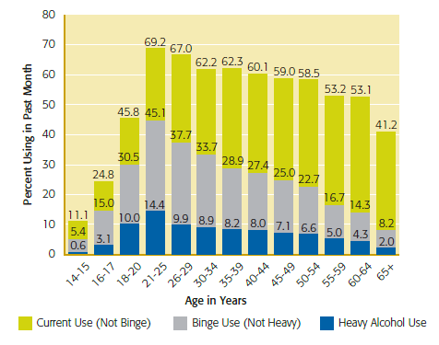
Comparisons of Alcohol Use Across Age Groups
Notes:
Figure 11.4 Comparisons of alcohol use across age groups
In 2012, almost half of those ages 18–20 reported underage alcohol use in the previous month, including 30.5 percent who reported binge drinking at least once and 10 percent who were heavy drinkers, binge drinking on at least five occasions. The highest level of binge drinking and heavy alcohol use is seen in the 21–25 age group.
Source : Substance Abuse and Mental Health Services Administration (2013a).

Slide 11
Effects of Alcohol Abuse
Alcohol poisoning
Can result in impaired breathing, coma, and death
Alcohol-use disorder
2x as likely to develop in men
Alcoholism progresses more quickly in women
Delirium tremens (confusion, shaking, fast heart beat, sweating, hallucinations)
Life-threatening condition produced by alcohol withdrawal symptoms

Slide 12
Course of Alcoholism
High functioning alcoholics
Able to function without obvious disruption to their life
Often deny the problem or hide their drinking
Common to alternate between periods of excessive drinking and sobriety

Slide 13
Opioids
Pain-killing agents that depress the central nervous system
Illegal substances
Heroin and opium
Prescription pain relievers
Morphine, codeine, oxycodone, fentanyl
Starts w/ injury, surgery, chronic pain
Highly addictive
Produce both euphoria and drowsiness

Slide 14
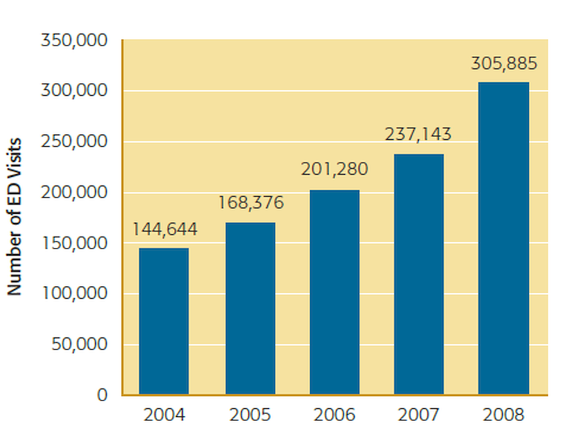
Emergency Department Visits Related to Illicit Use of Prescription Opioids
Notes:
Figure 11.6 Emergency department visits related to illicit use of prescription opioids
The number of emergency department visits due to illicit use of prescription pain medications increased 111 percent between 2004 and 2008, more than doubling in all age groups and for both males and females. Source : Substance Abuse and Mental Health Services Administration (2010a).

Slide 15
Sedatives, Hypnotics, and Anxiolytics
Have calming effects
Used to treat agitation, muscle tension, insomnia, and anxiety
Hypnotics: induce sleep (trazodone, ambien)
Anxiolytics: reduce anxiety (Xanax, Ativan)
Barbiturates and benzodiazepines
Rapid anxiolytic effects in moderate doses
Hypnotic effects in higher doses

Slide 16
Effects of Sedatives
Drowsiness, impaired judgment, and diminished motor skills
Excessive use can lead to accidental overdose and death
Combining alcohol with sedatives increases danger
High potential for tolerance and physiological dependence
Withdrawal symptoms

Slide 17
Caffeine
Stimulant found in coffee, chocolate, tea, and soft drinks
Most widely consumed psychoactive substance in the world
In North America, 90% of adults use daily
Withdrawal symptoms
Headache, fatigue, irritability, difficulty concentrating

Slide 18
Amphetamines
Also known as “uppers”
Speed up central nervous system activity
Taken to increase energy, performance, weight loss
Increasingly used illicitly
Can cause psychosis and brain damage
Methamphetamine
Can cause permanent damage to heart
Addiction develops rapidly

Slide 19
Cocaine
Crack
Potent form produced by heating cocaine
Typically smoked
Produces immediate but short-lived effects
Addiction is rapid
Cocaine withdrawal
Lethargy and depression
Users often have a shortened life span

Slide 20
Hallucinogens
Produces vivid sensory awareness
LSD, Peyote, Mushrooms
Effects can vary significantly
“Good trips” versus “bad trips”
Trigger psychosis
Hallucinogen Persisting Perception Disorder
Hallucinogens used by 1.1 million people in 2012

Slide 21
Dissociative Anesthetics
Produce dream-like detachment
Phencyclidine (PCP/Angel Dust) and ketamine (Special K)
Highly dangerous and addictive
Dissociative, stimulant, depressant, amnesic, and hallucinogenic properties
Club drugs
Dextromethorphan (DXM)
Ingredient in over-the-counter cold medicines

Slide 22
Nicotine
Highly addictive substance found in tobacco
Stimulant in low doses
Relaxant in higher doses
26.7 percent of the U.S. population uses tobacco
Euphoric effects decrease over the day
Tolerance increases
Top preventable cause of premature death

Slide 23
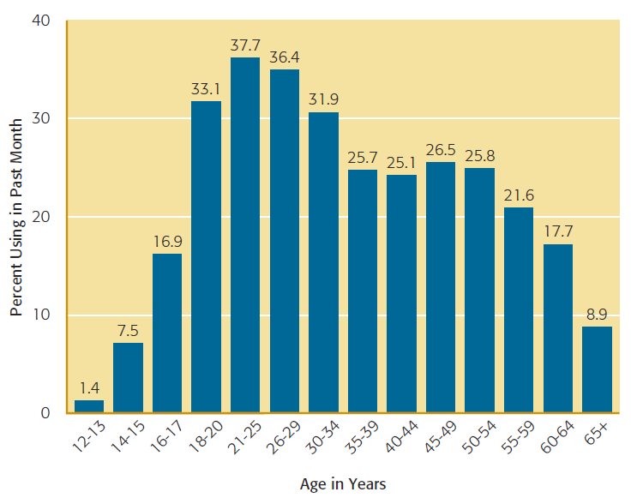
Past-Month Cigarette Use Among Adolescents and Adults Across Age Groups
Notes:
Figure 11.7 Past-month cigarette use among adolescents and adults across age groups
Cigarette smoking increases significantly during late adolescence and peaks between ages 21 and 29.

Slide 24
Cannabis
Botanical name for a plant that contains chemical THC (tetrahydrocannabinol)
Can produce stimulant, depressant, and hallucinogenic effects
Growing conditions affect THC content
Marijuana is derived from leaves and flower
Hashish comes from pressed resin

Slide 25
Marijuana
Most commonly used illicit drug worldwide
20 million adults and adolescents report current use
Males are more likely to use
Most frequently associated with diagnosis of substance abuse
Dependence produces a pervasive lack of concern over consequences
Withdrawal symptoms

Slide 26
Inhalants
Intoxication from chemical vapors found in common household products
Solvents, aerosol sprays, and compressed air products
Intoxicating effects are brief
Most common among 12 to 17 year olds
Use is declining
Hypoxia
“Sudden sniffing death”

Slide 27
Designer Drugs
Substances manufactured as recreational drugs
Ecstasy (MDMA)
Synthetic marijuana
MDPV marketed as “bath salts” or “plant food”
DOM, known as STP
Bromo-Dragonfly
MXE
Opioid substances

Slide 28
Ecstasy (MDMA)
Has both stimulant and hallucinogenic properties
Decreasing use among high school students
Effects
Euphoria, mild sensory and cognitive distortion, feelings of intimacy and well-being, followed by intense depression
Hyperthermia, involuntary jaw spasms or teeth clenching

Slide 29
Ecstasy (cont’d.)
Has properties that accelerate dependence
Even among infrequent users
Withdrawal symptoms
Depression, irritability, social withdrawal
Permanent Brain Damage in areas of critical thinking and memory

Slide 30
Club Drugs
Many of the designer drugs considered “club drugs”
Used at a party or club
Used to induce energy, excitement, and reduce inhibitions
Typically followed by a “crash”
Cocaine also used in the club drug culture
GHB
Particularly dangerous when combined with alcohol

Slide 31
Combining Multiple Substances
Synergistic effect
Interactions between the substances intensify effects
Can create unique side effects
Dangerous combinations
Tranquilizers and alcohol
Stimulants and sleeping pills
Multiple drug use involving ecstasy
Alcohol and energy drinks (caffeine)

Slide 32
Etiology of Substance-Use Disorders
Progression from substance use to abuse
Individual decides to experiment with drugs
Drug begins to serve important purpose; consumption continues
Brain chemistry becomes altered from chronic use
Results in physiological dependence, withdrawal symptoms, and cravings
Lifestyle changes occur due to chronic abuse

Slide 33
Typical Progression Toward Drug Abuse or Dependence
Notes:
Figure 11.9 Typical progression toward drug abuse or dependence
The progression from initial substance use to substance abuse typically begins with curiosity about a drug’s effects and casual experimentation.

Slide 34
Etiology of Substance-Use Disorders: Psychological
Coping with stress and emotional pain
Major motive for substance use
Stress plays a role in development of alcoholism and relapse
45% of abusers have a concurrent psychiatric disorder
Behavioral undercontrol
Personality characteristic associated with rebelliousness, impulsivity, and risk-taking

Slide 35
Etiology of Substance-Use Disorders: Social
Influence varies across lifespan
Childhood
Victimization and stressful events (neglect)
Adolescents (particularly vulnerable period)
Parental attitudes and behaviors
Lack of parental monitoring
Peer pressure and wish to fit in socially
Desire to assert independence and rebel
Desire to “have fun” or take risks

Slide 36
Etiology of Substance-Use Disorders: Social
College
Freshman year is a vulnerable transitional period
Abrupt changes in parental supervision
Increased competition and pressure to achieve
Easy access to alcohol
Exposure to peers that drink heavily
Students frequently overestimate the extent of alcohol and marijuana use by peers

Slide 37
Etiology of Substance-Use Disorders: Biological
Genetic factors account for 56 percent of alcohol dependence risk
55 percent for nicotine dependence
75 percent for illicit drug abuse
Cannabis dependence has the strongest genetic risk
Genes can influence individual responses to specific drugs
Genes can decrease substance abuse risk

Slide 38
Treatment for Substance-Use Disorders
22 million people had a substance-use disorder in 2012
Only 4 million are receiving treatment
Cost is a significant barrier for some
Treatment and supportive intervention settings
Self-help groups, and inpatient and outpatient treatment centers

Slide 39
Treatment for Substance-Use Disorders
Integrated care enhances treatment outcome
Two phases
Detoxification – Medically managed
Preventing relapse – Psychological Intervention

Slide 40
Treatment for Alcohol-Use Disorder
Alcoholics Anonymous (AA)
Regards alcoholism as a disease and advocates total abstinence
Positive long-term outcomes
Controlled drinking
Medications
Modest effects
More research on treatments needed

Slide 41
Treatment for Opioid-Use Disorder
Early detoxification and treatment critical
Becomes more difficult with prolonged use
Synthetic opioids: Methadone
Can reduce cravings without producing euphoria
Improved outcomes
Behaviorally-oriented counseling
Contingency management with incentives for abstinence

Slide 42
Treatment for Stimulant-Use Disorder
No effective pharmacological interventions
Set up Incentives for clean reports
Improves rates of continuous abstinence
Researchers testing a vaccine to help individuals dependent on cocaine
Antibodies prevent cocaine from reaching the brain
Clinical trials are underway

Slide 43
Treatment for Cannabis-Use Disorder
Search for medications
Research is focusing brain systems uniquely affected by THC
Psychological approaches show promise
Cognitive and behavioral therapy
Motivational enhancement
Short, frequent therapy sessions
Rewards for verified abstinence
Not easily treated in outpatient settings

Slide 44
Treatment for Tobacco-Use Disorder
Relapse remains high despite cessation
Need for long-term treatment strategies
Pharmaceutical treatments
Nicotine replacement therapy (NRT)
Bupropion (Buspar)
Both have limited long-term effectiveness
Varenicline, Wellbutrin
Medications showing promise

Slide 45
Gambling Disorder
Compulsive desire to engage in gambling activities
Relatively uncommon
Lifetime prevalence less than one percent
Pattern of cravings and withdrawals
Treatment approaches
Group therapy, CBT, and improving financial management skills

Slide 46
Internet Gaming Disorder
Condition involving excessive and prolonged engagement in computerized or Internet games
Criteria are similar to gambling disorder
Most common among adolescent males

Slide 47
Opiate Addiction
Documentary: Fentanyl – the drug deadlier than heroin
https://www.youtube.com/watch?v=28rJqj-7pEY&t=1456s
Article: How the medical field is complicit with predatory pharmaceutical companies:
https://www.nytimes.com/interactive/2018/05/02/magazine/money-issue-insys-opioids-kickbacks.html?hp&action=click&pgtype=Homepage&clickSource=story-heading&module=photo-spot-region&region=top-news&WT.nav=top-news

Slide 48
Contemporary Trends and Future Directions
Areas of research focus
Individual and environmental circumstances that increase risk
Ways to counteract media and social media messages of the acceptability of substance abuse
Help parents more accurately estimate their children’s alcohol use and enhance communication

Slide 49
Review
What are substance-use disorders?
What substances are associated with addiction?
Why do people develop substance-use disorders?
What kinds of interventions and treatments for substance-use disorders are most effective?
Can gambling be addictive?

