Slide 1
Psychotic Disorders
Schizophrenia Spectrum Disorders

Slide 2
Introduction
Disorders on the schizophrenia spectrum
Involve psychosis,
impaired cognitive processes,
unusual or disorganized motor behavior,
social withdrawal

Slide 3
Symptoms of Schizophrenia Spectrum Disorders
Symptoms fall into four categories
Positive symptoms
Negative symptoms
Psychomotor abnormalities – catatonia, repetitive behaviors, agitation
Cognitive symptoms

Slide 4
Positive Symptoms of Schizophrenia
Delusions
Hallucinations
Disordered thinking
Incoherent communication
Bizarre behavior
Symptoms range in severity, and may persist or fluctuate
Poor insight
Failure to recognize symptoms as abnormal

Slide 5
Delusions
False personal beliefs
Consistently held despite evidence or logic
Lack of insight common
Delusional themes
Grandeur, control, thought broadcasting, thought withdrawal, persecution, and reference
Paranoid ideation
Often connected with persecutory delusions

Slide 6
Delusions
Capgras delusion
Rare delusion
Belief in the existence of “doubles” who replace significant others
Acute Stressor: Developing suddenly after an emotionally distressing event
Sudden Loss, Physical Trauma

Slide 7
Hallucinations
Perception of a nonexistent or absent stimulus
Auditory (hearing)
Most common type of hallucination
Visual (seeing)
Olfactory (smelling)
Tactile (feelings)
Gustatory (tasting)

Slide 8
Cognitive Symptoms
Disorganized thinking, communication, and speech
Common characteristics of schizophrenia
Ilogical, non-meaningful, disconnected
Loosening of associations (cognitive slippage)
Continual shifting from topic to topic without apparent logical or meaningful connection between thoughts

Slide 9
Grossly Disorganized or Abnormal Psychomotor Behavior
Catatonia
Extremes in activity level
Excited catatonia
Withdrawn catatonia
Peculiar body movements or postures
Loud, inappropriate laughter; Incongruent Affect

Slide 10
Negative Symptoms
Decreased ability to initiate actions or speech, express emotions, or feel pleasure
Avolition: inability to take action or become goal-oriented
Alogia: lack of meaningful speech
Asociality: minimal interest in social relationships
Anhedonia: reduced ability to experience pleasure
Misdx: Depression

Slide 11
Negative Symptoms (cont’d.)
Diminished emotional expression
Facial expression
Voice intonation
Gestures
Approximately 15-25 percent of individuals with schizophrenia display primarily negative symptoms

Slide 12
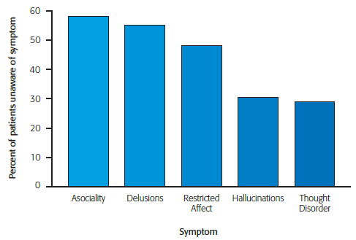
Lack of Awareness of Psychotic Symptoms in Patients
Notes:
Figure 12.1 Lack of awareness of psychotic symptoms in individuals with schizophrenia. Most individuals with schizophrenia are unaware or only somewhat aware that they have signs or symptoms of mental illness. The symptoms they are most unaware of include asociality, delusions and restricted affect.
Source : Amador, X. (2006) Percentage of patients with schizophrenia who were unaware of these signs and symptoms of their illness. http://mentalillnesspolicy.org/medical/lack-of-insight-schizophrenia.pdf. Used by permission of Dr. Xavier Amador.

Slide 13
Understanding Schizophrenia
Diagnosis involves presence of at least two of the following symptoms:
Delusions
Hallucination
Disorganized speech
Gross motor disturbance
Negative symptoms
Deterioration from a previous level of functioning

Slide 14
Costs and Prevalence of Schizophrenia
Financial costs of hospitalization, treatment, and loss of productivity
Estimated $62.7 billion annually
Lifetime prevalence of schizophrenia in the United States
1.1 percent
Many show impairment in premorbid functioning
Abnormalities prior to major symptom onset

Slide 15
Phases of Schizophrenia
Prodromal phase
Onset and buildup of symptoms
Social withdrawal and isolation
Inappropriate affect
Poor communication patterns
Neglect of personal grooming
Active phase
Full-blown symptoms
Residual phase
Positive Sx subside; Neg Sx may persist

Slide 16
Long-Term Outcome Studies
Improving Treatments - living optimally with disorder
Follow-up study results
10 year study
Majority improved over time; minority deteriorated
15 year study
40% showed periods of substantial recovery
Sizable minority were not on medication

Slide 17
Factors Linked with Recovery
Gender
Women have a better outcome
Higher education level
Being married
Having a higher premorbid level of functioning
Intervention early in course of the illness
Peer support and work opportunities also beneficial
Depressive Sx

Slide 18
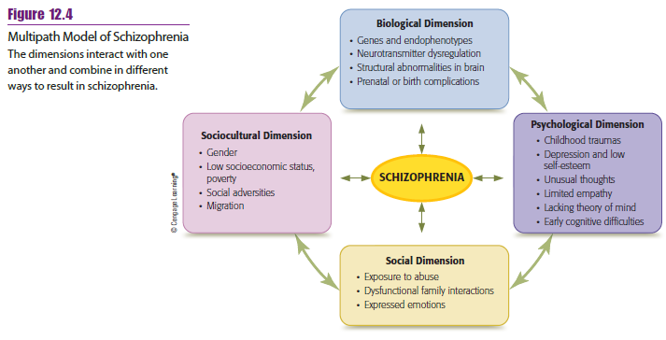
Model of Schizophrenia
Notes:
Figure 12.4 Multipath model of schizophrenia
The dimensions interact with one another and combine in different ways to result in schizophrenia.

Slide 19
Etiology of Schizophrenia: Biological
Genetics and heredity play a role
50% Identical Twins Concordance rate
Closer blood relatives have greater risk
16% chance for close relatives (e.g. mother and son)
4% chance for distant relatives (e.g. aunt and niece)
1% for general population

Slide 20
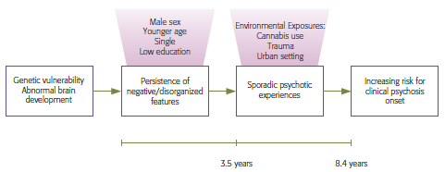
Interactive Variables and the Onset of Clinical Psychosis
Notes:
Figure 12.5 Interactive variables and the onset of clinical psychosis
This model shows how psychological and social factors may interact with genetic vulnerability to result in psychosis.
Source : Dominguez, M. D. G., Saka, M. C., Lieb, R., Wittchan, H.-U., & Van Os, J. (2010). Reprinted with permission from the American Journal of Psychiatry, copyright © 2010 American Psychiatric Association.

Slide 21
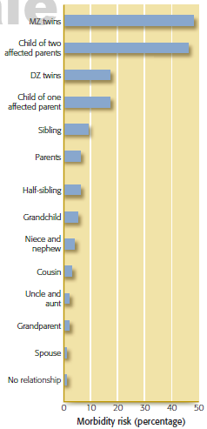
Genetic Risk of Schizophrenia
Notes:
Figure 12.6 Risk of schizophrenia among blood relatives of individuals diagnosed with schizophrenia
This figure reflects the estimate of the lifetime risk of developing schizophrenia—a risk that is strongly correlated with the degree of genetic influence.
Source : Data from Gottesman (1978, 1991).

Slide 22
Neurostructures
Decreased volume in the cortex and ventricle enlargements
Rapid loss of brain cells over six-year period
Ineffective communication between different brain regions
May lead to the cognitive, negative, and positive symptoms

Slide 23
Biochemical Influences
Dopamine hypothesis
Schizophrenia – caused by excess dopamine activity in certain brain areas
Supported from research with three drugs
Phenothiazines: block dopamine receptor sites
L-dopa: increases dopamine levels and sometimes produces schizophrenic-like symptoms
Amphetamines: increase dopamine availability; acute paranoid schizophrenia in non-schizophrenics

Slide 24
Link Between Cannabis Use and Psychosis
Cannabis use appears to increase the chance of developing a psychotic disorder
Higher the intake, greater the likelihood of psychotic symptoms
Several possible interpretations for link
Cannabis may influence dopamine levels
Individuals may use cannabis to self-medicate
Individuals predisposed to psychosis may also be predisposed to use cannabis

Slide 25
Correlates of Schizophrenia: Psychological
Deficits in empathy
Deficits in the theory of mind
Ability to recognize that others may have different emotions, beliefs, and desires
Early developmental delay
Low cognitive ability test scores in childhood and adolescence

Slide 26
Correlates of Schizophrenia: Social
Social factors contributing to risk
Maltreatment during childhood
Chronic bullying
Relationships within the home
Expressed emotion
Negative communication pattern among relatives of individuals with schizophrenia

Slide 27
Correlates of Schizophrenia: Sociocultural
Ethnic differences
Immigrant groups have highest rates of schizophrenia in Western Europe
Especially those of African descent
Other factors
Lower educational level of parents
Lower occupational status of fathers

Slide 28
Cultural Issues with Schizophrenia
Cultural Stigma - inapprop or abusive Tx
Highly stigmatized in Japan
Change in terminology in the year 2000 resulted in more patients being told of their disorder
Many psychiatrists in Turkey will not mention diagnosis to clients or family
Belief of supernatural causation in India

Slide 29
Explanatory Models of Illness in Schizophrenia Among Ethnic Groups
Notes:
Table 12.2 Explanatory Models of Illness in Schizophrenia among Four
Ethnic Groups

Slide 30
Treatment of Schizophrenia
Standard treatment today
Antipsychotic medication with some type of psychosocial therapy
Recent shift from focus on illness and deficit to recovery, promotion of health, independence and self-determination

Slide 31
Antipsychotic Medication
Treats the Positive Sx, not neg sx
Thorazine, Haldol
Introduced in 1955
First-generation antipsychotics
Still viewed as effective treatments
Reduce dopamine levels
Contemporary Tx: Risperdal, Zyprexa, Latuda, Abilify
Atypical antipsychotics
Act on both dopamine and serotonin

Slide 32
Medication Side Effects: Extrapyramidal Symptoms
Drop in Dopamine Levels
Parkinsonism
Muscle tremors, shakiness, immobility
Dystonia
Involuntary muscle contractions in limbs and tongue
Akathesia
Motor restlessness

Slide 33
Other Side Effects of Antipsychotic Medication
Neuroleptic malignant syndrome
Muscle rigidity
Tardive dyskinesia
Involuntary and rhythmic tongue movement
Chronic condition/ permanent damage
Metabolic syndrome- cluster of conditions (hypertension, diabetes, high cholesterol) increase heart attack/stroke/coma

Slide 34
Medication Effectiveness
Older and newer medications have same effectiveness
Newer medications much more costly
Newer medication less side effects
Between 50 and 75 percent of patients discontinue use of antipsychotics
Complaints of side effects

Slide 35
Psychosocial Therapy
Inpatient approaches
Milieu therapy (hospital as community and patients have responsibilities) and behavioral therapy can be beneficial
Psychosocial skills training: increasing appropriate self-care, conversational skills, and job skills
Undesirable behaviors are decreased through reinforcement and modeling techniques
Community homes can assist in transition from inpatient programs to community living; Independent Living Skill Building

Slide 36
Cognitive-Behavioral Therapy
Teach coping skills that allow clients to manage their positive and negative symptoms
18-month follow up results:
Those receiving CBT demonstrated more days of normal functioning compared to those treated with medication and contact with a psychiatric nurse

Slide 37
Negative Expectancy Appraisals Associated with Negative Symptoms
Notes:
Table 12.1 Negative expectancy appraisals associated with negative symptoms

Slide 38
Cognitive-Behavioral Therapy Steps
Engagement
Assessment
Identification of negative beliefs
Collaborative analysis of symptoms
Development of alternative explanations
Recent approach
Teach clients to accept hallucinations in a nonjudgmental manner

Slide 39
Interventions Focusing on Family Communication and Education
Normalize family experience
Demonstrate concern, empathy, sympathy
Educate family members about schizophrenia
Reduce criticism/blame
Identify strengths and competencies
Develop problem solving and stress management skills
Strengthen communication

Slide 40
Other Schizophrenia Spectrum Disorders
Delusional disorder
Brief psychotic disorder
Schizophreniform disorder
Schizoaffective disorder

Slide 41
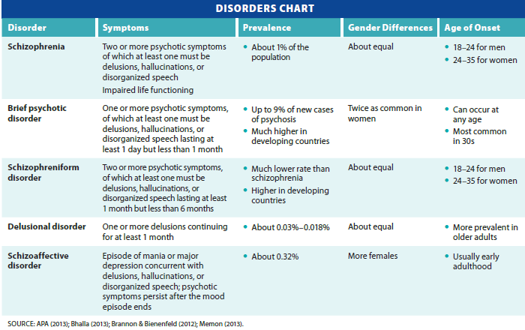
Schizophrenia Spectrum and Other Psychotic Disorders
Notes:
Table 12.3 Schizophrenia spectrum and other psychotic disorders

Slide 42
Comparison of Some Schizophrenia Spectrum Disorders
Notes:
Table 12.4 Comparison of brief psychotic disorder, schizophreniform disorder, and schizophrenia

Slide 43
Contemporary Trends and Future Directions
Early identification and treatment of high risk individuals
Prophylactic treatment to prevent onset
Antipsychotics
Therapy - improve stress management; family functioning

Slide 44
Life with Schizophrenia
Living with Hallucinations
https://www.cnn.com/videos/us/2014/06/09/ac-dnt-schizophrenia-simulator.cnn
Four Individuals with Sz
https://www.youtube.com/watch?v=bWaFqw8XnpA

Slide 45
Review
What are the symptoms of schizophrenia spectrum disorders?
Is there much chance of recovery from schizophrenia?
What causes schizophrenia?
What treatments are currently available for schizophrenia, and are they effective?
How do other psychotic disorders differ from schizophrenia?

