Slide 1
Personality
Characterological
Psychopathology

Slide 2
Introduction to Personality
Personality is a psychological characteristic
Influenced by biological factors
Temperament: differences in infancy
Different levels of reactivity to outside stimulation
Personality trait
Tendency to feel, perceive, behave and think in a relatively consistent manner

Slide 3
Personality Psychopathology
Healthy Personality: flexibility in responding to life situations
Shy people are not necessarily shy in all situations
Individuals with personality psychopathology
Rigid, inflexible patterns of responding
Patterns are long-standing and enduring
Present in nearly all situations

Slide 4
Prevalence of Personality Disorders
People with personality psychopathology often function well enough
Not aware they have a problem
Many individuals do not seek help or come to the attention of mental health professionals
Prevalence is difficult to determine
Estimated to be 9-13 percent of general population

Slide 5
DSM-5 Methods of Diagnosing and Classifying Personality Psychopathology
Categorical diagnostic model
Ten specific personality disorder types
Each a distinct clinical syndrome
Alternative model
Has components of both dimensional and categorical assessment

Slide 6
Personality Disorders
Specific disorders grouped into three behavior clusters
Odd or eccentric (cluster A)
Dramatic, emotional, or erratic (cluster B)
Anxious or fearful (cluster C)

Slide 7
Cluster A – Disorders Characterized by Odd or Eccentric Behaviors
Paranoid personality disorder
Pervasive distrust and suspiciousness of others
Motives interpreted as malevolent
Tend to be rigid in thinking
May seem aloof and lacking emotion
Use projection as a defense mechanism
“I am not hostile, they are”
Prevalence ranges from 2.3 to 4.4 percent

Slide 8
Schizoid Personality Disorder
Characteristics
Pervasive detachment from social relationships
Restricted range of emotions
Individuals have a long history of impairment in social functioning
Neither desire nor enjoy close relationships
May be associated with cold, emotionally impoverished childhood
See Patient Video

Slide 9
Schizotypal Personality Disorder
Characterized by odd, eccentric, or paranoid thoughts and behaviors and poor interpersonal relationships
Many with disorder believe they have magical abilities or special powers
Some are subject to recurrent illusions
Abnormalities in cognitive processing
Many characteristics resemble schizophrenia
Few individuals seek therapy
Notes:
See Patient Video

Slide 10
Cluster B – Disorders Characterized by Dramatic, or Erratic Behaviors
Antisocial personality disorder
Pervasive pattern of disregard for and violation of the rights of others
Must have occurred since age 15
Lack of remorse
Individuals seek power over others
Diagnosis applies to individuals age 18 or older
Prevalence: 0.6 to 4.5 percent
See Scene from “American Psycho”

Slide 11
Borderline Personality Disorder
Characterized by enduring pattern of volatile emotional reactions
Unstable interpersonal relationships
Poor-self image/ Hollow identity
Impulsive / Reactive
Intense mood fluctuations
May engage in behaviors with negative consequences
Poor coping skills

Slide 12
BPD (cont’d.)
Most commonly diagnosed personality disorder
Prevalence ranges from 1.6 to 5.9 percent
More common in women
Up to ten percent of those with BPD die by suicide
Many show remission of symptoms over a course of six or more years

Slide 13
BPD (cont’d.)
Three basic assumptions of individuals with BPD
The world is dangerous (be guarded)
I am powerless and vulnerable (I am a victim)
I am inherently unacceptable (self loath)
Early childhood trauma/abuse
CBT and DBT have shown to be effective
Accountability
Acceptance

Slide 14
Histrionic Personality Disorder
Characterized by pervasive pattern of excessive emotionality and attention-seeking
1
Intensely dramatic emotions and behaviors
Superficially charming and warm
Shallow and self-centered
Prevalence may be 0.4 to 1.8 percent
2
Diagnosed more often in females
3
In clinical settings

Slide 15
Narcissistic Personality Disorder
Individuals with this disorder have a sense of entitlement, exaggerated self-importance, and superiority
Grandiosity
Talk mainly about themselves
Lack of empathy
Little research on causes
Treatment recommendations frequently based on clinical experience

Slide 16
Cluster C – Disorders Characterized by Anxious or Fearful Behaviors
Avoidant personality disorder
Characterized by pervasive pattern of social inhibition, feelings of inadequacy, and hypersensitivity to negative evaluation
Individuals with disorder crave affection and an active social life
Prevalence ranges from 1.4 to 5.2 percent
May be a characterological version of social anxiety disorder

Slide 17
Dependent Personality Disorder
Pervasive, excessive need to be taken care of
Leads to submissive and clinging behavior
Individuals have fear of separation
High risk for becoming a victim of relationship violence
Associated with overprotective, authoritarian parenting
Relatively rare disorder

Slide 18
Obsessive-Compulsive Personality Disorder (OCPD)
Preoccupation with orderliness, perfectionism, and mental and interpersonal control
NOT Obsessive Compulsive Disorder
OCD involves unwanted, intrusive thoughts and urges
Individuals with OCPD see their way of functioning as correct
Genetic or early childhood environmental factors (overly perfectionistic demands)

Slide 19
Analysis of A Personality Disorder: Antisocial Personality
Individuals with APD often involved with criminal justice system
Results in relatively more information on this disorder
The Biopsychosocial model explains the factors leading to the development of APD

Slide 20
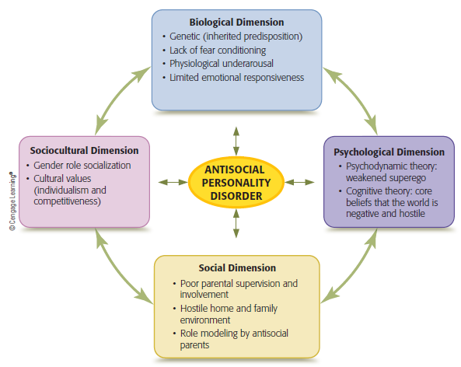
Model of Antisocial Personality Disorder
Notes:
Figure 15.1 Multipath model of antisocial personality disorder
The dimensions interact with one another and combine in different ways to result in antisocial personality disorder.

Slide 21
Biological Dimension of APD
Genetic influences
Genetic factors are Strong
Includes behavioral characteristics observed during childhood and adolescence
Risk taking, impulsivity
Supported by twin studies and adoptive child studies

Slide 22
Lack of Fear Conditioning and Emotional Responsiveness
Biological abnormalities make people with APD less susceptible to fear and anxiety
Less likely to learn from experiences involving punishment
Youth exhibiting antisocial behaviors showed diminished reactivity in the amygdala when shown pictures depicting fearful facial expressions

Slide 23
Arousal and Sensation Seeking
Another hypothesis: Stimulation Seeking
People with APD have lower levels of physiological reactivity
Generally underaroused
May require more stimulation to reach optimal level of arousal
Thrill seeking behavior without concern for conventional behavior standards

Slide 24
Psychological Dimension of APD
Psychoanalytic perspective
Faulty superego development
Learning perspective
Lack of positive role models
Type of punishment may influence learning
See next chart – responsive to monetary loss

Slide 25
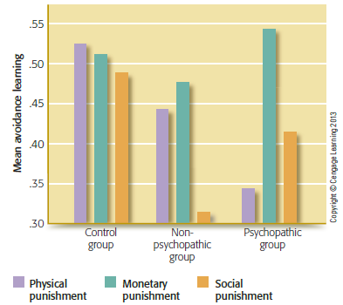
Effect of Punishment Type on Psychopaths and Others
Notes:
Figure 15.2 Effect of type of punishment on psychopaths and others
The effects of three different types of punishment on an avoidance learning task are shown for three groups of participants. Although physical or social punishment had little impact on psychopaths’ learning, monetary punishment was quite effective.

Slide 26
Social Dimension of APD
Family relationships
Poor parental supervision and involvement
Rejection or neglect
Parental separation or absence
Parents engaging in antisocial behavior
Especially if exhibiting hostility or abuse

Slide 27
Sociocultural Dimension of APD
Gender
Men more likely to exhibit characteristics of APD
Traditional gender-role training accepts or encourages aggression in boys but not girls
Cultural Values in the U.S.
Individualism and independence viewed as aspects of healthy function
Idea that people can and should control their own lives
Q: Does that lead to underdx of Antisocial pd?

Slide 28
Treatment of APD
NO MOTIVATION
Legal Requirement for Tx
Treatment must provide enough control to force confronting inability to form close relationships
Incarceration or psychiatric hospitalization may offer setting for treatment
Material rewards for behavior modification

Slide 29
Treatment (cont’d.)
Family and peer involvement necessary
Creates motivation to stay in Tx
Cognitive approaches
Away from thinking in terms of self-interest and immediate gratification
toward Relationship Fulfillment
Prevalence of APD diminishes with age
Recent study showed promising results with clozapine
An Antipsychotic Medication

Slide 30
Problems with Diagnosing Personality Disorders
Poor inter-rater reliability for personality disorder categories
Comorbidity is high, reducing diagnostic accuracy
Exclusive categorical approach has limitations
Arbitrary decisions about Sx
All-or-none method does not take into account continuous nature of personality traits (e.g., degrees of avoidance, callousness, etc.)

Slide 31
DSM-5 Alternative Personality Model
Dimensional model assesses personality traits on a continuum
Consider significant deviations from normal on five key personality dimensions
Extraversion
Agreeableness
Neuroticism
Conscientiousness
Openness to experience

Slide 32
Alternative Model (cont’d.)
Four personality disorders removed from the model
Paranoid
Schizoid
Histrionic
Dependent
New model allows these traits to be considered in noncategorical fashion

Slide 33
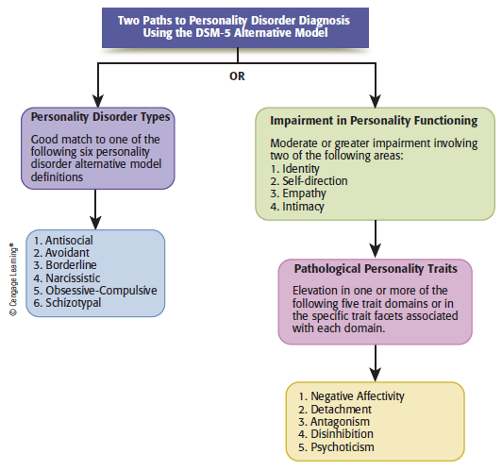
Paths to Personality Disorder Diagnosis Using the DSM-5 Alternative Model
Notes:
Figure 15.3 Two paths to personality disorder diagnosis using the DSM-5 alternative model

Slide 34
Example of Alternative Dx
Narcissistic Personality Disorder: Disturbance in domains of
Identity: exaggerated self-appraisal; reference others for self-esteem
Self-Direction: goals set to impress others
Empathy: Insensitivity to other’s needs
Intimacy: superficial
Meet following Traits:
Grandiosity; Attention Seeking; Exploitive

Slide 35
Traditional Categorical Dx
Narcissistic Personality Disorder;
Pervasive Pattern of Grandiosity (5 or more)
Exaggerates achievements
Fantasies of success
Believe is superiority/special
Requires excessive admiration
Sense of Entitlement
Exploitive
Lacks Empathy
Envy
Arrogant

Slide 36
Contemporary Trends and Future Directions
Recent research data: personality disorders appear to remit more often than previously believed
Leads to a less pessimistic outlook for individuals with personality psychopathology
Clinicians favor the traditional categorical model
Use of alternative model in clinical diagnosis unknown

Slide 37
Review
Can one’s personality be pathological?
What traits are associated with personality disorders?
How does an antisocial personality develop and can it be changed?
What problems occur with personality assessment?
Are there alternative methods of personality assessment?

