Slide 1
Pediatric Psychopathology
Disorders of Childhood and Adolescence

Slide 2
Introduction
Accurate assessment of mental disorders
Requires understanding normal child development and temperament
Symptoms criteria for children differs from adult adults
Clinician considers child age, developmental level, and environmental factors
Disorders are common among youth
Large percentage go untreated

Slide 3
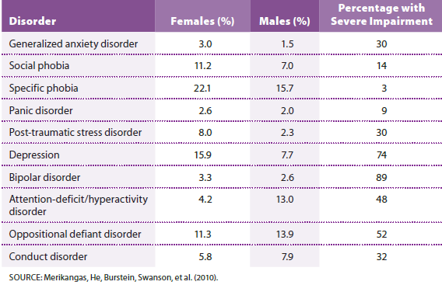
Lifetime Prevalence of Psychiatric Disorders in Youth Ages 13-18
Notes:
Table 16.1 Lifetime prevalence of psychiatric disorders in youth ages 13-18

Slide 4
Internalizing Disorders Among Youth
Internalizing disorders involve inward-directed emotional symptoms
Anxiety and depressive disorders most common internalizing disorders
Often lead to substance abuse and suicide
Abrupt behavior changes
Assess for possible abuse (physical, sexual, neglect)

Slide 5
Anxiety, Trauma, and Stressor-Related Disorders in Early Life
Most common mental health disorder in childhood and adolescence (32%)
Anxiety disorders
Fear and Avoidance undermines Academic, Interpersonal, Daily Fx
Can significantly impact academic and social functioning
Types of anxiety disorders (specific to children)
Separation anxiety disorder
Selective mutism

Slide 6
Attachment Disorders
Poor Quality of Attachment with Primary Caretakers
Cause: stressful early environments that lack predictable caretaking and nurturing
Types of attachment disorders
Reactive attachment disorder (RAD)
https://www.youtube.com/watch?v=ME2wmFunCjU
Disinhibited social engagement disorder (DSED)

Slide 7
Post-Traumatic Stress Disorder in Early Life
Prominent Sx: recurring, distressing memories of a shocking experience
Threat or witnessing death, serious injury, or sexual violation
Can be a Vicarious Threat
Symptoms:
Distressing dreams, intense reactions to cues, playacting, or dissociative reactions
Repetitive Play
Night terrors, Bed Wetting

Slide 8
Nonsuicidal Self-Injury (NSSI)
Involves intentionally inflicted superficial wounds
Pain induces a temporary sense of calm and well-being
Urge triggered by emotional pain
DSM-5: NSSI a category under study
For diagnosis: episodes happening more than 5 times per year

Slide 9
Mood Disorders in Early Life
Depressive disorders most prevalent among females and older adolescents
Situational Stressors primary cause during childhood
Biological factors exert more influence during adolescence
Evidence-based treatments
Individual & family-focused therapy, and focus on building resilience; CBT

Slide 10
Disruptive Mood Dysregulation Disorder
Characterized by chronic irritability and severe mood dysregulation
Results in episodes of temper triggered by common childhood stressors
Diagnosis not made in children 7 or older
Predicts depressive or anxiety disorders later in life

Slide 11
Pediatric Bipolar Disorder (PBD)
Rapid Cycling more common
Hypomanic/manic episodes may alternate with depressive/irritable episodes
Nighttime food binges; Aggression
Elevated neurological responsiveness to emotional stimuli and various brain abnormalities have been found
May be overdiagnosed/misdx
Confused with ADHD

Slide 12
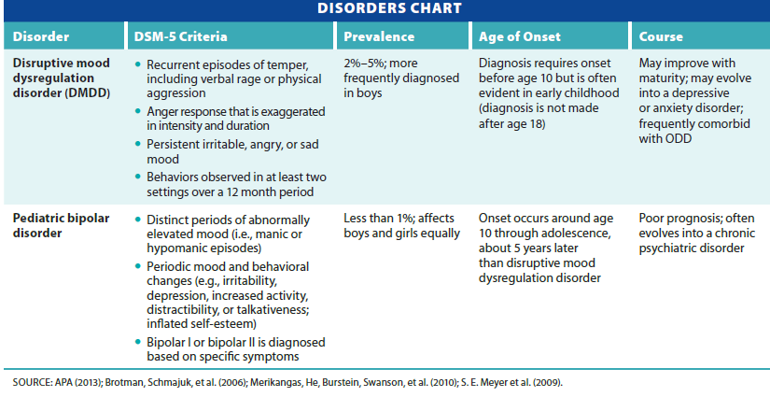
Disruptive Mood Dysregulation Disorder and Pediatric Bipolar Disorder
Notes:
Table 16.2 Disruptive mood dysregulation disorder and pediatric bipolar disorder

Slide 13
Externalizing Disorders
Disruptive, impulse control, and conduct disorders
negative parent-child interaction-both cause and effect
High family stress and negative feelings about parenting
Early intervention is key
Diagnosing these disorders is controversial
Difficult to distinguish from normal defiance/noncompliance

Slide 14
Oppositional Defiant Disorder (ODD)
Pattern of negativistic, argumentative, and hostile behavior
Loss of temper
Argue and defy adult requests
Primarily directed toward parents, teachers, and others in authority
No serious violation of societal norms
Symptoms often resolve
Especially with intervention

Slide 15
Intermittent Explosive Disorder
Prevalent, persistent, and seriously impairing disorder
Both underdiagnosed and undertreated
Involves recurrent outbursts of verbal or physical aggression
Symptom frequency
Twice weekly for at least three months, or three outbursts per year that result in injury or property damage

Slide 16
Conduct Disorder (CD)
Persistent pattern of antisocial behavior that violates rights of others
Requires presence of at least three different behaviors
Aggression, bullying, cruelty to people or animals, property destruction, theft or deceit, serious rules violations
Those with CD exhibit limited prosocial emotions
Significant concern to the public

Slide 17
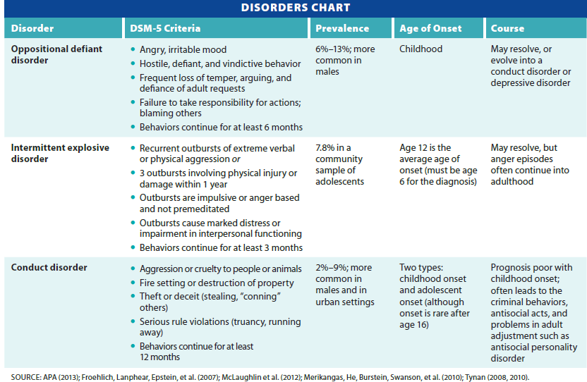
Oppositional Defiant, Intermittent Explosive, and Conduct Disorder
Notes:
Table 16.3 Oppositional defiant, intermittent explosive, and conduct disorder

Slide 18
Treatment of Externalizing Disorders
Family Therapy
Significant improvement seen – conflict management; communication
Parent-focused interventions effective
Healthy assertiveness and anger management techniques
Mobilizing adult mentors who demonstrate empathy, warmth, and acceptance

Slide 19
Elimination Disorders
Enuresis
Periodic voiding of urine during the day or night into clothes, bed, or floor
Usually involuntary
Most likely to occur during sleep
Diagnostic criteria
Must be at least five years old and void inappropriately at least twice a week for three months or more
Prevalence varies with age of the child

Slide 20
Encopresis
Defecation onto clothes, floor, or other inappropriate places
Diagnosis
Must be at least four years old and have defecated inappropriately at least once a month for three months or more
Typical pattern
History of constipation and withholding of painful bowel movements

Slide 21
Neurodevelopmental Disorders
Involve impaired development of the brain and central nervous system
Increasingly evident as child gets older
Types
Tic disorders
Attention-deficit hyperactivity disorder
Autism spectrum disorders
Intellectual and learning disorders

Slide 22
Tics and Tourette’s Disorder
Tics
Recurrent, sudden, involuntary, nonrhythmic motor movements or vocalizations
Examples of motor tics
Blinking, grimacing, jerking the head, tapping, flaring nostrils and contracting the shoulders
Examples of vocal tics
Coughing, grunting, throat-clearing, sniffling, or sudden, repetitive, and stereotyped outburst of words

Slide 23
Tics
Short-term suppression of a tic is possible
Often results in subsequent increases in the tic
Tension may build prior to tic, followed by a sense of relief after tic occurs
Symptoms often peak prior to puberty
Symptoms often temporary and may disappear without treatment
Due to neuroplastic brain reorganization

Slide 24
Tourette’s disorder (TD)
Characterized by multiple motor tics and one or more vocal tic
Present for at least one year
Coprolalia
Involuntary uttering of obscenities or inappropriate remarks
Present in ten percent of those with TD
Comorbid conditions often more disruptive than the tics themselves

Slide 25
Attention-Deficit Hyperactivity Disorder
Characterized by inattention and/or hyperactivity and impulsivity
Diagnostic requirements
Symptoms begin before age 12 and persist for at least six months
Symptoms interfere with social, academic, or occupational activities
Display symptoms in at least two settings
Most frequently diagnosed disorder in preschool and school-age children

Slide 26
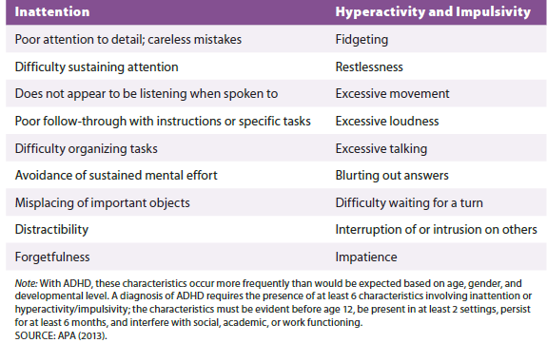
Characteristics of Attention-Deficit/Hyperactivity Disorder
Notes:
Table 16.5 Characteristics of attention-deficit/hyperactivity disorder

Slide 27
Attention-Deficit Hyperactivity Disorder: Etiology
Biological dimension
Highly heritable with up to 80% of symptoms explainable by genetic factors
Exact nature is unclear
Hypotheses about neurological mechanisms
Abnormalities in prefrontal cortex
Brain structure and circuitry irregularities in frontal cortex, cerebellum, and parietal lobes
Reduction in neurotransmitters

Slide 28
Psychological, Social, and Sociocultural Consequences of ADHD
Social adversity
Stressors in family
Cultural and regional expectations
Interpersonal conflict
Exercise and outdoor activity
Reduces risk of ADHD symptoms

Slide 29
Treatment of ADHD
Stimulants such as Ritalin have been used for decades
Normalize neurotransmitter functioning
30 percent do not respond or experience significant side effects
Still considered first-line treatment approach
Likelihood of medication use greatest for those with severe symptoms
Behavioral and psychosocial treatment shown effective

Slide 30
Autism Spectrum Disorders
Characterized by significant impairment in social fx
Stereotyped interests and behaviors
Symptoms range from mild to severe
Occurs 5x boys
Prevalence has increased over 120 percent between 2002 and 2010
Expanded awareness, possible unknown influences

Slide 31
Symptoms of Autism Spectrum Disorder
Deficits in social communication and social interaction
Deficit in social-emotional reciprocity
Deficit in Pragmatic Language
Difficulties developing and maintaining relationships

Slide 32
ASD Symptoms (cont’d.)
Repetitive behavior or restricted interests or activities involving at least two of following:
Repetitive speech, movement, or use of objects
Intense focus on rituals or routines and strong resistance to change
Intense fixations or restricted interests
Atypical sensory reactivity
Acquisition of Language

Slide 33
Other Facts About Autism Spectrum Disorders
Not diagnosed before the age of four
ASD highly linked with declining eye gaze beginning from a young age (2 months)
Encouraging sign towards early diagnosis
Intense, early intervention has reversed progression and eliminated the disorder in some children

Slide 34
Autism Spectrum Disorders: Etiology
Biological influences
Strong genetic influence
Twins and siblings
Degree of impairment varies
ASD linked with neurological findings
Unique patterns of metabolic brain activity
Reduced gaze towards eye regions of faces
High serotonin levels
Accelerated growth of amygdala

Slide 35
Recent Research Findings
Careful analysis of postmortem brains of children with ASD found patchy areas of disrupted neuronal development
Suggests brain abnormalities begin during pregnancy in the normal cell-layering process
Effect of genetic mutations occur during fetal development
Children with ASD metabolize environmental toxins differently

Slide 36
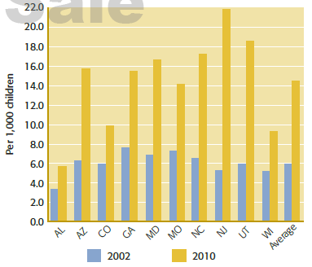
Geographic and Year-to-Year Comparison of Prevalence of ASD
Notes:
Figure 16.5 Changes in the prevalence of autism spectrum disorder among 8-year-old children in 10 U.S. States, 2002–2010

Slide 37
ASD Intervention and Treatment
Prognosis is guarded – Behavioral Treatment Primary
Most children retain diagnosis and require support throughout lifetime
Individuals with milder symptoms may be self-sufficient and successfully employed
Social awkwardness, restrictive interests, or atypical behaviors often persist
Significant recovery linked with intense early intervention

Slide 38
Intellectual Disability (ID)
Formerly referred to as mental retardation
Characterized by limitations in intellectual functioning and adaptive behaviors
Four distinct categories
Mild
Moderate
Severe
Profound

Slide 39
Etiology of Intellectual Disability
Etiology differs depending on level of intellectual impairment
Mild ID is often idiopathic (no known cause)
Pronounced ID related to genetic factors, brain abnormalities, or brain injury
Genetic factors
40 genes have been identified
80 percent reside on the X-chromosome
Fragile X syndrome results in mild to severe ID

Slide 40
Down Syndrome (DS)
Most have mild to moderate ID
With support, many adults with DS can have jobs and live semi-independently
Prenatal detection is possible
Environmental influences during pregnancy play a role

Slide 41
Psychological, Social, and Sociocultural Dimensions
Genetic background interacts environment- improve prog
Children with socioeconomically advantaged homes often experience enriching activities
Strong, positive influences
Enriching, encouraging home environment
Ongoing education intervention
Religious and cultural beliefs affect parent attitudes and coping strategies

Slide 42
Learning Disorders
Academic disability characterized by reading, math, or writing skills deficits
Primarily interferes with academic achievement and daily living activities requiring reading, writing, or math skills
Prevalence
Approximately five percent of students in public schools
Occurs twice as frequently in boys

Slide 43
Support for Individuals with Neurodevelopmental Disorders
Goal of intervention
Build skills and develop potential to the fullest extent possible
For those with moderate to severe ID or ASD
Support often begins in infancy and extends across the life span

Slide 44
Support in Adulthood
Programs focusing on specific job skills
Institutionalization is rare
Many adults live with family members
“Least restrictive environment” possible
As much independence and personal choice as is safe and practical
Many assisted living environments promote social interaction with the larger community

Slide 45
Contemporary Trends and Future Directions
The root of many adult mental disorders lies in a stressful childhood
Prevention programs to improve family functioning is a high priority
Evidence-based interventions that promote resilience in children who have experienced maltreatment
Research to address long-term risks and assess intervention efficacy

Slide 46
Review
What internalizing disorders occur in childhood and adolescence?
What are the characteristics of externalizing disorders?
What are elimination disorders?
What are neurodevelopmental disorders?

